Slide 1
Output Sensitive Enumeration
7. Frequent Pattern Mining
Data-Driven Fast Implementation
Frequent Itemset Mining
Fast Implementations
Sequence Mining
Graph mining
Tree Mining in Tree

Slide 2
Enumeration is Already Efficient
• Enumeration algorithms we have seen are output polynomial time, linear in output size in particular
• On the other hand, enumeration algorithms output exponentially many solutions, so we might think that the problem sizes are usually small (up to 100)
• …so, “input size is constant” would be valid
and thus enumeration algorithms are optimal.
(“less than 100” is constant)
← this would be true in “theoretical sense”
• …however, there exist other kinds of applications

Slide 3
Big Data Applications
• In practice, enumeration is widely used in data mining / data engineering area
← frequent pattern mining, candidate enumeration,
community mining, feasible solution enumeration…
• In such areas, input data is often big data
• Indeed, #solutions is small, often O(n) to O(n²)
thus, actually “tractable large-scale problems”

Slide 4
Why #Solutions is Small?
• …#solutions seem to easily increase to exponential, however…
+ if exponentially many solutions, many solutions are similar,
thus quite redundant
+ We don’t want to have such many solutions!
← they are intractable (too long time for post process)
+ Even though #solutions is huge,
the modeling was bad, from the beginning
Ex) #Maximal cliques in the large sparse graphs are not huge, but #independent sets (no vertex pair is connected) are extremely huge

Slide 5
Constant Time Enumeration
• …so, enumeration should take short time per solution
← in particular, constant time for each
• However, handling big data in constant in an iteration is hard
→ we need techniques to compute without looking the whole data
+ data structure for dynamic computation, data compression to unify the operation, ancestor-processing for reducing descendants…
• Further, engineering techniques help the improvements
+ memory saving
+ make the computation fitting to the architecture
See the techniques in itemset mining and clique enumeration

Slide 6
7-1. Frequent Itemset Mining
(LCM)

Slide 7
Frequent Pattern Mining
• Problem of enumerating all frequently appearing patterns in big data
(pattern = itemsets, item sequence, short string, subgraphs,…)
• Nowadays, one of the fundamental problems in data mining
• Many applications, many algorithms, many researches
High Speed Algorithms are important
mining
database
patterns
• 実験1● ,実験3 ▲
• 実験2● ,実験4●
• 実験2●, 実験3 ▲, 実験4●
• 実験2▲ ,実験3 ▲
．
．
．
実験1 | 実験2 | 実験3 | 実験4
● | ▲ | ▲
 | ● |  | ▲
● | ● | ▲ | ●
● | ● | ▲ | ●
▲ | ● |  | ●
 | ● | ▲ | ●
● | ▲ | ▲
 | ▲ | ▲
ATGCGCCGTA
TAGCGGGTGG
TTCGCGTTAG
GGATATAAAT
GCGCCAAATA
ATAATGTATTA
TTGAAGGGCG
ACAGTCTCTCA
ATAAGCGGCT
• ATGCAT
• CCCGGGTAA
• GGCGTTA
• ATAAGGG
．
．
．
POS
genome

Slide 8
Applications of Pattern Mining
Market Data
automatic classification
•Books & coffee are frequently sold
together
•Male coming at Night tends to purchase
foods with bit higher prices…
•••
geneZ： ●○★
geneZ： ●○★
•••
gene A： ●△▲
geneB： ●△▲
geneD： ●△▲
•••
geneF1： ■□
geneF2： ■□
•••
Image Recognition
clustering topics in Web pages
•find features distinguishing orange vs
others
• by links, keywords, dates, and their
combinations
football
life
bike in
world
football
funs
bike fun
Fundamental, thus applicable to vatious areas

Slide 9
Transaction Database
• A database D such that each transaction (record) T is a subset of itemset E, i.e., ∀T ∈D, T ⊆ E
For itemset S,
occurrence of S: a transaction of D including S
occurrence set of S (Occ(S)): set of occurrences of S
frequency of S (frq(S)): cardinality of Occ(S)
1,2,5,6,7,9
2,3,4,5
1,2,7,8,9
1,7,9
2,7,9
2
D ＝
Occ({1,2})
＝ { {1,2,5,6,7,9},
{1,2,7,8,9} }
Occ({2,7,9})
＝ { {1,2,5,6,7,9},
{1,2,7,8,9},
{2,7,9} }

Slide 10
Frequent Itemset
frequent itemset: an itemset included in at least σ transactions of D
（a set whose frequency is at least σ）（σ is given, and called minimum support）
Ex) itemsets included in at least 3 transactions in D
1,2,5,6,7,9
2,3,4,5
1,2,7,8,9
1,7,9
2,7,9
2
included in at least 3
{1} {2} {7} {9}
{1,7} {1,9}
{2,7} {2,9} {7,9}
{1,7,9} {2,7,9}
D ＝
Frequent itemset mining is to enumerate all frequent itemsets of the given database and minimum support σ

Slide 11
Backtracking Algorithm
• Set of frequent itemsets is monotone
(any subset of a frequent itemset is also frequent)
➔ backtrack algorithm is applicable
+ #recursive calls = #frequent itemsets
+ a recursive call（iteration）takes time
(n- (tail of S))×(time for frequency counting)
Backtrack (S)
1. output S
2. for each e > tail of S (maximum item in S)
if S∪e is frequent then call Backtrack (S∪e)
O(||D||)
1,2,3,4
1,2,3
1,2,4
1,3,4
2,3,4
1,2
1,3
1,4
2,3
2,4
3,4
1
2
3
4
O(n||D||) per solution is too long
φ

Slide 12
Shorten “Time for One Solution”
• Time per solution is polynomial, but too long
• Each P∪e needs to compute its frequency
+ Simply, check each transaction includes S∪e or not
➔ worst case: linear time in the database size
average: max{ #transactions, frq(S)×|S| }
+ Constructing efficient index, such as binary tree,
is very difficult, for inclusion relation
1,2,5,6,7,9
2,3,4,5
1,2,7,8,9
1,7,9
2,7,9
2
Algorithm for fast computation is needed

Slide 13
(a) Breadth-first Search
“Apriori”
Agrawal et al. ‘94
Apriori
1. D₀={φ}, k := 1
2. while D_{k-1} ≠φ
3. for each S ∈ D_{k-1}
4. output S
5. for each e not in S
6. if S∪e is frequent then insert S∪e to D_{k}
1,2,3,4
• Before computing frequency of S∪e,
check whether S∪e -f is in D_{k}
or not for all f ∈S
• If some are not, S∪e is not frequent
1,2,3
1,2,4
1,3,4
2,3,4
1,2
1,3
1,4
2,3
2,4
3,4
1
2
3
4
We can prune some infrequent itemsets,
but takes much memory and time for search
φ

Slide 14
(b) Using Bit Operations
• Represent each transaction/itemset by a bit sequence
{1,3,7,8,9} ➔ [101000111]
{1,2,4,7,9} ➔ [110100101]
intersection [100000101]
➔ Intersection can be computed by AND operation
(64 bits can be computed at once!)
Also, memory efficient, if the database is dense
➔ On the other hand, very bad for sparse database
“MAFIA”
Burdick et al. ‘01
But, incompatible with the database reduction, explained later

Slide 15
(c) Down Project
Bayardo et al. ‘98
• Any occurrence of S∪e includes S (→ included in Occ(S))
➔ to find transactions including S∪e ,
we have to see only transactions in Occ(S)
• T∈ Occ(S) is included in Occ(S∪e)
if and only if T includes e
• By computing Occ(S∪e) from Occ(S),
we do not have to scan the whole database
➔ Computation time is reduced much

Slide 16
Example: Down Project
• See the update of Occ(S)
+ Occ(φ) = {A,B,C,D,E,F}
+ Occ( {2} ) = {A,B,C,D,E,F} ∩ {A,B,C,E,F}
= {A,B,C,E,F}
+ Occ( {2,7} ) = {A,B,C,E,F} ∩ {A,C,D,E}
= {A,C,E}
+ Occ( {2,7,9} ) = {A,C,E} ∩ {A,C,D,E}
= {A,C,E}
+ Occ( {2,7,9,4} ) = {A,C,E} ∩ {B}
= φ
Occ({2})
Occ({7})
Occ({9})
A: 1,2,5,6,7,9
B: 2,3,4,5
C: 1,2,7,8,9
D: 1,7,9
E: 2,7,9
F: 2
Occ({4})

Slide 17
Intersection Efficiently
• T∈ Occ(S) is included in Occ(S∪e) if and only if T includes e
➔ Occ(S∪e) is the intersection of Occ(S) and Occ({e})
• Taking the intersection of two itemsets can be done by scanning the itemsets simultaneously in the increasing order of items (itemsets have to be sorted)
{1, 3, 7,8,9}
∩{1,2, 4,7, 9}
＝ {1, 7, 9}
Linear time in #scanned items → sum of their sizes

Slide 18
7-2. Fast Implementation

Slide 19
Using Delivery
LCM: Uno et al. ‘03
• Taking intersection for all e at once, fast computation is available
1. Set empty bucket for each item
2. For each transaction T in Occ(S),
+ Insert T to the buckets of all item e included in T
➔ After the execution, the bucket of e
becomes Occ(S∪e)
1: A,C,D
2: A,B,C,E,F
3: B
4: B
5: A,B
6: A
7: A,C,D,E
8: C
9: A,C,D,E
Delivery (S)
1. bucket[e] := φ for all e
2. for each T∈Occ(S)
3. for each e∈T, e > tail(S)
insert T to bucket[e]
A: 1,2,5,6,7,9
B: 2,3,4,5
C: 1,2,7,8,9
D: 1,7,9
E: 2,7,9
F: 2

Slide 20
Time for Delivery
Delivery (S)
1. jump := φ, bucket[e] := φ for all e
2. for each T∈Occ(S)
3. for each e∈T, e > tail(S)
4. if bucket[e] = φ then insert e to jump
5. insert T to bucket[e]
6. end for
7. end for
A: 1,2,5,6,7,9
B: 2,3,4,5
C: 1,2,7,8,9
D: 1,7,9
E: 2,7,9
F: 2
• Comp. time is Σ_{T∈Occ(S)} |{e | e∈T, e > tail(S)}|
• Computation time is reduced by sorting the items in each transaction, in the initialization

Slide 21
Leftmost Sweep for Memory Reduction
• Delivery computes occurrences at once, thus needs O(||D||) space
→ accumulated recursively, thus O(n||D||) in total
• Generate recursive calls from smallest item;
After the termination of recursive call for i, the space
for items < i are unnecessary, thus re-used
(the recursive call for i uses space for only items < i )
A
B
C
E
F
A: 1,2,5,6,7,9
B: 2,3,4,5
C: 1,2,7,8,9
D: 1,7,9
E: 2,7,9
F: 2
O(||D||) memory in total
A
C
D
E
A
C
D
E
A
C
D
no need of
memory re-allocation
A
B
B
B
A
C
1 2 3 4 5 6 7 8 9

Slide 22
Delivery
Compute the denotations of S∪{i} for all i’s at once
A: 1,2,5,6,7,9
B: 2,3,4,5
C: 1,2,7,8,9
D: 1,7,9
E: 2,7,9
F: 2
A | 1 | 2 |  |  | 5 | 6 | 7 |  | 9
B |  | 2 | 3 | 4 | 5
C | 1 | 2 |  |  |  |  | 7 | 8 | 9
D | 1 |  |  |  |  |  | 7 |  | 9
E |  | 2 |  |  |  |  | 7 |  | 9
F |  | 2
A
A
A
A
D＝
C
C
C
D
S = {1,7}
Check the frequency for all
items to be added in linear
time of the database size
Generating the recursive calls in reverse
direction, we can re-use the memory

Slide 23
Intuitive Image of Iteration Cost
• Simple frequency computation scan
The whole data, for each S∪e
• Set intersection scans Occ(S)
and Occ({e}) once
➔ n-t times scans Occ(S), and
items larger than t of all transactions
• Delivery scans items larger than t
of transactions included in Occ(S)
(n-t)
Advantage is more
＋
(n-t)
t
t

Slide 24
Bottom-wideness
• In the deep levels of the recursion, frequency of S is small
➔ Time for delivery is also short
• Backtrack generates several recursive calls in each iteration
➔ Recursion tree spreads exponentially, as going down
➔ Computation time is dominated by the bottom-level exponentially many iterations
Long time,
but few
Short time, numerous
•••
Almost all iterations takes short time
➔ In total, average time per iteration is also short

Slide 25
Even for Large Support
LCM2: Uno et al. ‘04
• When σ is large, |Occ(S)| is large in bottom levels
➔ Bottom-wideness doesn’t work
• Speed up bottom levels by database reduction
(1) delete items smaller than added item most recently
(2) delete items infrequent in the database induced by Occ(S)
(they never be added to the solution, in the recursive calls)
(3) unify the identical transactions
• In real data, usually the size of reduced
database is constant, in bottom levels
１ |  | ３ | ４ | ５
１ | ２ |  | ４ |  | ６
 |  | ３ | ４ |  |  | ７
１ | ２ |  | ４ |  | ６ | ７
 |  | ３ | ４ | ５ | ６ | ７
 | ２ |  | ４ |  | ６ | ７
fast as much as small σ

Slide 26
Synergy with Cache
• Efficient implementation needs “hit/miss ratio” of cache
－ open the loops
－ change memory allocation
for i=1 to n { x[i]=0; }
➔ for i=1 to n step 3 { x[i]=0; x[i+1]=0; x[i+2]=0; }
● |  | ● |  |  |  | ●
● | ● | ●
● |  | ● |  |  |  | ●
●▲ |  | ● ▲ |  |  |  | ● ▲
▲ |  | ▲ |  |  |  | ▲
By database reduction, memory for deeper levels fits cache
➔ Bottom-wideness implies “cache hits almost all accesses”

Slide 27
Compression by Trie/Prefix Tree
Han et al. ‘00
• Regarding each transaction as a string, we can use trie / prefix tree to store the transactions, to save memory usage
➔ Orthogonal to delivery, shorten the time to scan
(disadvantage is overhead, for its representations)
*
1
2
5
6
7
9
A
A: 1,2,5,6,7,9
B: 2,3,4,5
C: 1,2,7,8,9
D: 1,7,9
E: 2,3,7,9
F: 2,7,9
7
8
9
C
7
9
D
2
3
4
5
B
7
9
E
7
9
F

Slide 28
7-3. Result of Competition

Slide 29
Competition: FIMI04
FIMI repository
http://fimi.ua.ac.be
• FIMI: Frequent Itemset Mining Implementations
+ A satellite workshop of ICDM (International Conference on Data Mining). Competition on implementations for frequnet/closed/maximal frequent itemsets enumeration
FIMI 04 is the second, and the last
• The first has 15, the second has 8 submissions
Rule and Regulation:
+ Read data file, and output all solutions to a file
+ Time/memory are evaluated by time/memuse command
+ direct CPU operations (such as pipeline control) are forbidden

Slide 30
Environment： FIMI04
• CPU, memory: Pentium4 3.2GHz、1GB RAM
OS, Language, compiler: Linux, C, gcc
• dataset:
+ real-world data: sparse, many items
+ machine learning repository: dense, few items, structured
+ synthetic data: sparse, many items, random
+ dense real-world data: very dense, few items
LCM ver.2 (Uno, Arimura, Kiyomi) won the Award

Slide 31
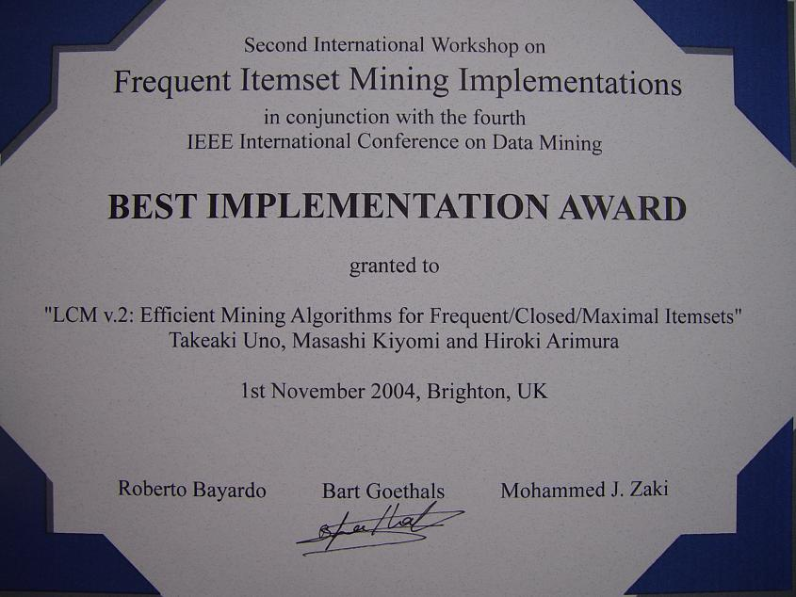
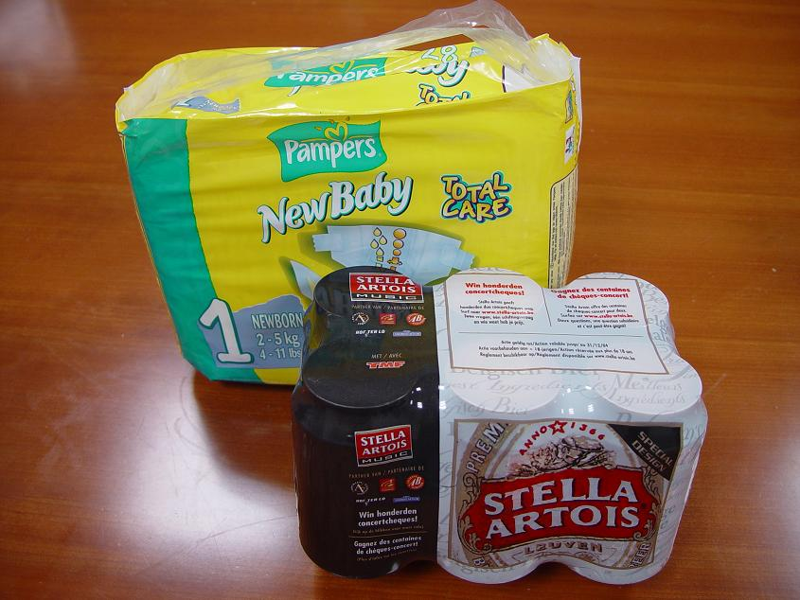
Award and Prize
Prize is {beer, nappy}
the “Most Frequent Itemset”

Slide 32
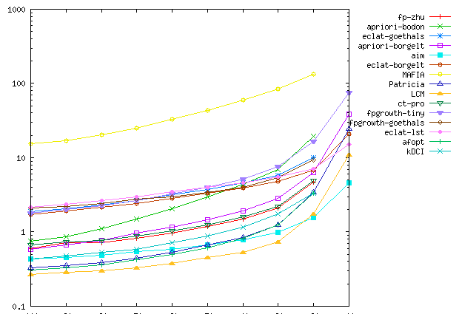
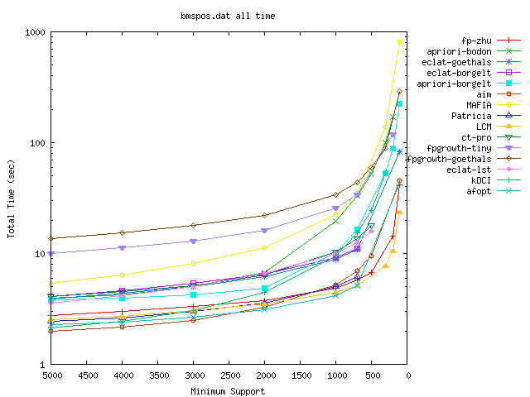
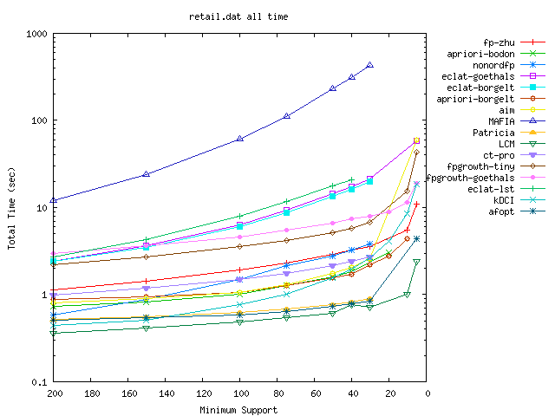
Real-world data
(sparse) average size 5-10
BMS-WebView2
BMS-POS
retail

Slide 33
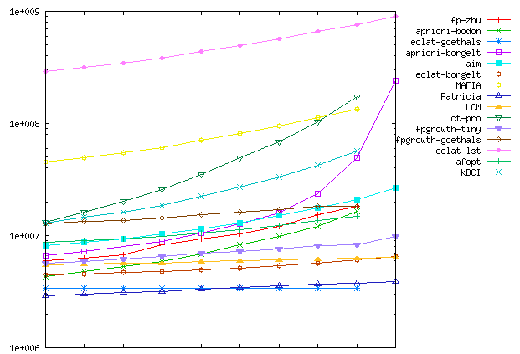
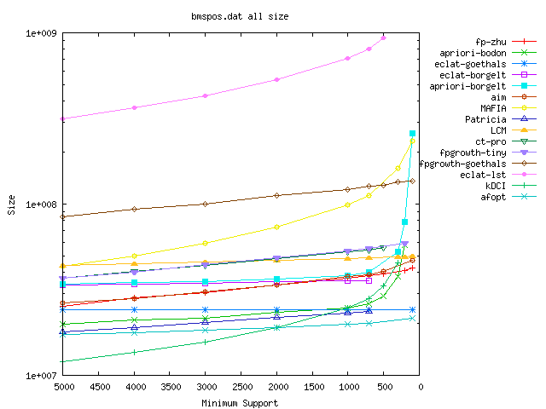
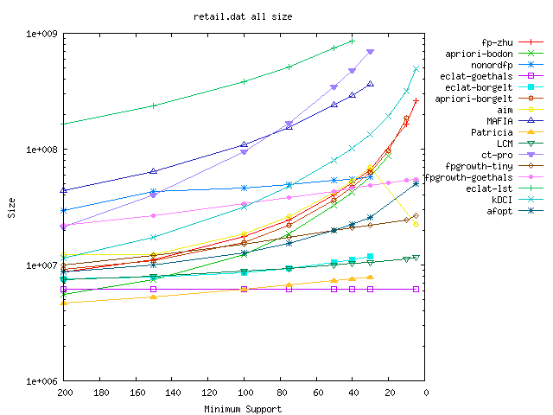
Real-world data(sparse) memory usage
BMS-WebView2
BMS-POS
retail

Slide 34
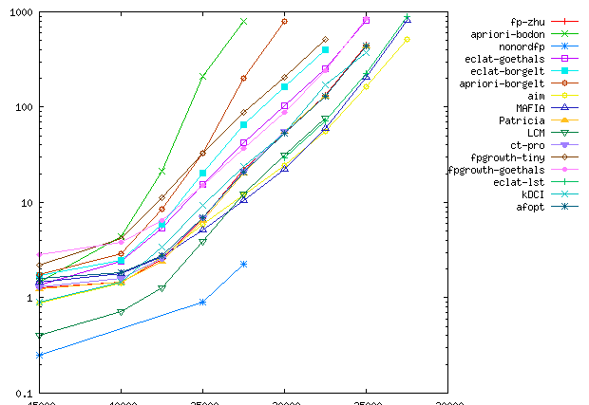
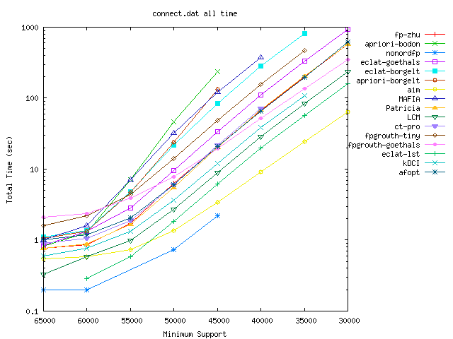
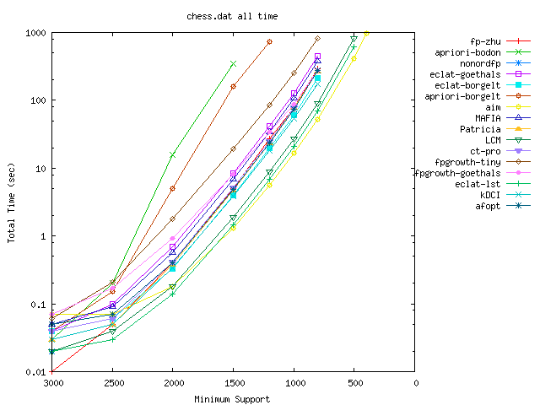
Dense (50%) structured data
pumsb
connect
chess

Slide 35
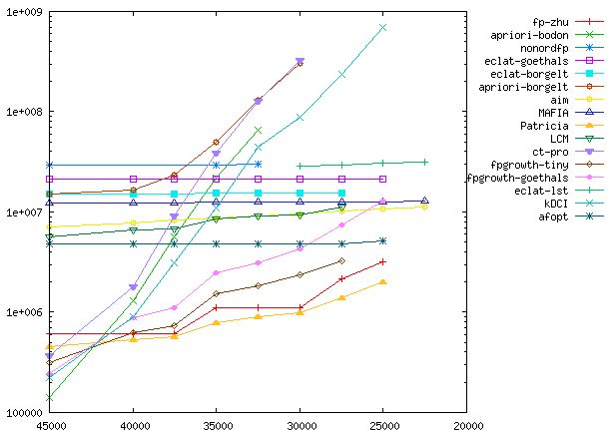
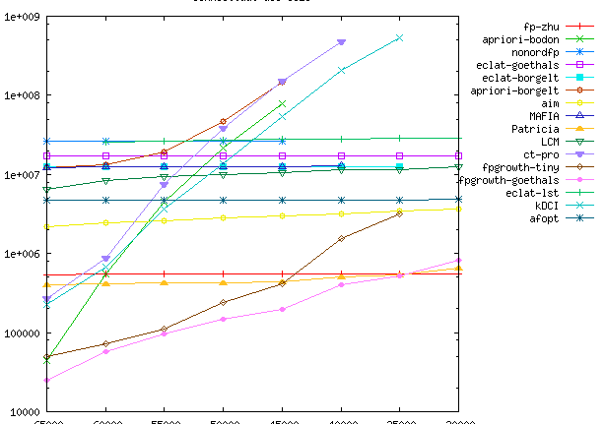
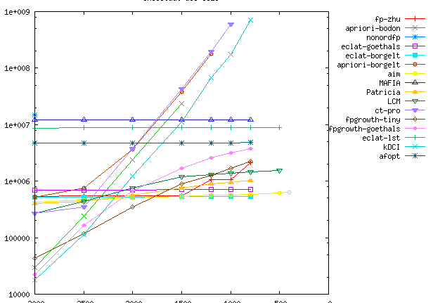
Memory usage: dense structured data
pumsb
connect
chess

Slide 36
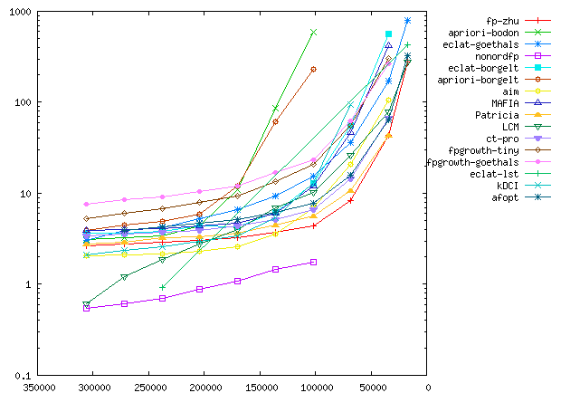
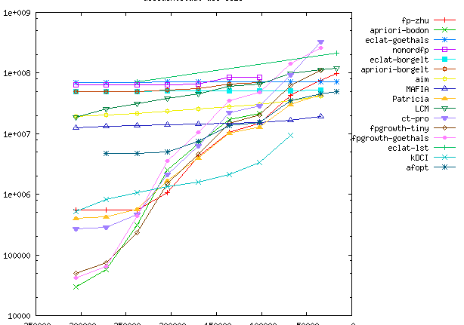
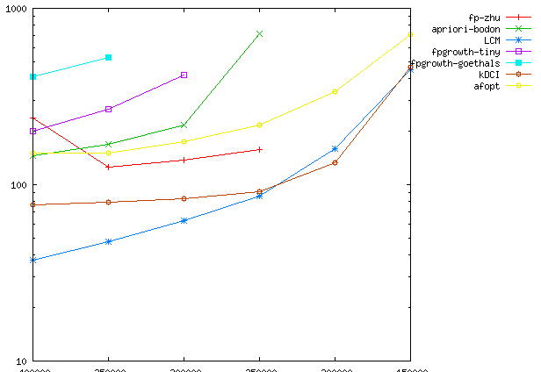
Dense real-world/ Large scale/ data
accidents
(time)
accidents
web-doc

Slide 37
7-4. General Pattern Mining

Slide 38
Pattern Mining in General Terms
• The appearance of a pattern is defined by inclusion
• The frequency is defined by # of records including the pattern
← We need only of “inclusion relation”
• More general version of the inclusion, the relation should satisfy the transitivity A⊆B, B⊆C → A⊆C
(Suppose that pattern A is included in pattern B, and pattern B is included in pattern C. Then A should be included in C)
Then, the relation has to be a partial order, and the set of patterns has to be a poset
(Actually, only the transitivity is important)

Slide 39
Requirements for Enumeration
• A pattern mining algorithm can be obtained by exhaust enumeration and frequency counting
← enumerate all patterns (elements) of
a poset, and for each pattern, count the
number of records including each pattern
• To be efficient, we need pruning methods;
the frequency of any pattern in a branch is
no more than the current pattern
← when the algorithm climbs up the poset,
naturally this condition holds (down project)
≦
≧

Slide 40
Pattern Enumeration
• The elements of the poset is not always easy;
output-polynomial time algorithms do not always exist
solutions to SAT, graphs, geometric objects…
• In practice, simple patterns are more important, and usually that are easily enumerated
sets, sequences, strings, trees, cycles…
they usually induce some inclusion relation

Slide 41
Enumeration Framework
• Start the search (enumeration) from the minimal elements
← pattern mining is hard if the minimal are hard to enumerate
• Then, generate the successors of current elements;
this makes a backtracking algorithm
(marks for duplication check is required)
PatternMiningOnPoset (S)
1. mark{S} = 1; output S
2. for each successor S’ of S
3. if mark{S’} == 0 & frq(S’) ≧ σ then
call PatternMiningOnPoset (S’)
4. end for

Slide 42
Polynomiality
• The resulted pattern mining algorithm is efficient if
+ minimal elements can be efficiently enumerated
+ successors can be efficiently enumerated
+ partial order oracle can be easily realized
PatternMiningOnPoset (S)
1. mark{S} = 1; output S
2. for each successor S’ of S
3. if mark{S} == 0 & frq(S’) ≧ σ then
call PatternMiningOnPoset (S’)
4. end for
computation time for a pattern =
(time for (generation & frequency comp.) of all successors)
computation space = || all frequent patterns||

Slide 43
Apriori for Decreasing Memory
• When the elements of the poset have “sizes”, and any successor has one larger size, we can use apriori
Apriori
1. D₀={φ}, k := 1
2. while D_{k-1} ≠φ
3. for each S ∈ D_{k-1}
4. output S
5. for each successor S’ of S
6. if frq(S’) ≧ σ then insert S’ to D_{k}
computation time for a pattern =
(time for (generation & frequency comp.) of all successors)
computation space = || all frequent patterns of the same size||

Slide 44
Reverse Search
• When predecessor is efficiently obtained, reverse search is possible
P(S): the predecessor that is given by an algorithm
to compute a predecessor of the given element
ReverseSearchOnPoset (S)
1. output S
2. for each successor S’ of S
3. if P(S’) == S & frq(S’) ≧ σ then
call PatternMiningOnPoset (S’)
4. end for
computation time for a pattern =
(time for (generation & frequency comp.) of all successors & P(S))
computation space = depth of recursion + alg. for succ. & pred.

Slide 45
Other Frequent Patterns
• Bottom-wideness, delivery and database reduction are available for many kinds of other frequent pattern mining
+ string, sequence, time series data
+ matrix
+ geometric data, figure, vector
+ graph, tree, path, cycles…
pattern
XYZ
{A,C,D}
record
AXccYddZf
{A,B,C,D,E}

Slide 46
7-5. Sequential Pattern Mining

Slide 47
Sequential Database
• Suppose that we have a collection of sequences (sequential data), such as string, sequence of attributes, access log, event sequence, etc.
Those data is of sequence of letters (string), or sequence of letters with time stamp
the former is dense format, and the latter is sparse format
A: 1,5,4,6,8,1,1,2,1,1
B: 3,3,5,1,4
C: 1,1,2,1,1,8,9,1,1,1,8,8
…
A: (a, 11), (b, 32), (d, 47), (e, 89)
B: (c, 11), (c, 12)
C: (d, 1), (e, 2), (e, 67), (a, 68)
…

Slide 48
Sequential Pattern Mining
• We consider sequential patterns for sequential databases
A happens → B happens → C happens…
For conciseness, we consider “dense format”
← when we think only of “order of appearance”, the timestamp does not have meanings
Naturally, we consider that
1,2,4 ⊆ 1,2,4,6,8,1
1,2,4 ⊆ 1,4,2,1,1,4,1
A: 1,5,4,6,8,1,1,2,1,1
B: 3,3,5,1,4
C: 1,1,2,1,1,8,9,1,1,1,8,8
…

Slide 49
Definition of Appearance
• How many times does 1,2,4 appears in 1,4,2,2,2,1,1,4,1,2,4,1 ?
We consider
1. document occurrence
count records (sequence) including the pattern
2. position occurrence
count positions from where the pattern is embedded
3 embedding occurrence
count all correspondences between letters of the pattern and letters of a sequence, for all sequences
Itemset mining uses document occurrence

Slide 50
Pattern Enumeration
• Natural backtracking algorithm does work
for each pattern, we add a letter to its end
then, enumeration is complete, and no duplication happens
• The time is (alphabet size) × (frequency counting)
For this, we can use delivery
SequenceMining (S)
1. output S
2. for each e
if S + e is frequent then call Backtrack (S+e)

Slide 51
Using Delivery
LCMseq： Uno ‘06
• Taking intersection for all e at once, fast computation is available
1. Set empty bucket for each item
2. For each sequence T in Occ(S),
document Insert T to the buckets of all first letters e, that are locating after the first appearance of the last letter of S
position/embedding Insert T to the buckets of all letters e, that are locating after the appearance of the last letter of S
1: A7 A8 B6 C4
2: C5
3: B4 C3 C6
4: B7
5: B5
6:
1: A B C
2: C
3: B C
4: B
5: B
6:
A: 1,5,4,6,1,2,1,1
B: 3,1,2,3,5,1,4
C: 1,2,3,1,2,3
…
S=(1,2)

Slide 52
Time for Delivery
Delivery (S)
1. jump := φ, bucket[e] := φ for all e
2. for each T∈Occ(S)
3. for each i > appear(S,T)
4. if bucket[T[i]] = φ then insert e to jump
5. insert T to bucket[e]
6. end for
7. end for
T[i]: ith letter of T
appear(S,T): the smallest index
s.t. S can be embedded in T[1..i]
• Computation time is Σ_{T∈Occ(S)} |{i | i > appear(S)|

Slide 53
Sequence Mining with Delivery
LCMseq： Uno ‘06
• The leftmost sweep doesn’t work for this, thus we have to
reallocate the memory for the recursive iterations
• An iteration takes O(Σ_{T∈Occ(S)} |{i | i > appear(S)|) time
the time complexity for a solution is O(||D||)
SequenceMining (S)
1. output S
2. delivery (occ(S)) // document occurrence
3. for each e, s.t. frq(S + e)≧σ
call SequenceMining (S+e)
4. end for

Slide 54
7-6. Graph Mining

Slide 55
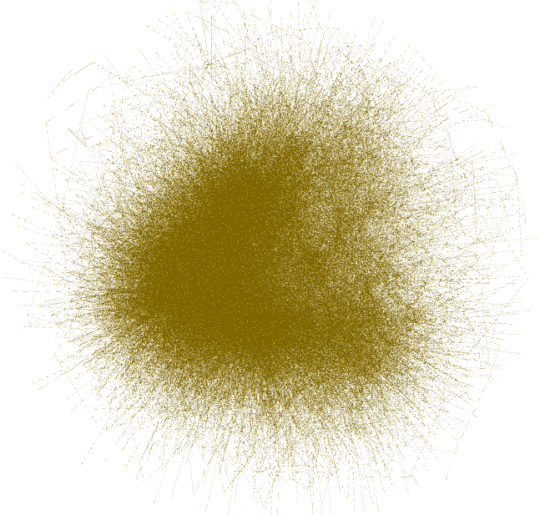
Graph Database
• Graph data is appearing in many areas recently
+ internet network
+ similarity, relation of entities / human / animals
+ SNS, twitter, microblog, social network
+ chemical compounds
+ metabolic networks, genomic evolution
• They are collected and stored, as a big data
• Importance of graph mining had arose
NO₂
O
OH

Slide 56
Embedding Variations
• Each vertex/edge would have some labels (or colors), so pattern graph has to be colored
• Graph data is often composed only of a (few) big graph
we then want to find patterns appearing at many places
→ frequency is counted by embeddings
• … then, we have to think about what kind
of embeddings we will consider
Actually, there are exponentially many
ways to embed a graph, even though
it seems to be constant number of places

Slide 57
Embedding Variations
A graph is included when it can be embedded
1. Count all vertex correspondence (O(n!))
2. Count all vertex subsets to be embedded (O(2^{n}))
3. Choose a vertex of the pattern as its root
Count all vertices s.t. the root corresponds
to the vertices in some embeddings (O(n))
+ 1 is easy to be checked when we add a vertex to a pattern graph, and we know all the embeddings (O(n|frq(P)|) time )
+ 2 and 3 need subgraph isomorphism, so takes exponential time of the pattern size in principle

Slide 58
Graph Enumeration
• Embedding relation is a partial order, so we have a poset
Successor and predecessor are easily computed; removing an edge
Any graph is generated by adding vertices / edges iteratively
…however, the enumeration involves difficulty of isomorphism
← simple extensions make numerous
isomorphic graphs, and isomorphism
needs long computation time

Slide 59
Simple Solution
AGM： Washio et. al. ‘00
• Let’s not mind, to spend time to isomorphism check!
Then, usual “marking approach” does work; This leads simple apriori algorithm
AprioriGraphMining
1. D₀={φ}, k := 1
2. while D_{k-1} ≠φ
3. for each S ∈ D_{k-1}
4. output S
5. for each S’ obtained from S
by adding a vertex/edge
6. if S’ is in D_{k} then go to 8
7. if frq(S’)≧σ then insert S’ to D_{k}
8. end for
9. end while

Slide 60
Cost for Isomorphism...
• When we find many patterns, and they are in memory, we have to check the isomorphim to all, for each newly found graph pattern
… This cost is so heavy
The next idea is, instead of checking isomorphism, find a normalized letter sequence for each graph
+ execute DFSs for every vertex as starting vertex, and examine all order of out-going edges for each vertex
Record the sequence of DFS
(go, A, go, B, back, go, (the first A), back,…)
Then, choose the lexicographically smallest one
That is uniquely computed for any vertex index ordering

Slide 61
Cost for Isomorphism...
Record the sequence of DFS
(go, A, go, B, back, go, (the first A), back,…)
Then, choose the lexicographically smallest one
That is uniquely computed for any vertex index ordering
To improve, introduce several rules, on the order of neighboring vertices to be visited
+ vertices already visited have priority
+ vertices having smaller labels have priority
Then, the number of examination drastically
decreases
Which is first?
Which is first?
Which is first?
Which is first?

Slide 62
Simple Solution
Gspan： Han et. al. ‘02
Store the code given by DFS, with the graph pattern
Gspan
1. D₀={φ}, k := 1
2. while D_{k-1} ≠φ
3. for each S ∈ D_{k-1}
4. output S
5. for each S’ obtained from S
by adding a vertex/edge
6. compute the code of S’
7. if the code is in D_{k} then go to 9
8. if frq(S’)≧σ then insert (tcode, S’) to D_{k}
9. end for
10. end while

Slide 63
7-7. Frequent Tree Mining

Slide 64
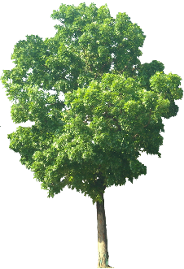
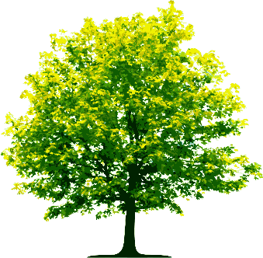
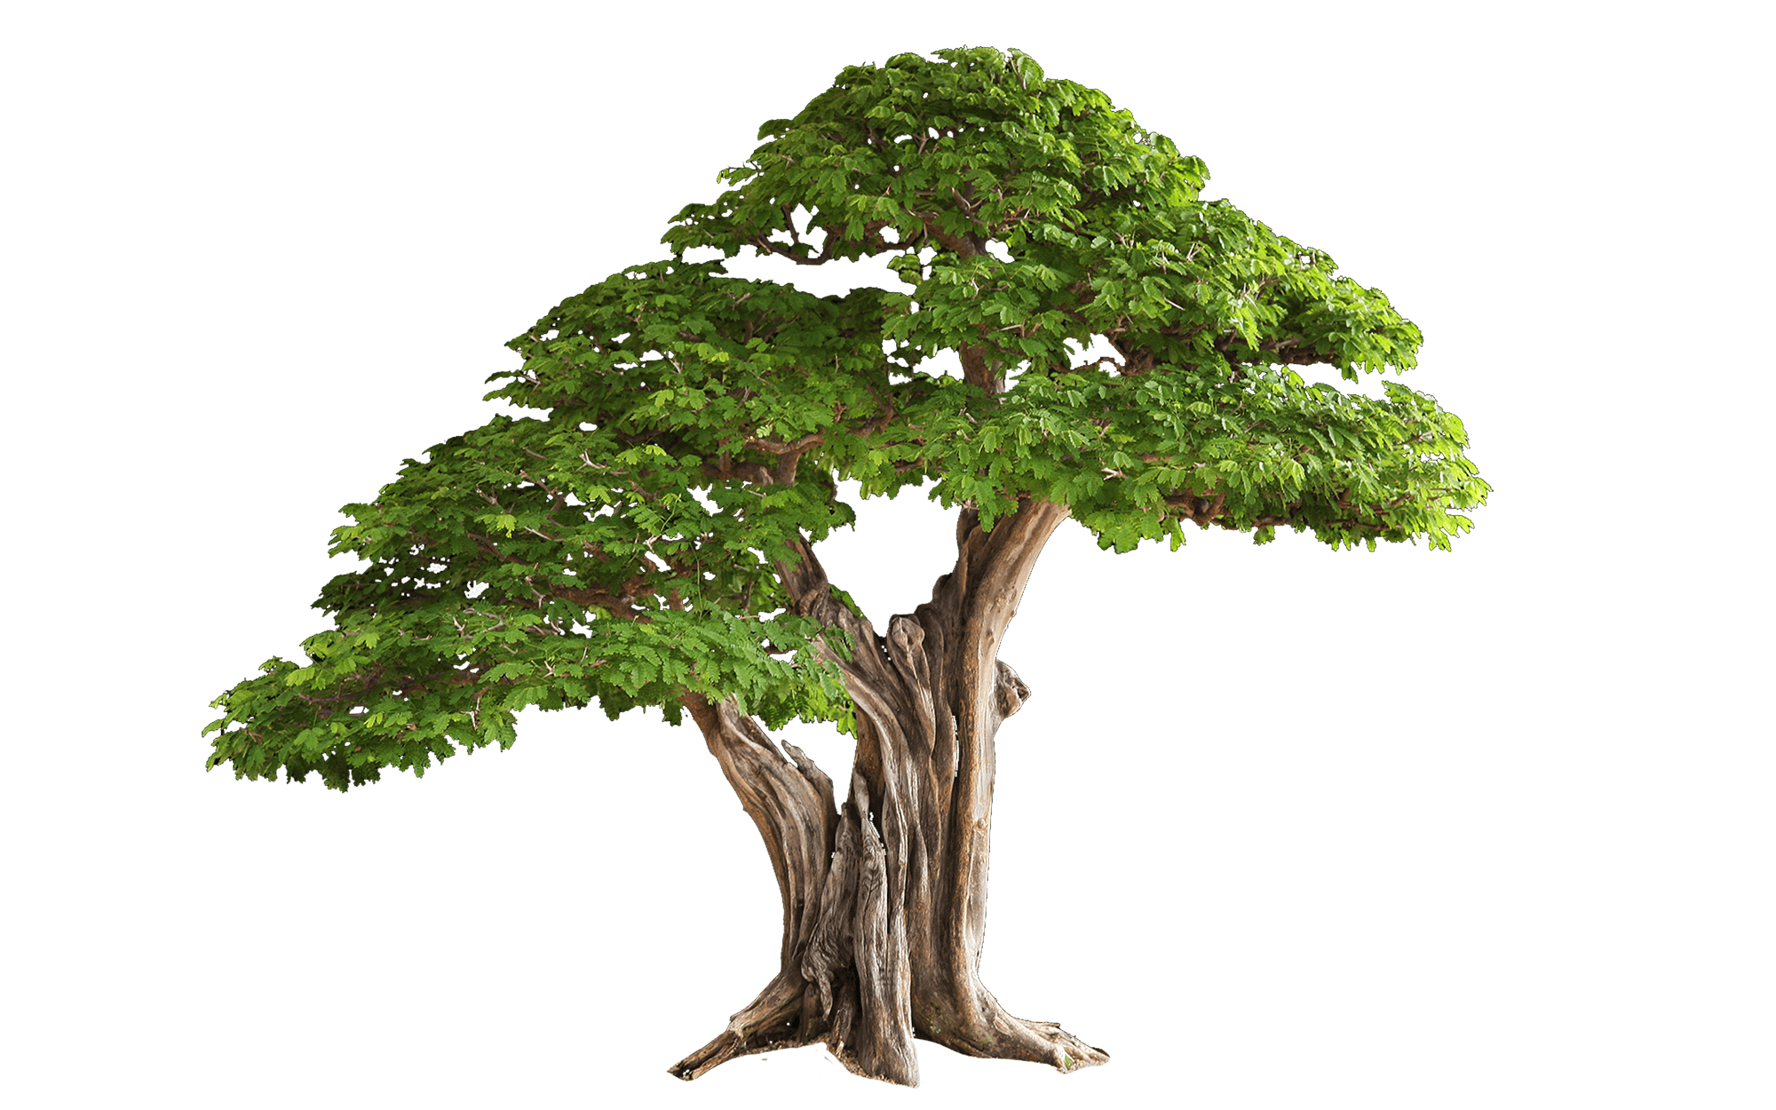
Tree Database
NO₂
• Graph data is important, but not its handling is not good
If it is a tree database, then handling is easy
• In fact, there are many database including only trees
+ html, XML
+ ontology, item category, species
+ structures of documents, organizations, …
+ chemical compounds
• There are also databases of “almost trees”
+ phylogenetic trees
+ Organizations
+ Family trees
O
OH
databases
person
name
name
C
name
name
H
H
H
name
age
phone
H
C
O
family
C
person
C
H
O
person
C
H
C
H
name
name
name
N
H
H
C
XML database
chemical compounds

Slide 65
Tree Database
• So, we are naturally motivated to enumerate all trees that appear in the given database at least σ times
← “Frequent tree mining problem”
+ The embedding relation induces a partial order
→ we have monotonicity
+ The reverse search enumerates all trees in an ascending order
→ we can prune infrequent patterns efficiently
+ The embedding check can be done in polynomial time
→ we can count the frequency
• Of course, we can use down project
and delivery for efficient computation

Slide 66
Models for Trees, To be Mined
• Ordered trees
each vertex has ordering for its children, and we think two ordered trees are isomorphic if the children orderings are kept
• Rooted trees
• Rooted labeled trees (for vertex/edges/both)
• Free trees

Slide 67
Subgraph Isomorphism (Embedding)
• For given ordered trees S and T, answer whether S can be embedded into T or not
• There are several embedding models
+ keep the children ordering or not
+ embed as a non-rooted trees
+ edges can be stretched (an edge corresponds to many edges)
+ two stretched edges can share some edges
• The subgraph isomorphism can be solved in
O(|S|²|T|²) time in the simplest embedding model
(by dynamic programming from the bottom)

Slide 68
Updating Isomorphism (Embedding)
• Dynamic programing finds all embeddable correspondence between all vertices of S and all vertices of T
• For each vertex pair, we solve a matching problem for checking the existence of correspondence between their children
• For a vertex addition to the pattern,
update correspondence;
it is required only on
the ancestor path
of that vertex
1,2,3
data
pattern
2,3
1
1,2,3
2
3
2,3
4
2,3
2,3
2,3

Slide 69
Updating Isomorphism (Embedding)
• Dynamic programing finds all embeddable correspondence between all vertices of S and all vertices of T
• For each vertex pair, we solve a matching problem for checking the existence of correspondence between their children
• For a vertex addition to the pattern,
update correspondence;
it is required only on
the ancestor path
of that vertex
1,2,3,4
data
pattern
2,3,4
1
1,2,3,4
2
3
2,4
4
2,4
2,4
2,4

Slide 70
References
Frequent Itemsets
T. Uno, M. Kiyomi, H. Arimura, LCM ver. 2: Efficient Mining Algorithms for Frequent/Closed/Maximal Itemsets, ICDM'04 Workshop FIMI'04 (2004)
T. Uno, T. Asai, Y. Uchida, H. Arimura, An Efficient Algorithm for Enumerating Closed Patterns in Transaction Databases, LNAI 3245, 16-31 (2004)
A. Pietracaprina, D. Zandolin, Mining Frequent Itemsets using Patricia Tries, ICDM'03 Workshop FIMI'03 (2003)
C. Lucchese, S. Orlando, R. Perego, DCI Closed: A Fast and Memory Efficient Algorithm to Mine Frequent Closed Itemsets, ICDM workshop FIMI'04 (2004)
G. Liu, H. Lu, J. Xu Yu, W. Wei, X. Xiao, AFOPT: An Efficient Implementation of Pattern Growth Approach, ICDM'03 Workshop FIMI'03 (2003)
J. Han, J. Pei, Y. Yin, Mining Frequent Patterns without Candidate Generation, SIGMOD 2000, 1-12 (2000)
G. Grahne, J. Zhu, Efficiently Using Prefix-trees in Mining Frequent Itemsets, ICDM'03 Workshop FIMI'03 (2003)
B. Racz, nonordfp: An FP-growth variation without rebuilding the FP-tree, ICDM'04 Workshop FIMI'04 (2004)

Slide 71
References
Sequential Pattern Mining
Wiki: https://en.wikipedia.org/wiki/Sequential_pattern_mining

Slide 72
References
Graph Mining
A. Inokuchi, T. Washio, H. Motoda: An apriori-based algorithm for mining frequent substructures from graph data. In European Conference on Principles of Data Mining and Knowledge Discovery, 13-23 (2000)
Xifeng Yan, and Jiawei Han. "gspan: Graph-based substructure pattern mining." Data Mining, 2002. ICDM 2003 (2002)
Tree Mining
T. Asai, H. Arimura, T. Uno, S. Nakano, Discovering Frequent Substructures in Large Unordered Trees, DS2003, LNAI 2843, 47-61 (2003)
T. Asai, K. Abe, S. Kawasoe, H. Sakamoto, H. Arimura, S. Arikawa: Efficient Substructure Discovery from Large Semi-Structured Data. IEICE Transactions 87-D(12): 2754-2763 (2004)
M. J. Zaki: Efficiently Mining Frequent Trees in a Forest, SIGKDD2002, pp.71–80 (2002)
Y. Chi, R. R. Muntz, S. Nijssen, J. N. Kok: Frequent Subtree Mining - An Overview, Fundamenta Informaticae 66, pp.161–198 (2005)

Slide 73
Exercise 7

Slide 74
Frequent Patterns
7-1. We have a database such that each record is a 01 matrix.
Consider model of frequent 01-matrix pattern mining problem
7-2. ↑ construct an algorithm for solving this problem; is it possible to introduce down project and delivery?
7-3. An itemset sequence is a sequence of itemsets. For databases composed of itemset sequences, consider model of frequent itemset sequence, and construct efficient algorithm
7-4. In the sequence mining, we want to deal only with appearance such that items of a pattern (considered as events) appear at the places close to each other. How do you give the constraint, and how do you construct the algorithms?

Slide 75
Frequent Patterns
7-5. The appearance of two items of a sequence are allowed to appear with having gaps. We want to give some restriction for the gaps. When we want to allow only constant number of gaps, how do you construct the algorithm?
7-6. ↑ if we want to allow α(length) gaps with α<1, how do you construct an algorithm?
7-7. Rule mining is to find all interesting rules in the form S → x
where S is an itemset (or just item) and x is an item. The confidence of the rule is the ratio of records including x among all records including S (if S happens, x happens in prob. XX)
For an item x (or enumerate all rules), construct algorithms for finding all rules of confidence at least θ and frequency at least σ, based on usual pattern mining algorithms

Slide 76
Frequent Patterns
7-9. Describe a dynamic programming algorithm for deciding whether a tree S is included in a tree T or not. Analyze the time complexity and show it
7-10. Consider some ways to speeding up this process
7-11. Precisely describe an algorithm to update the above
correspondence efficiently

