Slide 1
Output Sensitive Enumeration
8. Closed Pattern Mining
Closed Itemset Mining
General Algorithm
Motif Mining
Geograph Mining

Slide 2
8-1. Closed Itemset

Slide 3
Disadvantage of Frequent Itemset
• To find interesting(deep) frequent itemsets, we need to set σ small
➔ numerous solutions will appear
• Without loss of information, we want to shift the problem (model)
1. maximal frequent itemsets
included in no other frequent itemsets
2. closed itemsets
maximal among those
having the same occurrence set
111…1
Pasquier et al. ‘99
000…0

Slide 4
Ex) Maximal Frequent / Closed Itemsets
• Classify frequent itemsets by their occurrence sets
A: 1,2,5,6,7,9
B: 2,3,4,5
C: 1,2,7,8,9
D: 1,7,9
E: 2,7,9
F: 2
included in at least 3
{1} {2} {7} {9}
{1,7} {1,9}
{2,7} {2,9} {7,9}
{1,7,9} {2,7,9}
D＝
frequent closed
maximal frequent
A closed itemset is the intersection of its occurrences

Slide 5
Advantage and Disadvantage
maximal
• existence of output polynomial time algorithm is open
• fast computation is available by pruning like maximal cliques
• few solutions but sensitive against the change of σ
closed
• polynomial time enumeratable by reverse search
• discrete algorithms and bottom-wideness fasten computation
• no loss w.r.t occurrence sets
• no advantage for noisy data (no decrease of solution)
Both can be enumerated O(1) time on average, 10k-100k / sec.

Slide 6
Bipartite Graph Representation
• Items and transactions are vertices, and the inclusion relations are the edges
A: 1,2,5,6,7,9
B: 2,3,4,5
C: 1,2,7,8,9
D: 1,7,9
E: 2,7,9
F: 2
1 2 3 4 5 6 7 8 9
A B C D E F
D＝
• itemset and transactions including it
➔ bipartite clique of the graph
• itemset and its occurrence set
➔ bipartite clique maximal on the transaction side
• closed itemset and its occurrence set ➔ maximal bipartite clique

Slide 7
From Adjacency Matrix
• See the adjacency matrix of the bipartite graph
 | 1 | 2 | 3 | 4 | 5 | 6 | 7 | 8 | 9
A | 1 | 1 |  |  | 1 | 1 | 1 |  | 1
B |  | 1 | 1 | 1 | 1
C | 1 | 1 |  |  |  |  | 1 | 1 | 1
D | 1 |  |  |  |  |  | 1 |  | 1
E |  | 1 |  |  |  |  | 1 |  | 1
F |  | 1
A: 1,2,5,6,7,9
B: 2,3,4,5
C: 1,2,7,8,9
D: 1,7,9
E: 2,7,9
F: 2
D＝
S = {1,7}
• itemset and transactions including it
➔ a submatrix all whose cells are 1

Slide 8
Methods for Closed Itemset Enumeration
• Based on frequent itemset enumeration
－ enumerate frequent itemsets, and output only closed ones
－ can not get advantage of fewness of closed itemsets
• Storage ＋ pruning
－ store all solutions found, and use them for pruning
－ pretty fast
－ memory usage is a bottle neck
• Reverse search ＋ database reduction （LCM）
－ computation is efficient
－ no memory for previously found solutions
CHARM: ZAKI et al. ‘02
LCM: Uno et al. ‘03

Slide 9
Neighbor Relation of Closed Itemsets
• Remove items from a closed itemset, in decreasing ordering
• At some point, occurrence set expands
• Compute the closed itemset of the expanded occurrence set
• The obtained closed itemset is the parent (uniquely defined)
• Frequency of the parent is always larger than the child, thus the parent-child relation is surely acyclic
➔ The parent-child relation induces a directed spanning tree

Slide 10
Reverse Search
Parent-child relation induces a directed spanning tree
DFS search on the tree can find all solutions
• Enumeration method for all children of a parent is enough to search
• If children are found polynomial time on average, output polynomial
(child is obtained by adding an item to the parent)
Acyclic relation and polytime children enumeration are sufficient to polytime enumeration of any kind of objects

Slide 11
Ex) Parent-child Relation
• All closed itemsets of the following database, and the parent-child relation
φ
2
1,2,5,6,7,9
2,3,4,5
1,2,7,8,9
1,7,9
2,7,9
2
7,9
1,7,9
D ＝
2,5
2,7,9
1,2,7,9
2,3,4,5
Move by adding an item
Parent-child
(ppc extension)
1,2,7,8,9
1,2,5,6,7,9

Slide 12
Computing the Children
• Let e be the item removed most recently to obtain the parent
By adding e to the parent, its occurrence set will be the occurrence set of the child
➔ A child is obtained by adding an item and computing
the closed itemset
➔ However, itemsets obtained in this way are not always children
➔ Necessary and sufficient condition to be a child is
“no item appears preceding to e” by closure operation
(prefix preserving closure extension (ppc-extension))

Slide 13
Database Reduction
• We want to reduce the database as frequent itemset enumeration
• However, can not remove smaller items (than last added item e)
⬅ computation of ppc extension needs them
• However,
+ if larger items are identical, included in Occ at the same time
+ so, only the intersection of the smaller parts is needed
store the intersection of transactions having the same large items
• The intersection of many transactions
has a small size
intersection is “2, 6,7”
１ |  | ３ | ４ | ５
１ | ２ |  | ４ |  | ６
 |  | ３ | ４ |  |  | ７
１ | ２ |  | ４ |  | ６ | ７
 | ２ | ３ | ４ | ５ | ６ | ７
 | ２ |  | ４ |  | ６ | ７
no much loss compared with large σ

Slide 14
Cost for Comparison
• We can simply compute the intersection of Occ(S∪e), but would be redundant. We do just “checking the equality of the intersection Occ(S∪e) and S”, thus no need to scan all
⬅ We can stop when we confirmed that they are different
• Trace each occurrence of S∪e in the
increasing order, and check each item
appears all occurrences or not
• If an item appears in all, check
whether it is included in S or not
• Proceed the operations from
the last operated item
S
4
11
3
4
6
9
3
4
6
9
11
1
3
4
5
9
11
1
3
4
5
9
Occ(S∪e)
2
3
4
4
5
5
9
9
11
1
1
2
2
4
4
6
6
9
9
11
1
1
4
4
9
9
11

Slide 15
Using Bit Matrix
• Sweep pointer is a technique for sparse style data.
We can do better if we have adjacency matrix
• But, adjacency matrix is so huge (even for construction)
• Use adjacency matrix when the occurrence set becomes sufficiently small
➔ By representing the matrix by bitmap, each column (corresponding to an item) fits one variable!

Slide 16
O(1) Time Computation of Bit Matrix
• By storing the occurrences including each item by a variable, we can check whether all occurrence of S∪e includes an item or not in O(1) time
• Take the intersection of bit patterns of Occ({i}) and Occ(S∪e)
• If i is included in all occurrences of S∪e, their intersection is equal to Occ({i})
Occ(S)
•••
Occ({e})

Slide 17
8-2. Result of Competition

Slide 18
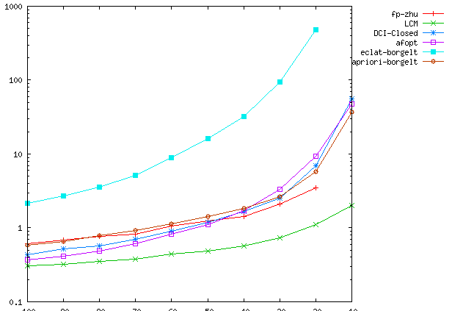
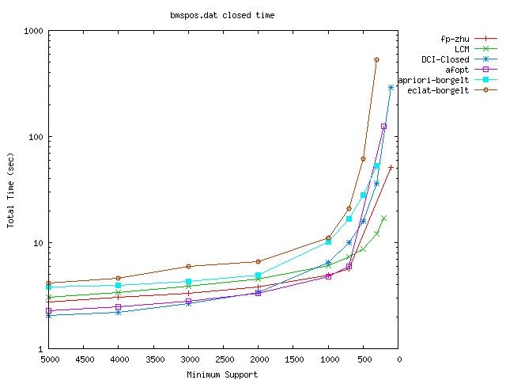
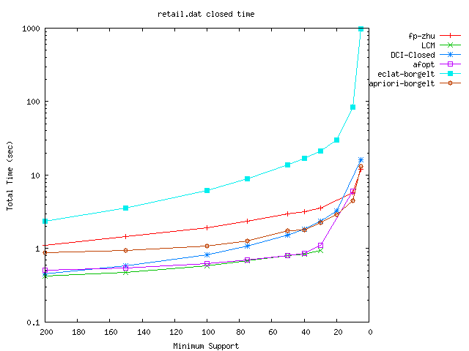
real-world data (sparse) average size 5-10
BMS-WebView2
BMS-POS
retail

Slide 19
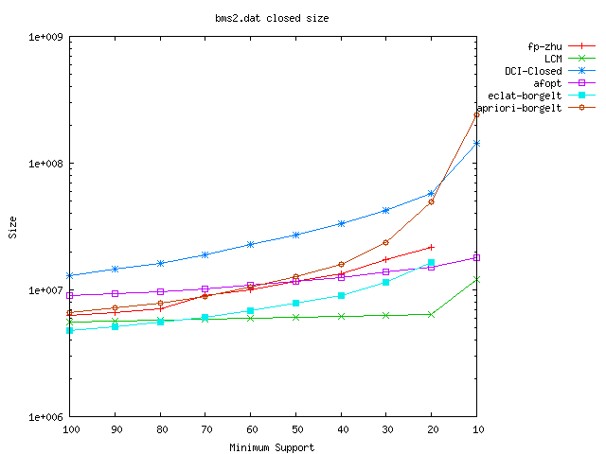
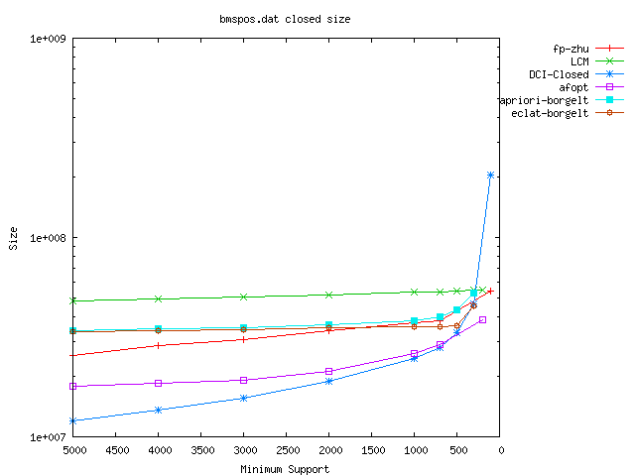
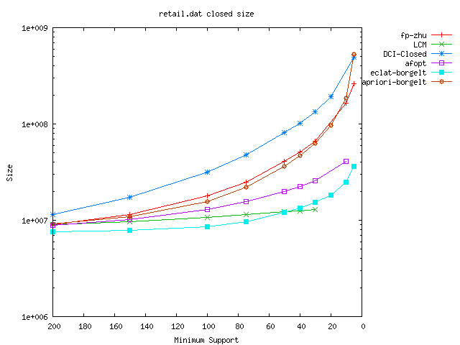
real-world data (sparse) memory usage
BMS-WebView2
BMS-POS
retail

Slide 20
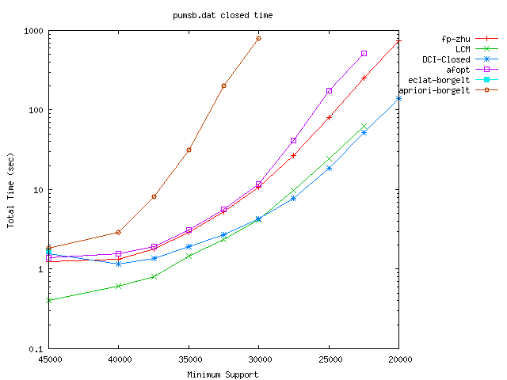
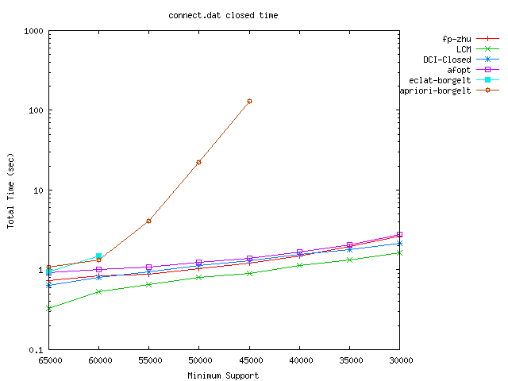
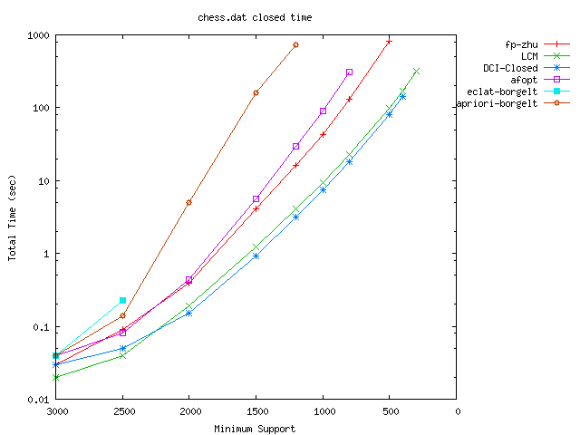
dense (50%) structured data
pumsb
connect
chess

Slide 21
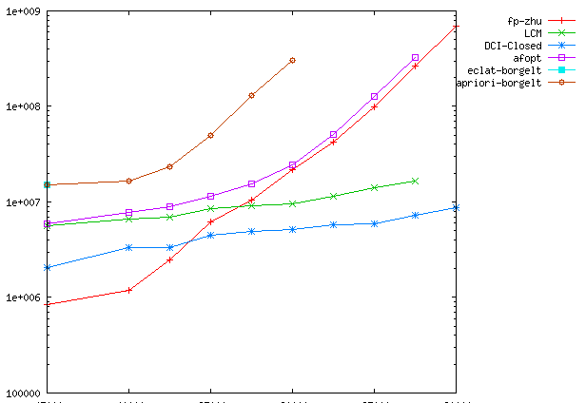
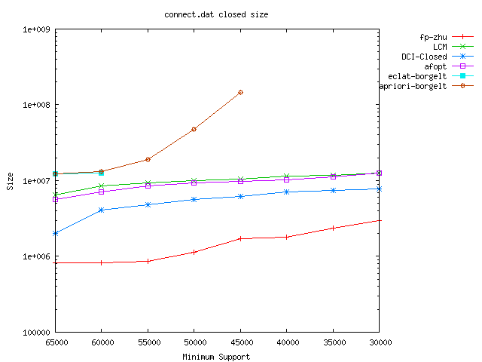
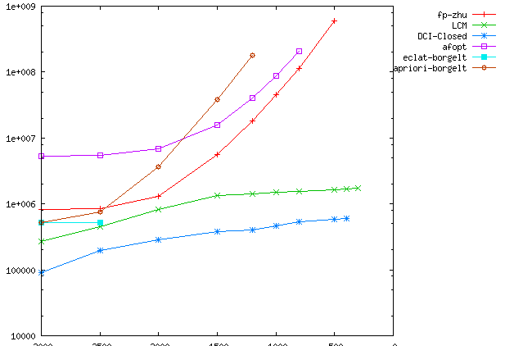
dense structured data, memory usage
pumsb
connect
chess

Slide 22
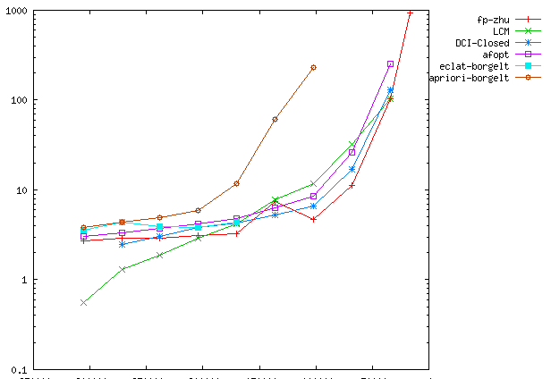
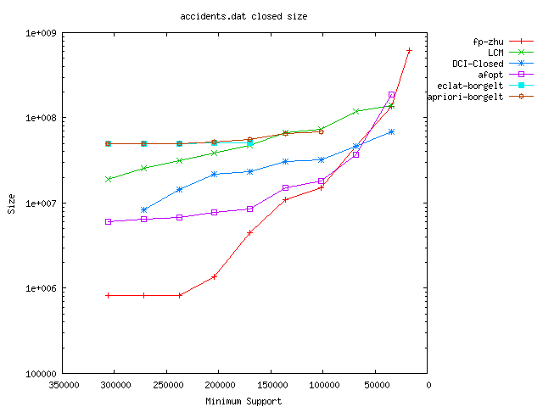
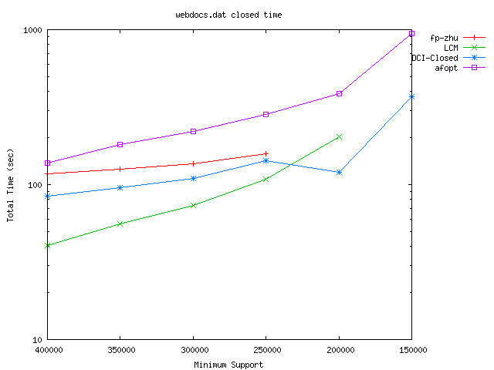
dense real data large scale data
accidents
accidents memory
web-doc

Slide 23
8-3 Closed Pattern in General

Slide 24
Another Definition
• Closed patterns can defined in another way;
closed pattern ⬄ maximal in those having same occurrence set
• Then, in some poset, we have many maximals, thus
closed pattern is not uniquely defined
• If the poset is a lattice, the maximal is unique (join)
Moreover, the maximal has the same occurrence set, if the lattice is distributive
→ Closed pattern is defined
by the meet of the occurrence set
(so, uniqueness of join is not necessary)

Slide 25
Cases that don’t work
+ Sequences
A B C D A C B D
+ graphs (even rooted trees)
Usually, if occurrence is determined when matching of one (or few) entity is determined, and not if not ← Occ can be exp.

Slide 26
Problem Setting
Closed pattern enumeration:
For given a set of elements y₁,…,y_{m} of a distributive lattice, enumerate all the elements that are the meet of some S⊆{y₁,…,y_{m}}
(Closed pattern is the maximal element included in all occurrences
meet of the occurrences)
For an element z, y_{i} s.t. z≦y_{i} is an occurrence,
and meet of the occurrence set is the closure

Slide 27
Proof
• The maximal has the same occurrence set, if the lattice satisfies that the meet is uniquely defined (more general than distributive)
When x_{i}≦y_{j} holds for any x₁…,x_{k} and y₁,…,y_{h}, the meet z of y₁,…,y_{h} satisfies x_{i}≦z for any x_{i}
the definition of meet is
“maximal among all z’ s.t., z≦{y₁,…,y_{h}}”
Any x_{i} satisfies the condition, thus x_{i} ≦z

Slide 28
Extension
• For the enumeration, we need a method to make a closed pattern from another
• For an element x (pattern), we compute the occurrence set
then, their meet is the closed pattern (closure operation)
• For the meet, every its successor has a different occurrence set
→ By applying the closure operation,
we can get a new closed pattern
(closure extension)

Slide 29
Completeness of Extension
• For an occurrence set X, consider a maximal set Y,
included in X and has its meet different from X
The meet ∧Y of Y satisfies ∧Y ≦ x_{i} for any x₁…,x_{k}
→ at least one successor of ∧Y (in the path from ∧Y to ∧X)
has its occurrence set equal to X
→ at the closure of the successor is ∧X
→ any meet can be obtained from
another smaller meet

Slide 30
Enumeration Framework
• Start the search (enumeration) from the minimal elements
← pattern mining is hard if the minimal are hard to enumerate
ClosedPatternMiningOnDisLattice (S)
1. mark{S} = 1; output S
2. for each successor S’ of S
3. S’ == ∧Occ(S’)
4. if mark{S’} == 0 & frq(S’) ≧ σ then
call ClosedPatternMiningOnDisLattice (S’)
5. end for

Slide 31
Complexity
• Each iteration takes time for computing successor, occurrence set, and the meet of the occurrence set
→ the computation time for one iteration is given by these
(# of successors × (occurrence, meet))
if all these are polynomial time, then polynomial delay
(same as one iteration, by alternative output)
• Space is required to store all the solutions
already found in memory
→ Exponential space in general

Slide 32
Reverse Search Sophisticated
• Define the parent of a closed pattern in a sophisticated way
• Go down to a lower area (by adding a record of the data to the occurrence set and take the meet)
• Go up until just below the original area
(by following the path to the original pattern
by iterative closure extensions)
• In this way, we can define the parent uniquely,
and it is computable in polynomial time
(If I’m not your parent, I don’t make you!)
→ polynomial space!

Slide 33
PPC Extension Needs More
• In PPC extension, we remove the items from larger one, and obtain an itemset with larger occurrence set
← this is equivalent to the lattice version
• Then, we don’t have to climb up, since by adding the
vertex removed last, we get the original occurrence set
↑ this differs from the lattice version!

Slide 34
PPC Extension Needs More
• In itemset version, the vertex removed last can be added
to other pattern always, and then it it restricts the occurrence
to the original occurrence
• The “item” works well; it recovers the original
occurrence set, if the prefix is preserved
• The patterns having similar “item-like” structures,
we can develop ppc-extension type algorithms

Slide 35
8-4. Closed Motifs

Slide 36
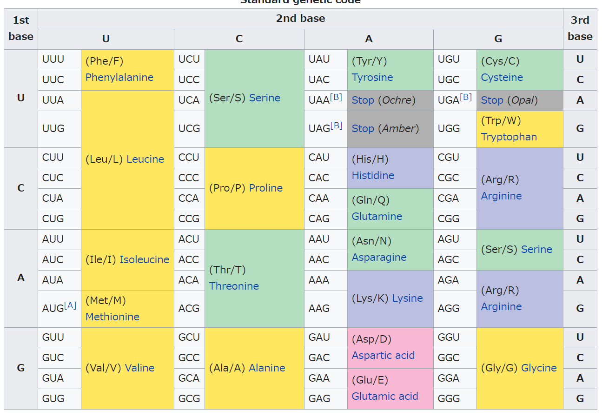
Motivated by Bioinformatics
• In genome analysis, some genome sequences represent the same function (meaning), but have different sequence (string)
Even each amino acid is made from different three letters
The third letter often
doesn’t matter
so, some genome
sequences should be
represented like
AT●TT●CG● …
1 letter

Slide 37
General Setting
• In general, we want find patterns of this type (called “motif”)
AT●●TT●●●CCGCC●G
(● is called “wildcard”, and other letters “solid letters”)
• A solid letter x matches only x
A wildcard ● match any solid letter and ●
• A motif S matches a position of another motif (or string) if any ith letter of S matches the ith letter of the substring starting from the position
AT●GTGCC●TT●●●CCGCC●G
GT●C GTCC

Slide 38
Problem Formulation
• Our problem is to find all motifs appearing at least σ times in the given string data (one long, or many short)
ATGCCGACCC
appear at least twice in ↑
A, T, G, C, CC, A●●C, G●C
• There are two ways to count the appearance;
document occurrence
# of strings (motifs) of the database that the motif matches
position occurrence
# of (position i, strings T) to which the motif matches

Slide 39
Enumeration Framework
• The empty string is the start point
(Φ ＝ ・・・●●●●●●●・・・) matches to everywhere
Then, change ● to some letter, and motif becomes more complicated
(they are successors)
specified
general
AA
A●A
A●●A
AB
A●B
A
B
Φ

Slide 40
Enumeration Framework
• For a motif S, let S(i, x) be the motif obtained from S by replacing its ith letter to x, if ith letter is ●, and S itself otherwise
Let tail(S) be the position of the last letter that is not ●
For avoiding duplications, change letters after the last solid letter
MotifMining (S)
1. output S
2. for each (i,x), s.t. i>tail(S)
3. if frq(S(i,x)) ≧ σ then
call MotifMining (S’)
4. end for

Slide 41
Motif has Meet
• For a set of motifs we can get the most specified motif
(corresponding to their meet)
ATCGTTGC●●
●CCGCCGC●G
ATCGCCGCGG
●CCGCCGCTG
ATC●TAGCAA
●CCGTAGCAG
●●C●●●GC●●
Computed in O( (# of motifs) × (length) )

Slide 42
PPC Extension
• When ith letter of S is ●, it can be changed in any more specified motif unless it is already changed to a solid letter
(this is “item-like property”)
A●●AA●●●C●T
+ Change the last solid letter to wildcard, one by one
+ At some point, occurrence set expands
+ Then, take the closure (meet)
• The prefix part doesn’t change, and some latter solid letters will recover

Slide 43
PPC Extension
• When ith letter of S is ●, it can be changed in any more specified motif unless it is already changed to a solid letter
(this is “item-like property”)
A●●AA●●●C●T
+ Change the last solid letter to wildcard, one by one
+ At some point, occurrence set expands
+ Then, take the closure (meet)
• The prefix part doesn’t change, and some latter solid letters will recover

Slide 44
PPC Extension
• When ith letter of S is ●, it can be changed in any more specified motif unless it is already changed to a solid letter
(this is “item-like property”)
A●●AA●●●C●●
+ Change the last solid letter to wildcard, one by one
+ At some point, occurrence set expands
+ Then, take the closure (meet)
• The prefix part doesn’t change, and some latter solid letters will recover

Slide 45
PPC Extension
• When ith letter of S is ●, it can be changed in any more specified motif unless it is already changed to a solid letter
(this is “item-like property”)
A●●AA●●●●●●
+ Change the last solid letter to wildcard, one by one
+ At some point, occurrence set expands
+ Then, take the closure (meet)
• The prefix part doesn’t change, and some latter solid letters will recover

Slide 46
PPC Extension
• When ith letter of S is ●, it can be changed in any more specified motif unless it is already changed to a solid letter
(this is “item-like property”)
A●●A●●●●●●●
+ Change the last solid letter to wildcard, one by one
+ At some point, occurrence set expands
+ Then, take the closure (meet)
• The prefix part doesn’t change, and some latter solid letters will recover

Slide 47
PPC Extension
• When ith letter of S is ●, it can be changed in any more specified motif unless it is already changed to a solid letter
(this is “item-like property”)
A●●A●●●●C●●
+ Change the last solid letter to wildcard, one by one
+ At some point, occurrence set expands
+ Then, take the closure (meet)
• The prefix part doesn’t change, and some latter solid letters will recover

Slide 48
Listing Children
• To obtain the one’s children, we change each wildcard ●, to each solid letter, compute the closure, and check the ppc condition
A●●AA●●●●C●●
• If the prefix part doesn’t change (prefix preserving), then the result is a child
• For each wildcard at ith position, we can compute the occurrence sets of the motifs s.t. it is changed to each solid letter, by delivery
25 64
1 20 47 87 Occ = {1, 20, 25, 47, 64, 87}
A T G C O(|max. pattern length| × |Occ|)

Slide 49
Closed Pattern Enumeration
• Naturally, the following algorithm is obtained
• Each iteration takes
O(|max. pat. len.| × |Occ(S)|) for occurrence computation
O(|max. pat. len.| × |Occ(S’)|) for meet computation
➔ O(|max. pat. len.|² × |Occ(S)|) time in total
ClosedMotifMining (S, j)
1. output S
2. for each (i,x), s.t. i>j
3. compute Occ(S(i,x))
4. compute the meet S’ of Occ(S(i,x))
5. if frq(S(i,x)) ≧ σ then
call ClosedMotifMining (S’, i)
6. end for
Σ(|max. pat. len.|×|Occ(S’)|) = |Occ(S)|

Slide 50
8-5. GeoGraphs

Slide 51
Geometric Objects
• We are surrounded by geometric objects, and in many data we have geometric data
road network, CPU design, blueprints, CAD, chemical compounds, protein,…
• We want to find some “frequent appearing shapes” from these geometric data

Slide 52
Data Definition
• Objects are many kinds…
Many are difficult to describe, compare, identify the equivalence
→ restrict to points and segments
• Each record of data is composed points and straight segments connecting some points (Geograph)

Slide 53
Inclusion
• A geometric object appears in the other when the other has a part that is same to it
→ each point has its position, but to consider the inclusion, we have to move it (translation)
when it is same to the part, by adding +(x’,y’) to the position

Slide 54
Other Ways?
• Shall we rotate?
• Shall we expand/shrink?
Anyway, how can we check the embedding correspondence?

Slide 55
Vertex Correspondence
• Correspondence of one vertex
determines the translation
• Correspondence of two vertices
determines rotation & expansion
• Correspondence of 3 vertices determines affine transformation

Slide 56
Variations on Vertex Correspondence
• Check all 1 vertex ⬄ 1 vertex correspondences
→ all possible translation giving embeddings will be found
• Check all 2 vertices ⬄ 2 vertices correspondences
→ all possible (translation, rotation, expansion) giving embeddings will be found
• Check all 3 vertices ⬄ 3 vertices correspondences
→ all possible (translation, affine transformation) giving embeddings will be found
• All are polynomial time checkable

Slide 57
Checking Correspondence
• Check all 1 vertex ⬄ 1 vertex (translation)
→ n² candidates, O(|pat.|) time to check remaining correspondence
• Check all 2 vertices ⬄ 2 vertices (translation, rotation, expansion)
→ n⁴ candidates, O(|pat.|) time to check remainings
• Check all 3 vertices ⬄ 3 vertices (translation, affine)
→ n⁶ candidates, O(|pat.|) time to check remainings

Slide 58
Pattern Enumeration
• A point is given by pair of real numbers; (x, y)
a segment is given by two points, so (x,y,p,q)
• Set of points and segments can be represented as an itemsets
For the enumeration (backtracking), we need a total order on points and pairs of points (ex. by lexicographic order of 2/4 numbers)
For normalization, translate the points so that the smallest point in the order will be (0,0)

Slide 59
Points/Segments to be Added
• Suppose that we are considering only the translation
The pattern composed of one point (root) is included in all objects
Duplicate each object with setting different vertex to “root”
(root corresponds to the root of the pattern)
Only when we add the points (or segments)
in the yellow area, the generated pattern
has non-zero frequency

Slide 60
With Rotation and Expansion
• With rotation and expansion, we start from a segment (or two points) and for each edge do the same

Slide 61
Delivery, Motivated
Only when we add the points (or segments) in the yellow area the generated pattern has non-zero frequency
This leads naturally the use of delivery
• Locate the current pattern at the origin
• For each occurrence, we translate/rotate/expand each object so that uppose that we are considering only the translation
The pattern composed of one point (root) is included in all objects
Duplicate each object with setting different vertex to “root”
(root corresponds to the root of the pattern)

Slide 62
Delivery, Motivated
This leads naturally the use of delivery
1. Locate the current pattern S at the origin
2. For each occurrence, we translate/rotate/expand
each object so that they overlap S
3. Count the number of points/segments at the
same place ← frequency
↑ the set of objects having point at the
same place is the occurrence set of (S + the point)
3
4
4
2

Slide 63
Enumeration Framework
• Suppose that any segment is larger than any point
Then, backtracking like algorithm does work
GeoGraphMining (S)
1. output S
2. delivery with Occ(S)
3. for each point/(segment having both ends in S) x>tail(S),
counted in delivery
4. if frq(S+x) ≧ σ then call GeoGraphMining (S+x)
5. end for
• Points are real numbers, thus delivery cannot use buckets;
use binary search, and the time increase with factor of log n
An iteration takes O(|max. object size| |max occ. size| log n)

Slide 64
Closed Pattern
• By locating the occurrences, the objects act as itemsets
(once located, never change again unless root moves to the next)
so, usual closure operation, ppc extension can be naturally defined and work
An iteration takes O(|max. object size| |max occ. size|² log n)

Slide 65
References
Clique
K. Makino, T. Uno, New Algorithms for Enumerating All Maximal Cliques, SWAT2004, LNCS 3111, 260-272 (2004)
E. Tomita, A. Tanaka, H. Takahashi, The Worst-case Time Complexity for Generating all Maximal Cliques and computational experiments", Theoretical Computer Science 363, 28-42 (2006)
D. Eppstein, D. Strash: Listing All Maximal Cliques in Large Sparse Real-World Graphs, SEA2011, LNCS 6630, 364-375 (2011)
D. Eppstein, M. Löffler, D. Strash, Listing All Maximal Cliques in Sparse Graphs in Near-Optimal Time, ISAAC2010, LNCS 6506, 403-414 (2010)

Slide 66
References
Closed Itemsets
T. Uno, M. Kiyomi, H. Arimura, LCM ver. 2: Efficient Mining Algorithms for Frequent/Closed/Maximal Itemsets, ICDM'04 Workshop FIMI'04 (2004)
T. Uno, T. Asai, Y. Uchida, H. Arimura, An Efficient Algorithm for Enumerating Closed Patterns in Transaction Databases, LNAI 3245, 16-31 (2004)
C. Lucchese, S. Orlando, R. Perego, DCI Closed: A Fast and Memory Efficient Algorithm to Mine Frequent Closed Itemsets, ICDM workshop FIMI'04 (2004)
Closed Motif/Geograph/Attribute Trees
Hiroki Arimura, Takeaki Uno: An efficient polynomial space and polynomial delay algorithm for enumeration of maximal motifs in a sequence. J. Comb. Optim. 13(3): 243-262 (2007)
Hiroki Arimura, Takeaki Uno, Shinichi Shimozono: Time and Space Efficient Discovery of Maximal Geometric Graphs. Discovery Science 2007, 42-55 (2007)
Hiroki Arimura, Takeaki Uno: An Output-Polynomial Time Algorithm for Mining Frequent Closed Attribute Trees. ILP 2005, 1-19 (2005)

Slide 67
Exercise 8

Slide 68
Exercise
8-1. show some example such that ppc extension can work
hint: matrix, tensol, polygons, convex polygons,…
8-2. consider d-dimensional vectors only of non-negative numbers.
define meet of (x₁₁,…,x_{1d}),…, (x_{h1},…,x_{hd}) by
(max{x₁₁,…,x_{h1}},…, max{x_{1d},…,x_{hd}})
construct closed pattern mining algorithm using ppc-extension
8-3. For a permutation π of [1,…,n], let Q(π) be the set of index pairs s.t (i, j) is in Q(π) when i precedes j in π
Design a closed pattern mining algorithm for databases composed of Q(π₁),…, Q(π_{m})

Slide 69
Speed up
8-4. Consider a variant of geograph mining s.t. we allow only points and rotation of 90,180,270 degrees
How much can we speed up the algorithm? State the time complexity
8-5. Consider a mining problem of permutation, where each permutation is given by the set of all pairs (x,y) s.t. x proceeds y in the permutation. So, each permutation is converted to n(n-1)/2.
By defining the pattern by a set of pairs.
Consider the closed pattern mining on this setting
8-6. How do you modify ↑ so that we can deal not only with permutations but usual strngs (hint: put 2 to the second appearance of each letter)

Slide 70
Speed up
8-7. Extend the motif to matrix
8-8. Consider enumeration algorithm for closed pattern of ↑
8-9. For motif mining, if we consider a variable gap (wildcard can match any number of letters), the closed pattern doesn’t work.
Explain the reason, and difficulty.
8-10. ZDD allows intersection and union. Then, in principle, we can have natural definition of closed pattern. Consider databases composed of several (many) ZDDs as records, and model a closed pattern.
8-11. consider polynomial time algorithm for ↑

