Slide 1
Ideas from exact and approximative
classic and recent
Combinatorial Optimization:
Matchings, Edge-colorings and the TSP
András Sebő,
CNRS (G-SCOP)
Université Grenoble Alpes

Slide 2
Part A : MATCHING
1. Basics
2. Edge-colorings Tashkinov (2000) for me: dec. 2017
3. Algorithms
Method of variables, class RP
Exact Matchings (Yuster, 2012 ), for me: June 2018
Edmonds’ algorithm
4. Undirected shortest paths
Conservativeness, T-joins, Algorithms
5. Polyhedra, weights, Linear Programming
Sète 11-15 juin
Approximation: additive error of 1 for edge-
coloring and exact matching
Randomized algorithms, LP lower bound
Exercises : series 1-5

Slide 3
Part B : TSP
Classical
s=t, General metric
2. Two-edge-connected spanning subgraph
ear theorems `graph TSP’ , s=t (S., Vygen) 2014
Submodular functions, matroids
matroid intersection and approx. of submod max
3. General s,t path TSP
Zenklusen’s 3/2 approx algorithm (April 2018)
Exercices series 6 Approximation : constant ratio

Slide 4
1. Basics

Slide 5
Matching
G=(V,E) graph.
matching : a set M ⊆ E of vertex-disjoint edges.
perfect matching : In addition M partitions V.
INPUT : G=(V,E) graph.
TASK : Find a matching of maximum size
Do the red edges form a maximum matching ?

Slide 6
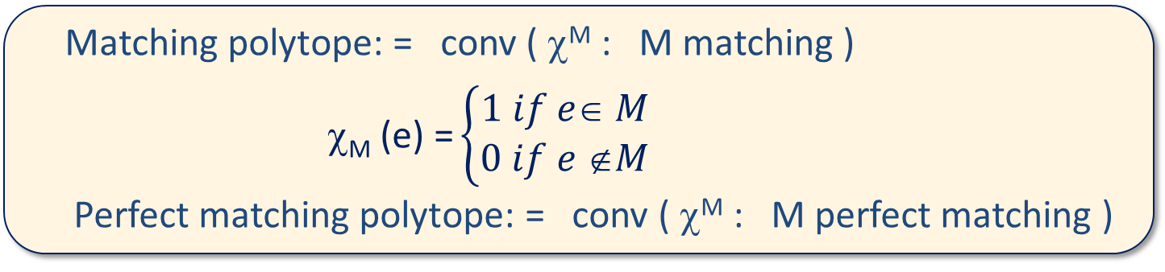
Augmenting Paths
augmenting path with respect to matching M : path alternating
between M and E \ M with the 2 endpoints uncovered by M.
G graph, M matching in G.
M is a maximum matching in G iff there is no augmenting path
Proposition (Berge) :
Matching polytope: = conv ( χ^{M} : M matching )
χ_{M} (e) = $\left\{\begin{aligned}1 if e∈ M \\ 0 if e ∉M\end{aligned}\right.$
Perfect matching polytope: = conv ( χ^{M} : M perfect matching )

Slide 7
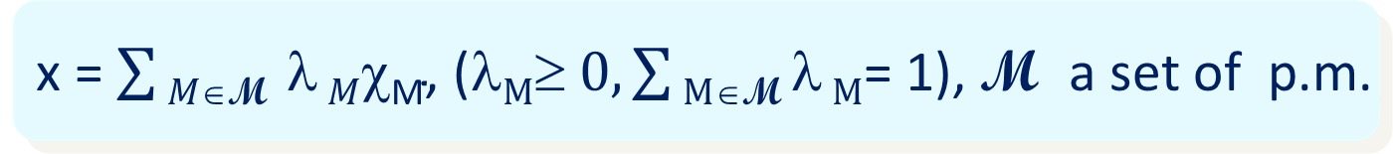
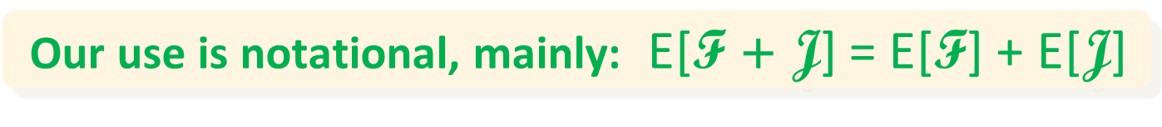
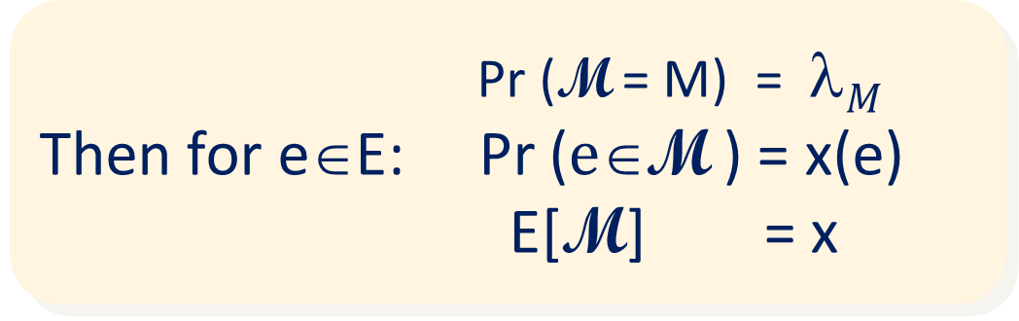
Interpretation with random sampling
x = $\sum{M∈\text{M} \text{λ}}M\text{χ}\text{M}\text{,} \text{(}\text{λ}M≥\text{ 0}, \sum{M∈\text{M} \text{λ}}M\text{= 1}\text{), }\text{M} \text{a} \text{set} \text{of} \text{p}\text{.}\text{m}\text{.}$
$\text{M}$ can be viewed as a p.m. valued random variable
Pr ($\text{M}$ = M) = λ$M$
Then for e∈E: Pr ($e\text{∈}\text{M}$ ) = x(e)
E[$\text{M}$] = x
Particular distributions (max entropy, or comb. restrictions)
Our use is notational, mainly: E[$\text{F}\text{ + }\text{J}\text{]}$ = E[$\text{F}\text{]}$ + E[$\text{J}\text{]}$

Slide 8
Matching and vertex cover
matching : M set of vertex-disjoint edges
Max |M| : υ
vertex cover : T set of vertices so that G-T has no edges
Min |T| : τ
υ τ
≤
Notes:
To make sure we use the same terms

Slide 9
Min max
Theorem (Kőnig) : If G=(V,E) is bipartite, then υ(G)= τ(G)
Exercise 1.2
Proof: ≤ is the proven ‘easy part’; ≥ is to be proved:
If for some v ∈ V : ν(G – v) = ν (G) – 1 , by induction :
ν (G) = ν(G – v) +1 = τ(G – v) + 1 ≥ τ (G) .
If uv ∈ E then either u or v satisfy this condition !
Q.E.D.
Exercise 1.1

Slide 10
2. Edge-coloring
Def : G=(V,E). edge-coloring : each color is a matching
Edge-chromatic number = chromatic index = χ’ :=min n. of colors

Slide 11
Bipartite edge-coloring
Theorem (Kőnig) : If G=(V,E) is bipartite, then χ’(G)= Δ(G)
Exercise 2.2
Proof: Now ≥ is now the ‘easy part’; ≤ is to be proved:
If uv ∈ E is not yet colored then u , v both miss some color !
If it is the same color or can be recolored so : DONE
If not, they are joined by an even path:
Q.E.D.
v
Exercise 2.1
u

Slide 12
Tashkinov tree 1
v
v
Exercise 2.3
BFS tree F from {u,v,uv} using
only edges whose color has
already been missed before
u
u
There is a common missing color in u and N(u) on F
⇒ uv can be colored
v
v
v
u
u
u

Slide 13
Tashkinov tree 2
b. There are two neighbors of u in F missing the same color
⇒ uv can be colored
swap a red-green component
v
v
→
u
u
Reduced to Case a.

Slide 14
Vizing’s theorem
Theorem: If G=(V,E) is simple, then χ(G) ≤ Δ(G) +1
Exercise 2.4
Proof: Color as much as you can with Δ(G) +1 colors.
Then : every vertex has always a missing color !
v
Exercise 2.3
u
either a. or b. :
a. There is a common missing color in u and N(u) on F
b. There are two neighbors of u in F missing the same color
either ⇒ uv can be colored
…

Slide 15
Tashkinov’s theorem
Generalizing the above proof :
Theorem: If such a BFS tree has two vertices missing
the same color, then all colored edges +
edge uv can be colored .
Corollaries: Better and better edge-coloring

Slide 16
3. Algorithms
Method of variables, class RP
Exact Matchings
Edmonds’algorithm

Slide 17
The method of variables
(Tutte, Lovász, Geelen,…)
G = (A, B, E) bipartite, |A|=|B|. M := (x_{ij} if ij ∈ E, else 0 )_{n×n} :
Proposition : det(M) is a nonzero polynomial ⬄ ∃ perfect matching
Proof : All terms of M are different, so there is no cancellation.
n! Terms, but determinants can be computed in polynomial time :
randomized algorithm: substitute values and then compute !
Questions : If then the det is nonzero can we conclude ?
If it is zero ?
What to do for nonbipartite graphs ?

Slide 18
The method of variables
The probability of error, precisely
Lemma: (Schwartz, Zippel) Let q be a nonzero polynomial of n variables
x₁,…, x_{n}, and let it be of degree d ; S ⊆ IN is finite, s:=|S|. Moreover, let
X₁,…, X_{n} be random variables taken independently and uniformly from S.
Then Pr (q(X₁,…, X_{n})=0) ≤ d/s .
Proof: For n=1 obvious. Let p∈Q[x₁,…, x_{n-1}] the coefficient of the highest power μ of x_{n} , and let π be the degree of p.
Pr (q(X₁,…, X_{n})=0)≤ Pr (p(X₁,…, X_{n-1})=0) + Pr (q(X₁,…, X_{n})=0 |p(X₁,…, X_{n-1}) ≠0)
≤ π /s + μ /s ≤ d/s
Notes:
Pr(X) = Pr(X,Y) + Pr(X, neg Y) \le Pr(Y) + Pr(X | neg Y) Pr(neg Y) delete the last multiplyers

Slide 19
The method of variables
A Randomized Algorithm
Oracle Algorithm :
An oracle tells the substitution values of a polynomial in pol(deg) time.
Let S = {1,…,2n}.
Make independent uniform choices in S for each variable.
Compute the polynomial (oracle call) for the chosen values.
If ≠ 0 : the polynomial is nonzero (∃ perfect matching)
If =0 ? We decide: no perfect matching: Pr (error) ≤ ½
Why not bigger S ? Better to choose |S| = const x deg and repeat !
Proposition : After O( log 1/ε ) repetitions Pr (error ) ≤ ε

Slide 20
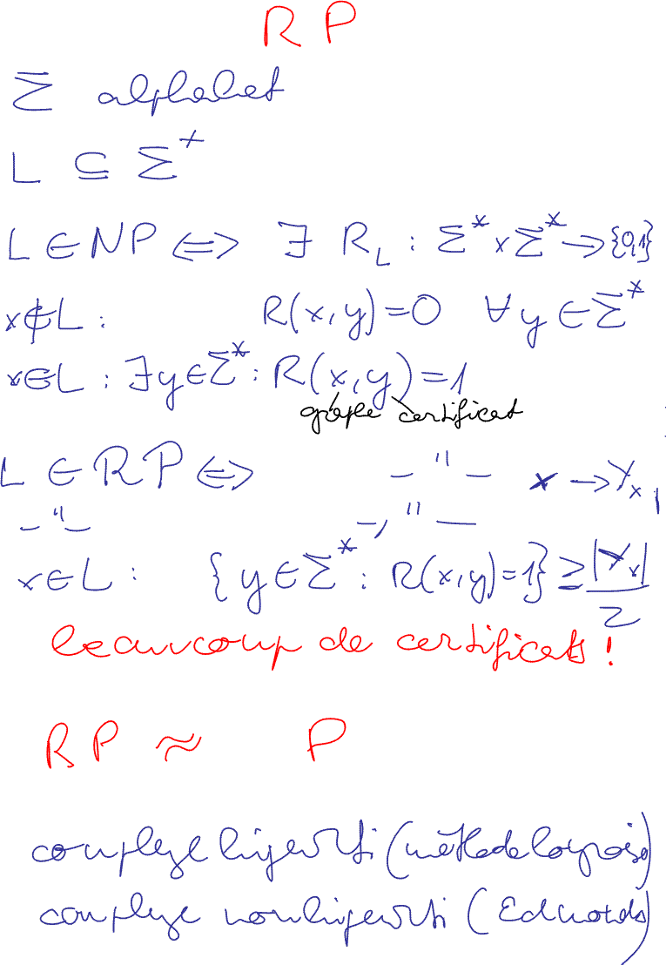
The complexity class P ⊆ RP ⊆ NP
Imagine : x= a graph, y the certificate (eg a substitution with ≠0 polynomial value )
.
The same def as NP but there are many certificates : constant proportion

Slide 21
Randomized algorithms for matching generalizations
RP thought of ≅ P
G = (A, B, E) bipartite, n= |A|=|B|. M := (x_{ij} if ij ∈ E, else 0 )_{n×n}
G = (V, E), n= |V| skew symm M := (x_{ij}= -x_{ji} if ij ∈ E, else 0 )_{n×n}
`Tutte matrix’ : square of the `Pfaffian’. Good for testing !
Path matchings (Cunningham, Geelen)
Exact matching: Given R⊆E, k∈IN, a max matching M, |M∩R|=k.
∃ Exact matching ⇔ multiplying x_{ij} for ij ∈R by y in the Tutte matrix,
the coeff of y^{k} is not the 0 pol: ∀substitution this pol can be evaluated
with n+1 x n+1 lin equ; ∈ RP (Lovász 1979) and not known to be in P !

Slide 22
Approximation for exact matchings
Theorem : (Yuster 2012) G=(V,E) graph, R⊆ E , k ∈ IN, then
Exactly one of the following possibilities holds :
(i) Each maximum matching of G meets R in < k edges.
(ii) Each maximum matching of G meets R in > k edges.
(iii) There exists a matching of size at least υ(G) – 1
that meets R in = k edges
Remark: (i), (ii) certified, checked in polytime (weighted match.)
Proof: If neither (i) nor (ii) holds,
Then M₁ : R-min max matching
M₂ : R-max max matching
How to have 3 red ?
Additive error of 1

Slide 23
Tutte-Berge theorem
Theorem : Let G=(V,E) be a graph. Then the minimum, over all
matchings M of the number of uncovered vertices of V =
max { q(X) - |X| : X ⊆ V }
Def : q(X) is the n. of comps of G-X having an odd number of vertices
Proof : ≥ : easy.
Exercise 1.4
We can adapt the proof of Kőnig’s theorem:
- If ν (G – v) = ν (G) – 1 , induction is easy.
≤ :
- If ν (G – u) = ν (G - v) = ν (G), apply Exercises 1.1, 1.3, 1.5 extended.
Hint : Observe that the new vertex is unconvered by a (actually two) maximum matching of the contracted graph. Can it be in X ? See Exercise 1.5.
Q.E.D.

Slide 24
Edmonds’ algorithm
Grow an (inclusionwise max) alternating forest F rooted in uncovered vertices
If two even vertices are adjacent
a.) between 2 different components : augment
b.) in the same component :
Adapt Exercise 1.3 to this case.
Heureka you shrink ! (Edmonds)
In both cases GOTO 1 (possibly using the actual forest).
If there is no edge between the even vertices STOP
X:= odd vertices
root
even
odd
Theorem : X is a Tutte-set and F is a maximum matching

Slide 25
Summary of algorithms for matchings
Unweighted :
- Algorithms for bipartite graphs: paths in digraphs;
- Method of variables
- Edmonds’ algorithm;
- Structural algorithms (for matchings by Lovász, S.:T-joins, b-match)
Weighted : Mainly two possibilities
- Primal-Dual framework with max cardinality subroutine
- Ellipsoid method

