Slide 1
E-Comics Protection
Avnish Kumar
Bachelor of Technology
Electrical Engineering, IInd Year
Indian Institute of Technology Roorkee, India
Supervisors:
William Puech
Mickael Pinto

Slide 2
Presentation Plan
Introduction
Objective
Step-by-Step Process
Step Taken so far
Proposed Plan
Conclusion

Slide 3
Presentation Plan
Introduction
Objective
Step-by-Step Process
Step Taken so far
Proposed Plan
Conclusion

Slide 4
Introduction
Several companies propose to transform comics into digital form and publish it directly on their website.
Major problem is to protect the digital content of comics.
Classical DRM Technology have an application, which protect the digital content, but one non-authorized user can break the application and can read and also distribute the digital version of comics.

Slide 5
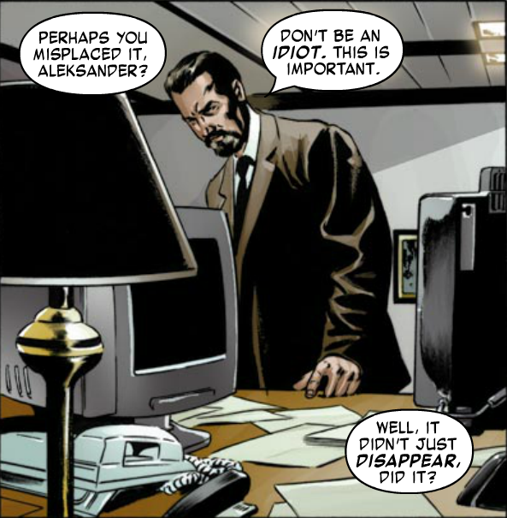
We can do selective encryption during the JPEG compression to blur the e-comic image, which can make it unreadable to non-authorized user.
It will me more interesting, if It is also possible to only encrypt some critical part of e-comics as bubble in order to appreciate the quality and coloring of comics, which will help in marketing purposes.

Slide 6
Presentation Plan
Introduction
Objective
Step-by-Step Process
Step Taken so far
Proposed Plan
Conclusion

Slide 7
Objective
Apart from DRM technology and their application, my objective is to encrypt only the text-bubble part of comic image.
I have to apply Selective reversible encryption during JPEG compression, which can be decrypt only by authorized user having secret key.
For selective encryption of text-bubble, firstly have to detect text-bubble from the Comic image.

Slide 8
Presentation Plan
Introduction
Objective
Step-by-Step Process
Step Taken so far
Conclusion

Slide 9
Step-by-Step Process
Bubble detection :
In typical comic Image, text-bubble usually has white background.
  Thresholding
  Morphology Filter ( dilation and erosion)
  Blob classification
Selective reversible encryption during JPEG compression
  SE is performed in Huffman coding stage of JPEG algorithm without affecting the size of compressed image.

Slide 10
Presentation Plan
Introduction
Objective
Step-by-Step Process : Proposed
Step Taken so far
Proposed Plan
Conclusion

Slide 11
Step Taken so far
Text - bubble detection
  Thresholding by taking threshold value 200
  Dilation of binarize image for merging neighbor white pixel.
  Erosion of dilated image for getting back original image.
  after dilation, I got increased white pixel, so by eroding get back to original image.

Slide 12
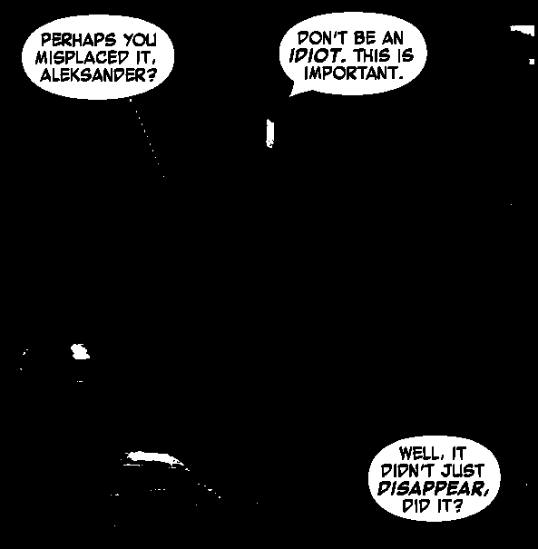
Thresholding
Original Image
Binarize Image

Slide 13

Morphology filter (Dilation and Erosion)
Binarize Image
Final Image after Dilation & Erosion

Slide 14
Presentation Plan
Introduction
Objective
Step-by-Step Process : Proposed
Step Taken so far
Proposed Plan
Conclusion

Slide 15
Proposed Plan
Thresholding
Morphology filter
  Dilation
  Erosion
Blob extraction : after blob extraction, we will get,
  Balloon blob
  Non- balloon blob
Blob classification

Slide 16
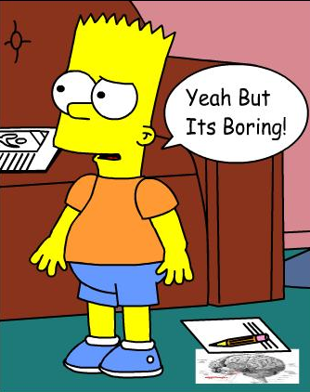
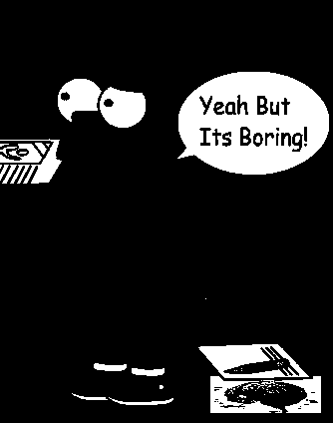
Thresholding
Original Image
Binarize Image

Slide 17
Blob Classification
Classification conditions:
  Minimum size of blob is about
  [Image. Height]/10 and [Image. Width]/8 of original comic image.
  Blob height size is less than 1.5 of blob width size.

Slide 18
Presentation Plan
Introduction
Objective
Step-by-Step Process : Proposed
Step Taken so far
Proposed Plan
Conclusion

Slide 19
Conclusion
After Thresholding, morphology filtering, blob extraction and classification, we can detect the balloon (ROI).
After detecting bubbles, we can do selective encryption during JPEG compression to blur the bubble part of comic image, which will make it good for marketing purposes. One can appreciate the quality and coloring of Image.

Slide 20


Slide 21

Any Questions

