Slide 1
Some indexing problems addressed by Amadeus, Gaia and PetaSky projects
Sofian Maabout
University of Bordeaux

Slide 2
Cross fertilization
All three projects
  process astrophysical data
  gather astrophysicists and computer scientists
Their aim is to optimize data analysis
  Astrophysicist know which queries to ask ➔ computer scientists propose indexing techniques ☺
  Computer scientists propose new techniques for new classes of queries ➔ Are these queries interesting for astrophysicists? ☺ ☺
  Astrophysicist want to perform some analysis. This doesn’t correspond to a previously studied problem in computer science➔ New problem with new solution which is useful. ☺ ☺ ☺

Slide 3
Overview
Functional dependencies extraction (compact data structures)
Multi-dimensionsional skyline queries (indexing with partial materialization)
Indexing data for spatial join queries
Indexing under new data management frameworks (e.g., Hadoop)

Slide 4
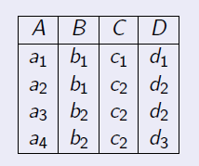
Functional Dependencies
D→C is valid
B→C is not valid
A is a key
AC is a non minimal key
B is not a key
Useful information
If X→Y holds then using X instead of XY for, e.g., clustering is preferable
If X is a key then it is an identifier

Slide 5
Problem statement
Find all minimal FD’s that hold in a table T
Find all minimal keys that hold in a table T

Slide 6
Checking the validity of an FD/ a key
X→Y holds in T iff the size of the projection of T on X (noted |X|) is equal to |XY|
X is a key iff |X|= |T|
D→C holds because |D|=3 and |DC|=3
A is a key because |A|=4 and |T|=4

Slide 7
Hardness
Both problems are NP-Hard
  Use heuristics to traverse/prune the search space
  Parallelize the computation
Checking whether X is a key requires O(|T|) memory space
Checking X→Y requires O(|XY|) memory space

Slide 8
Distributed data: Does (T1 union T2) satisfy D→C?
A | B | C | D
a1 | b1 | c1 | d1
a2 | b1 | c2 | d2
A | B | C | D
a3 | b2 | c2 | d2
a4 | b2 | c2 | d3
T1
T2
Local satisfaction is not sufficient

Slide 9
Communication overhead: D→C?
Site 1
Site 2
A | B | C | D
a1 | b1 | c1 | d1
a2 | b1 | c2 | d2
A | B | C | D
a3 | b2 | c2 | d2
a4 | b2 | c2 | d3
Send T2(D) = { <d2>, <d3>} to Site 1
Send T2(CD)= { <c2;d2>, <c2; d3>} to Site1
T1(D) ∪ T2(D) = {<d1>, <d2>, <d3>}
T1(CD) ∪ T2(CD) = {<c1;d1>, <c2;d2>, <c2; d3>}
Verify the equality of the sizes

Slide 10
Compact data structure: Hyperloglog
Proposed by Flajolet et al, for estimating the number of distinct elements in a multiset.
Using O(log(log(n)) space for a result less than n !!
For a data set of size 1.5*10⁹.
  There are ~ 21*10⁶ distinct values.
  We need ~ 10Gb to find them
  With ~1Kb, HLL estimates this number with relative error less than 1%

Slide 11
Hyperloglog: A very intuitive overview
Traverse the data.
For each tuple t, hash(t) returns an integer.
Depending on hash(t), a cell in a vector of integers V of size ~log(log(n)) is updated.
At the end, V is a fingerprint of the encountered tuples.
F(V): returns an estimate of the number of distinct values
There exists a function Combine such that
Combine(V1, V2)=V. So, F(V)= F(combine(V1, V2))
  Transfer V2 to site 1 instead of T(D).

Slide 12
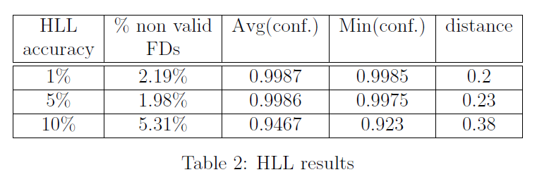
Hyperloglog: experiments
10⁷ tuples, 32 attributes
Conf(X→Y) = 1 – (#tuples to remove to satsify X->Y)/|T|
Distance = #attributes to remove to make the FD minimal

Slide 13
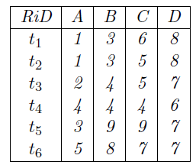
Skyline queries
Suppose we want to minimize the criteria.
t3 is dominated by t2 wrt A
t3 is dominated by t4 wrt CD

Slide 14
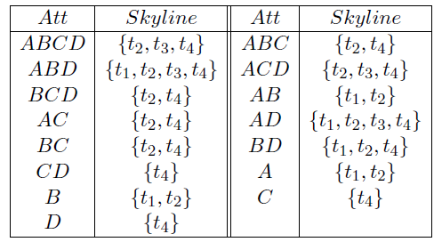
Example

Slide 15
Skycube
The skycube is the set of all skylines (2^{m} if m is the number of dimensions).
Optimize all these queries:
  Pre-compute them
  Pre-compute a subset of skylines that is helpful

Slide 16
The skyline is not monotonic
Sky(ABD) ⊄ Sky(ABCD)
Sky(AC) ⊄ Sky(A)

Slide 17

A case of inclusion
Thm: If X→Y holds then Sky(X) ⊆ Sky(XY)
The minimal FD’s that hold in T are

Slide 18
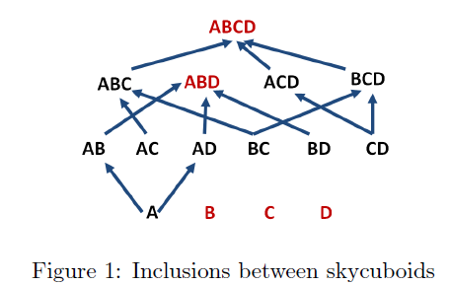
Example
The skylines inclusions we derive from the FD’s are:

Slide 19
Example
Red nodes: closed attributes sets.

Slide 20
Solution
Pre-compute only skylines wrt to closed attributes sets. These are sufficient to answer all skyline queries.

Slide 21
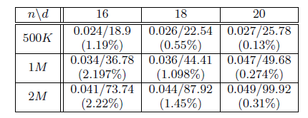
Experiments: 10^3 queries
0.31% out of the 2^20 queries are materialized.
49 ms to answer 1K skyline queries from the materialized ones instead of
99.92 seconds from the underlying data.
Speed up > 2000
21

Slide 22
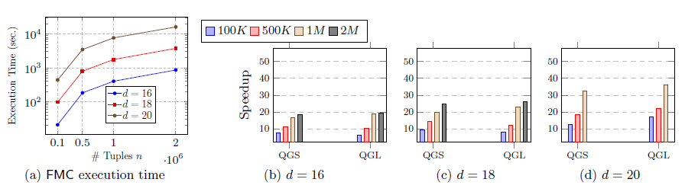
Experiments: Full skycube materialization

Slide 23
Distance Join Queries
This is a pairwise comparison operation:
  t₁ is joined with t₂ iff dist(t₁, t₂) ≤δ
Naïve implementation: O(n²)
How to process it in Map-Reduce paradigm?
Rational:
  Map: if t1 and t2 have a chance to be close then they should map to the same key
  Reduce: compare the tuples associated with the same key

Slide 24
Distance Join Queries
  Close objects should map to the same key
  A key identifies an area
  Objects in the border of an are can be close to objects of a neighbor area ➔ one object mapped to multiple keys.
  Scan the data to collect statistics about data distribution in a tree-like structure (Adaptive Grid)
  The structure defines a mapping : R² → Areas

Slide 25
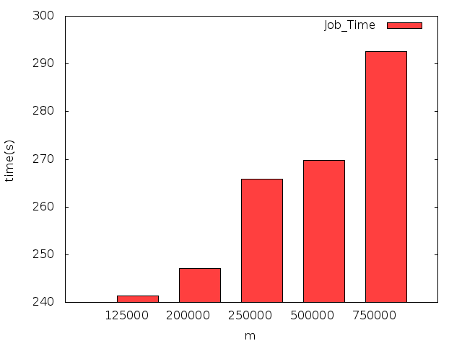
Scalability

Slide 26
Hadoop experiments
Classical SQL queries
  Selection, grouping, order by, UDF
HadoopDB vs. Hive
Index vs. No index
Partioning impact

Slide 27
Data
Table | size | #records | #attributes
Object | 109 TB | 38 B | 470
Moving Object | 5 GB | 6 M | 100
Source | 3.6 PB | 5 T | 125
Forced Source | 1.1 PB | 32 T | 7
Difference Image Source | 71 TB | 200 B | 65
CCD Exposure | 0.6 TB | 17 B | 45

Slide 28
Queries
id | Syntaxe SQL
Q1 | select * from source where sourceid=29785473054213321;
Q2 | select sourceid, ra,decl from source where objectid=402386896042823;
Q3 | select sourceid, objectid from source where ra > 359.959 and ra < 359.96 and decl < 2.05 and decl > 2;
Q4 | select sourceid, ra,decl from source where scienceccdexposureid=454490250461;
Q5 | select objectid,count(sourceid) from source where ra > 359.959 and ra < 359.96 and decl < 2.05 and decl > 2 group by objectid; 2-6 returned tuples
Q6 | select objectid,count(sourceid) from source group by objectid; ~ 30*10^6 tuples
Q7 | select * from source join object on (source.objectid=object.objectid) where ra > 359.959 and ra < 359.96 and decl < 2.05 and decl > 2;
Q8 | select * from source join object on (source.objectid=object.objectid) where ra > 359.959 and ra < 359.96;
Q9 | SELECT s.psfFlux, s.psfFluxSigma, sce.exposureType FROM Source s JOIN RefSrcMatch rsm ON (s.sourceId = rsm.sourceId) JOIN Science_Ccd_Exposure_Metadata sce ON (s.scienceCcdExposureId = sce.scienceCcdExposureId) WHERE s.ra > 359.959 and s.ra < 359.96 and s.decl < 2.05 and s.decl > 2 and s.filterId = 2 and rsm.refObjectId is not NULL;
Selection
Group By
join

Slide 29
Lessons
Hive is better than HDB for non selective queries
HDB is better than Hive for selective queries

Slide 30
Partitioning attribute: SourceID vs ObjectID
Q5 and Q6 group the tuples by ObjectID.
If the tuples are physically grouped by SourceID then the queries are penalized.

Slide 31
Conclusion
Compact data structures are unavoidable when addressing large data sets (communication)
Distributed data is de facto the realistic setting for large data sets
New indexing techniques for new classes of queries
Need of experiments to understand new tools
  Limitations of indexing possibilities
  Impact of data partitioning
  No automatic physical design

