Slide 1
Methods and challenges in the analysis of admixed human genomes
Simon Gravel
Stanford University

Slide 2
An individual is admixed if its ancestors from G generations ago belong to distinct groups.
Map from National Geographic

Slide 3
Admixed populations are underrepresented in medical genetics
96% of participants in genome-wide association studies are of European origin, because of
Geography/politics
Europeans are a model organism
“More statistically uniform”

Slide 4
Goals
Develop detailed quantitative models of human evolution
Understand the impact of gene flow on genetic diversity patterns
Empower medical association studies

Slide 5
Everyone is admixed
Yoruba-European
Gravel et al, PNAS 108, 11983 (2011)
Notes:
Legend details
Animate?
Pick relevant ones
Clarify label
Increase font size
Han

Slide 6
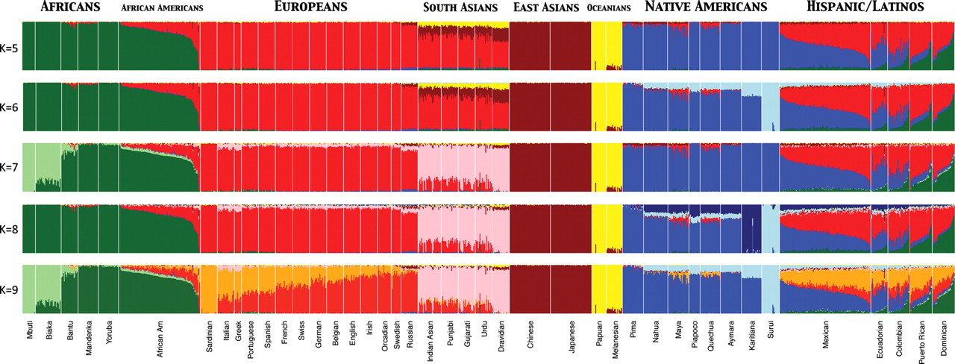
Global population structure
Henn*, Gravel*, et al, Hum. Mol. Genet. 19, R221 (2010)
Notes:
Population structure of worldwide human populations. Individual ancestry proportions are shown for 1112 individuals from 42 different populations globally distributed (from left to right: 114 Africans, 100 African-Americans, 255 Europeans, 108 South Asians, 100 East Asians, 36 Oceanians, 186 Native Americans and 212 Hispanic/Latinos). Each individual is represented by a vertical line on each barplot and sorted in the same order across panels. A clustering algorithm (implemented in ADMIXTURE) was used to infer global genome estimates from K = 5 up to K = 9 ancestral populations per individual. At K = 5 clusters roughly correspond to continental regions and at K = 9 fine-scale subcontinental structure can be detected (note the South–North gradient in Europeans and the light blue component decreasing from North to South in Native Americans). Admixed populations such as African-Americans and Hispanic/Latinos show dramatic variation in admixture proportions between individuals within populations and among populations. The plot was generated using 73 901 autosomal SNP markers by intersecting genome-wide genotype data from four publicly available data sets [i.e. HGDP (7), POPRES (26), data from Mao et al. (55) and data from Bryc et al. (21)].

Slide 7
Wright-Fisher Simulations

Slide 8
Variance in ancestry across individuals: simulations

Slide 9
Variance in ancestry across individuals: Models

Slide 10
Variance in ancestry across individuals: Models

Slide 11
Variance in ancestry across individuals: Models

Slide 12
Variance in ancestry across individuals: Models

Slide 13
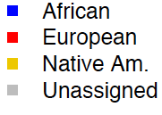
Ancestry Varies Along The Genome
Mexican-American
Local ancestry inferred from phased HapMap3 SNPs
88% Native American, 11% European, and 1.5% African segments
African
European
Native American
Unassigned
Assembly gap
Kidd*, Gravel* et al (in Review)
Notes:
Give % Genome Stats…

Slide 14
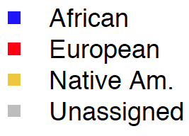
Ancestry Varies Along The Genome
ASW1
MXL1
African-American
Mexican
Kidd*, Gravel* et al (in Review)
Notes:
Give % Genome Stats…

Slide 15
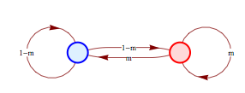
Modeling ancestry tracts using a Markov model
T₁
Each recombination occurs independently, giving rise to
a Poisson process.
(Work in genetic units)
Gravel S, Genetics 191, 607 (2012)
Notes:
Fonts

Slide 16
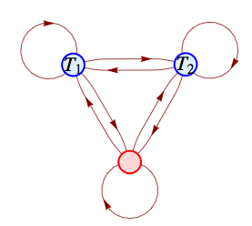
More complex demographic histories can be modeled via multiple-state Markov model
T₁
T₂
The entire demographic history contained in the transition matrix
Gravel S, Genetics 191, 607 (2012)

Slide 17
Markov model vs simulation
Gravel S, Genetics 191, 607 (2012)

Slide 18
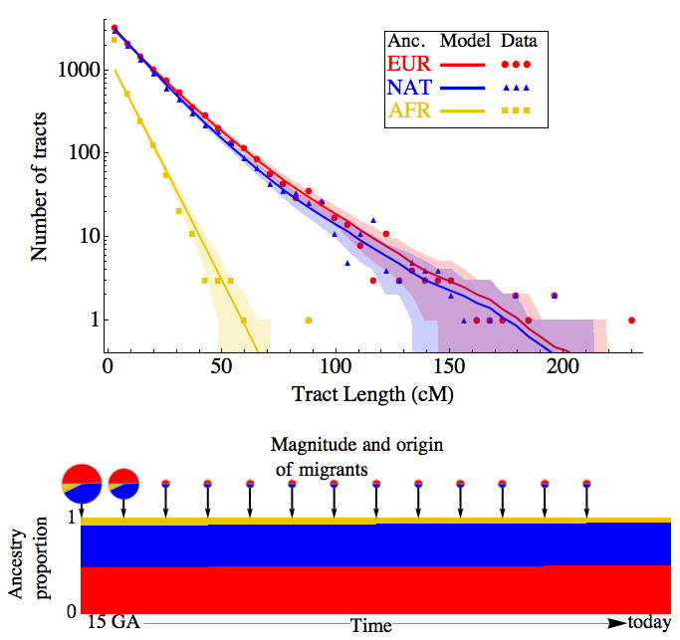
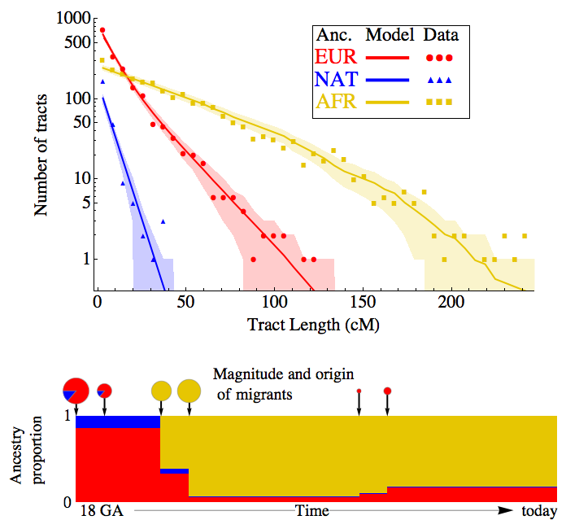
Evidence for continuous gene flow
African-Americans
Mexican-Americans
18 GA
15 GA
Gravel S, Genetics 191, 607 (2012)
Kidd*, Gravel* et al (in Review)

Slide 19
Summary
Proposed detailed models of linkage patterns in admixed populations
Found evidence for continuous gene flow in many populations
We can learn about recent admixture, and older demography of highly admixed populations
Results are consistent with historical records

Slide 20
Challenges
Finer scale admixture:
Local ancestry assignment difficult/impossible
Large number of source populations
Population genetics
Expand single-population, panmictic models to models with population structure
Medical genetics
Facilitate inclusion of all individuals in medical association studies

Slide 21
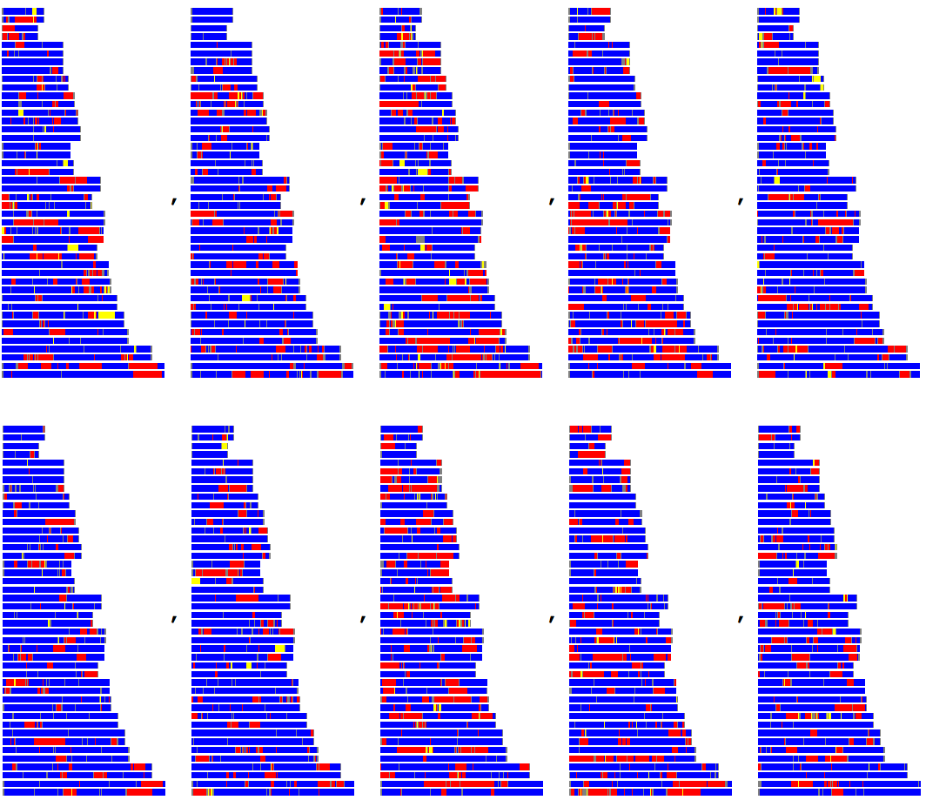
Thanks to
Stanford
Carlos Bustamante
Jake Byrnes
Brenna Henn
Jeff Kidd
Andres Moreno
Patricia Ortiz-Tello
Fouad Zakharia
NHLBI exome sequencing project
1000 Genomes Project

Slide 22
Ancestry statistics
Global Ancestry
Tract Lengths
X-vs-Autosomes
Variance across individuals
Local ancestry fluctuations
Demography of source populations
Kidd*, Gravel* et al (in Review)

Slide 23
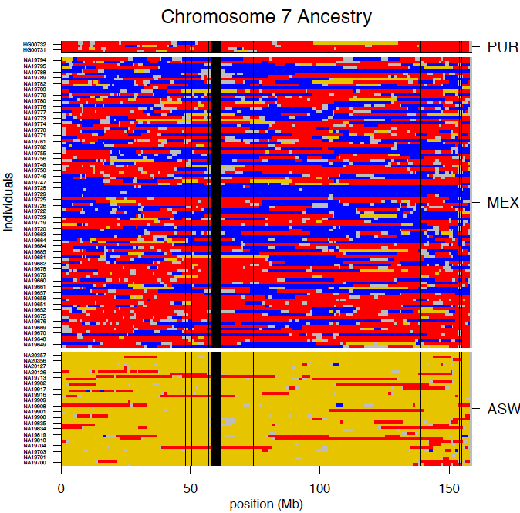
Modeling the admixture process
Individuals
Position (Mb)
Kidd*, Gravel* et al (in Review)

Slide 24
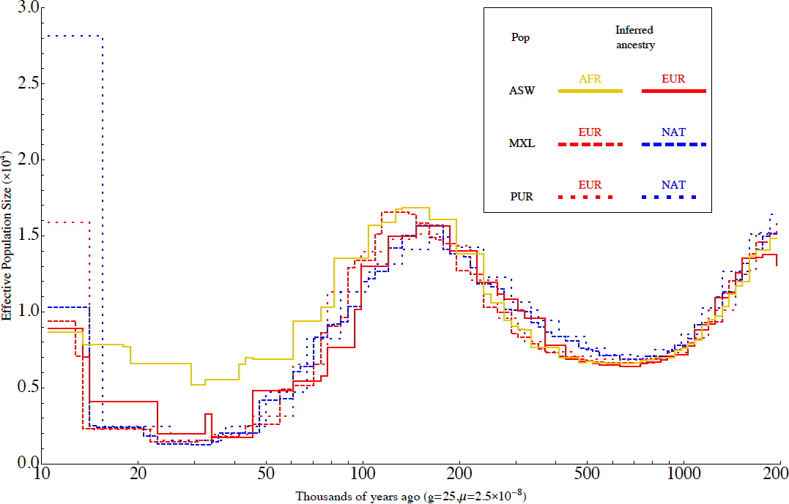
Demography estimates using coalescent approach
Effective population size (x10⁴)
2000
Thousands of years ago
Kidd*, Gravel* et al (in Review)

Slide 25
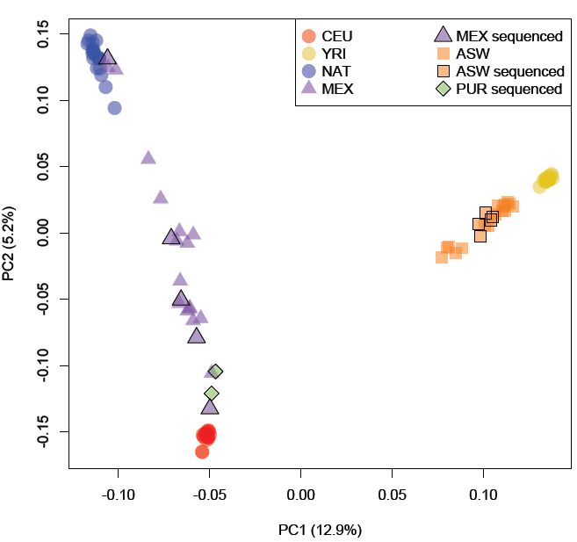
Analyzing admixed populations
Native Americans
European
Yorubans
Mexicans
African Americans (ASW)
African-Americans
Puerto Ricans
West African
Europeans
Kidd*, Gravel* et al (in Review)
Notes:
Explicit legends
Principle components analysis including the HapMap 3 Mexicans and African
Americans. After filtering for autosomal markers and reduced LD, this PCA was performed
on 673K SNPs.

Slide 26
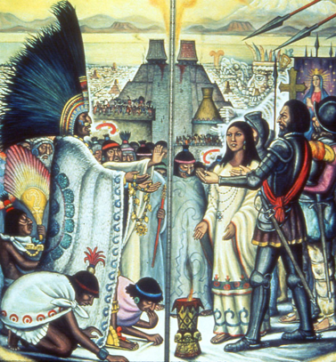
Comparing with slave trade records
Slave Trade [1500-1860]
Hernan Cortes [1519]
North America
Spanish Central America

Slide 27
The simplest model of admixture
T₁
time

