Slide 1
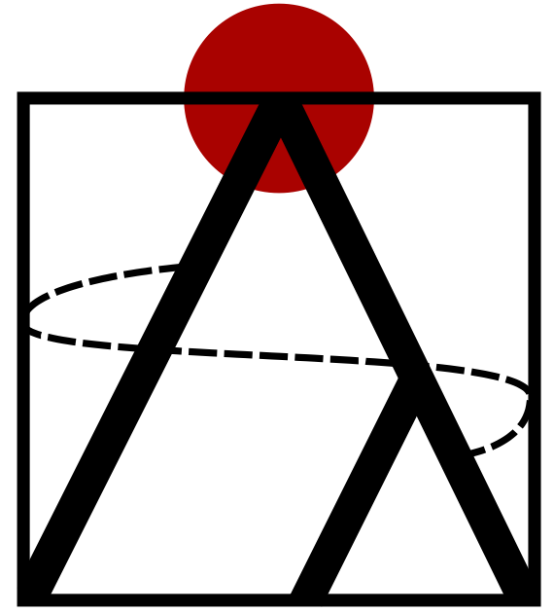
Genome-scale phylogenomics
Bastien Boussau
Huelsenbeck lab, Dept. of Integrative Biology, UC Berkeley
LBBE, CNRS, Université de Lyon
Notes:
Good afternoon and thank you for being here. I would like to present you methods that I have developed to study genome evolution, and more precisely to jointly reconstruct species and gene trees for complete genomes.

Slide 2
Collaborators
LBBE collaborators: Gergely Szöllősi, Laurent Duret, Manolo Gouy, Sophie Abby, Eric Tannier, Vincent Daubin
John Huelsenbeck and the Huelsenbeck lab at UC Berkeley
Poster 30: Efficient Exploration of the Space of Reconciled Gene Trees
Notes:
This first example of an integrative model of genome evolution, PHYLDOG, shows that these integrative approaches can provide better inferences of genome and species evolution, even for large datasets such as for multicellular organisms.
In unicellular organisms, another type of event can also be used by these integrative models: gene transfers. For instance, in collaboration with colleagues from Lyon, we have developed a model incorporating gene transfers in addition to duplications and losses. To illustrate how integrative models can inform genome and species evolution, I will show you how we use this model to help date the tree of life.

Slide 3
Why the tautological title?
“Phylogenomic” has been used to describe attempts at reconstructing species trees based on 10-100 genes
We are interested in the species tree, but also in genome evolution
A genome can contains >20,000 genes
Genome-scale: thousands of genes, dozens of species
Notes:
This first example of an integrative model of genome evolution, PHYLDOG, shows that these integrative approaches can provide better inferences of genome and species evolution, even for large datasets such as for multicellular organisms.
In unicellular organisms, another type of event can also be used by these integrative models: gene transfers. For instance, in collaboration with colleagues from Lyon, we have developed a model incorporating gene transfers in addition to duplications and losses. To illustrate how integrative models can inform genome and species evolution, I will show you how we use this model to help date the tree of life.

Slide 4
Genomes, Genes, gene families, gene trees and species trees
Genome
Gene
Homo sapiens; GeneA: ACTGGTGATGACATGAC…
Homo sapiens;
Homo sapiens;
Mus musculus;
Mus musculus;
Bison bison;
Canis lupus;
GeneA: ACTGGTGATGACATAAC…
GeneB: ACTGTTGATGACATGAC…
GeneC: ACTGATGATGACAAGAC…
GeneD: ACTGGTGA--CCATGAC…
GeneE: ACTGGTGATGACACGAC…
GeneF: ACT--TCATGAAACGAC…
Gene family alignment
Gene tree
Species trees
Notes:
Gene trees and species trees are intimately linked, as represented on this graph. Here the large structure represents a species tree, in which bifurcations represent speciation events. Inside the species tree, the thin lines represent the evolution of a gene family. Obviously the two structures are correlated, as speciation events, that occur at the level of the species tree, are also found in the gene family tree. However you can see that not all bifurcations in the gene tree can be linked to speciation events (some can be linked to duplication events for instance), which means that the relationship between the bifurcations in the gene tree and the species tree is not a simple bijection, and we need specific methods to reconcile a gene tree with a species tree.
However, methods used to build gene and species trees tend to ignore parts or all of this interdependence and make very rough assumptions.

Slide 5
A graphical model for phylogenomics
Species tree
Species tree construction
Gene tree
Gene tree construction
Gene family alignment
Homology prediction
Alignment
Gene
Gene prediction
Genome sequences
Error correction, base calling, assembly
Raw sequences

Slide 6
The usual approach to reconstructing phylogenetic trees
Homo sapiens;
Homo sapiens;
Mus musculus;
Mus musculus;
Bison bison;
Canis lupus;
GeneA: ACTGGTGATGACATAAC…
GeneB: ACTGTTGATGACATGAC…
GeneC: ACTGATGATGACAAGAC…
GeneD: ACTGGTGA--CCATGAC…
GeneE: ACTGGTGATGACACGAC…
GeneF: ACT--TCATGAAACGAC…
Parsimony
Model-based approaches: e.g. Felsenstein pruning algorithm (1981) to compute P(alignment|Gene tree)
No species tree object in the usual approach

Slide 7
The gene tree graphical model
Gene tree
Felsenstein pruning algorithm (1981)
Gene alignment

Slide 8
The species tree-gene tree approach to reconstructing phylogenetic trees
Homo sapiens;
Homo sapiens;
Mus musculus;
Mus musculus;
Bison bison;
Canis lupus;
GeneA: ACTGGTGATGACATAAC…
GeneB: ACTGTTGATGACATGAC…
GeneC: ACTGATGATGACAAGAC…
GeneD: ACTGGTGA--CCATGAC…
GeneE: ACTGGTGATGACACGAC…
GeneF: ACT--TCATGAAACGAC…
P(alignment|Gene tree)
P(Gene tree|Species tree)
Felsenstein pruning algorithm (1981)
Many models and algorithms
P(alignment , Gene tree|Species tree) =P(alignment|Gene tree) x P(Gene tree|Species tree)

Slide 9
The species tree-gene tree graphical model
Species tree
Many models and algorithms
Gene tree
Felsenstein pruning algorithm (1981)
Gene alignment

Slide 10
Gene tree and species tree are linked
Boussau and Daubin, Tree 2010
Notes:
Gene trees and species trees are intimately linked, as represented on this graph. Here the large structure represents a species tree, in which bifurcations represent speciation events. Inside the species tree, the thin lines represent the evolution of a gene family. Obviously the two structures are correlated, as speciation events, that occur at the level of the species tree, are also found in the gene family tree. However you can see that not all bifurcations in the gene tree can be linked to speciation events (some can be linked to duplication events for instance), which means that the relationship between the bifurcations in the gene tree and the species tree is not a simple bijection, and we need specific methods to reconcile a gene tree with a species tree.
However, methods used to build gene and species trees tend to ignore parts or all of this interdependence and make very rough assumptions.

Slide 11
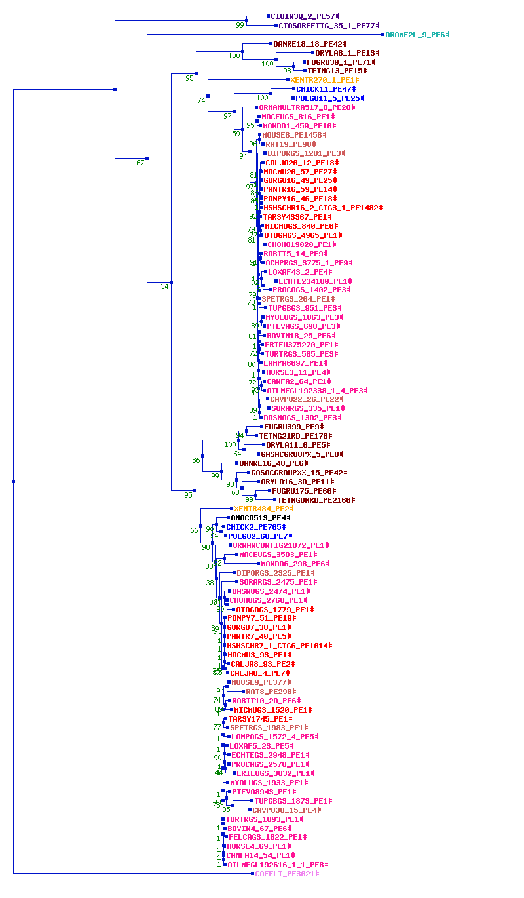
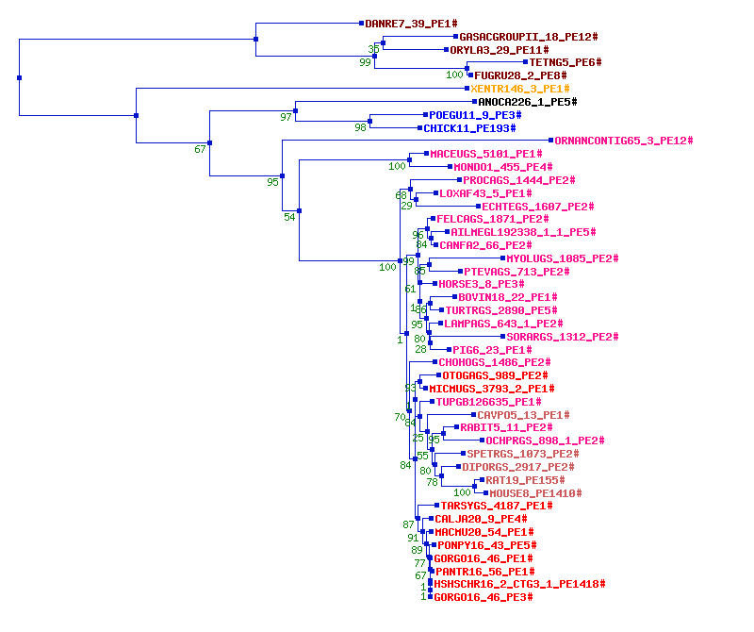
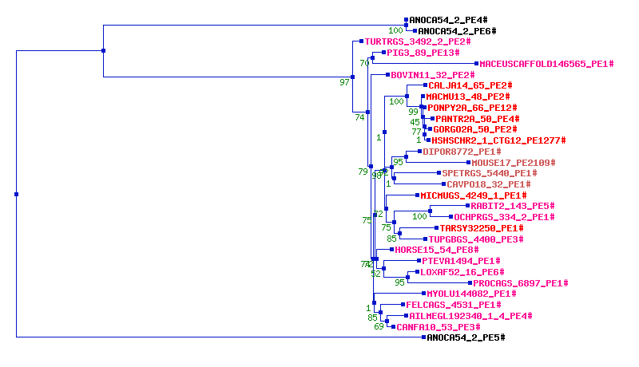
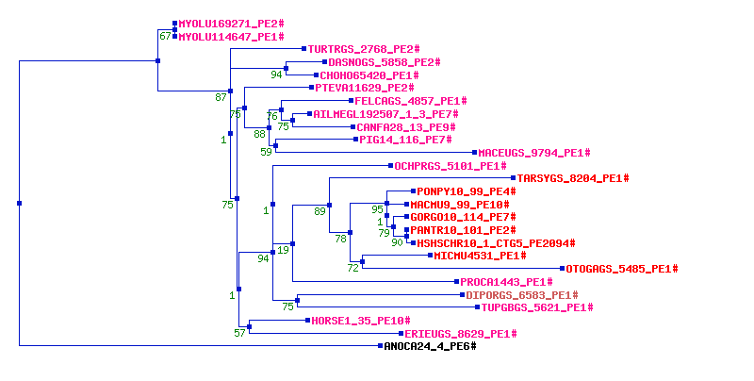
Gene trees from real data
Homolens database
Complex, messy, not to be trusted

Slide 12
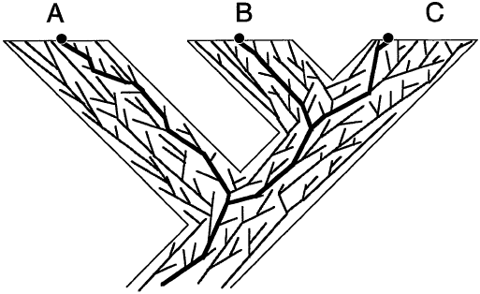
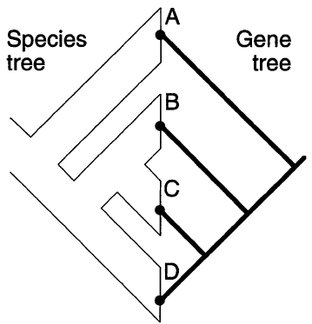
Gene trees in species trees
Maddison, Syst. Biol. 1997
Challenges
Given gene trees: reconstruct species tree
Given species tree and alignment: reconstruct gene tree
Given alignments: reconstruct genes and species trees

Slide 13
PHYLDOG
LGT:
exODT
ILS:
Thinking about it
D
DL
LGT
ILS
Notes:
I use these models to study species and genomic evolution.
Here I have represented a species tree with 4 species.
These genomes have a history, they have evolved alongside species. This means that to understand how genomes encode the phenotypic characteristics of an organism, one has to take into account the confounding factor that evolutionary history represents.
Genomes contain lots of genes. Inside genomes, gene families evolve. Some have a very simple evolution, such as this one, that has one gene per species. During gene family evolution, gene sequences evolve through base substitutions as well as insertion/deletion events.
However, most gene families have a more complex evolution than this one. For instance, some gene families undergo gene duplications. Other families undergo gene losses. Other families undergo gene transfers, that cross species boundaries.
Overall, although genomes have exactly the same history as species, there are lots of different histories for gene families. Properly studying genome evolution requires reconstructing all these peculiar gene family histories.
However, current phylogenetic methods only consider these most simple gene families, even though they represent less than 7% of all gene families in Drosophilids or less than 1% in Vertebrates for instance.
Therefore in this talk I will show you that I develop methods to use all gene families in the genomes, not just a few percent of them, to study genomic and phenotypic evolution.

Slide 14
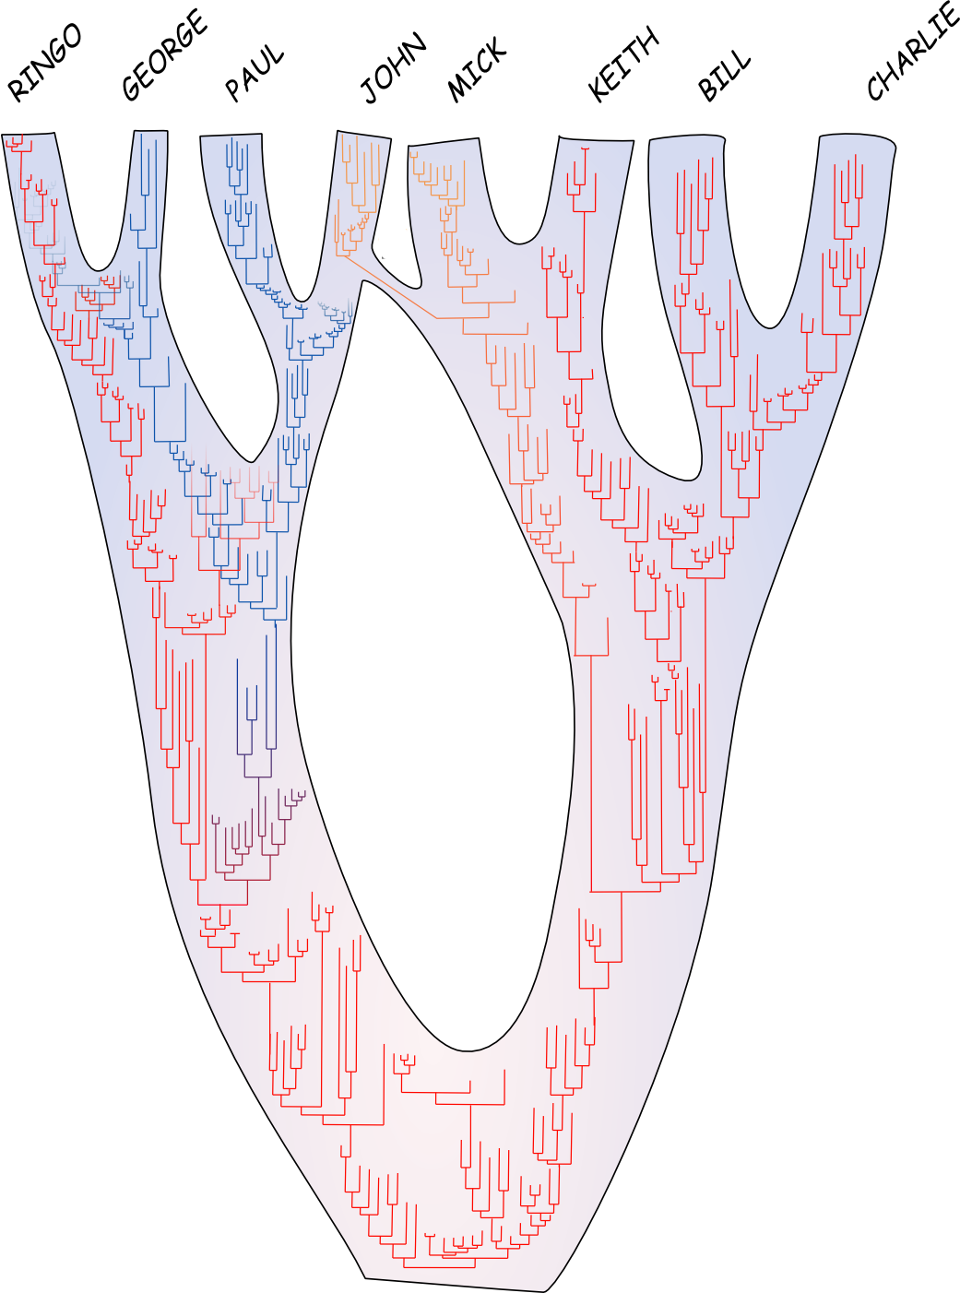
Plan
Modeling the relationship between species tree and gene tree
coalescent models (short!)
models of gene duplication and loss
models of gene transfer
models that combine the above
Results obtained using these models
Improving gene tree construction
Coestimation of gene and species trees
Inference of a species tree and time orders
Towards efficient Bayesian inference of gene trees and species trees

Slide 15
D
DL
LGT
ILS
Notes:
I use these models to study species and genomic evolution.
Here I have represented a species tree with 4 species.
These genomes have a history, they have evolved alongside species. This means that to understand how genomes encode the phenotypic characteristics of an organism, one has to take into account the confounding factor that evolutionary history represents.
Genomes contain lots of genes. Inside genomes, gene families evolve. Some have a very simple evolution, such as this one, that has one gene per species. During gene family evolution, gene sequences evolve through base substitutions as well as insertion/deletion events.
However, most gene families have a more complex evolution than this one. For instance, some gene families undergo gene duplications. Other families undergo gene losses. Other families undergo gene transfers, that cross species boundaries.
Overall, although genomes have exactly the same history as species, there are lots of different histories for gene families. Properly studying genome evolution requires reconstructing all these peculiar gene family histories.
However, current phylogenetic methods only consider these most simple gene families, even though they represent less than 7% of all gene families in Drosophilids or less than 1% in Vertebrates for instance.
Therefore in this talk I will show you that I develop methods to use all gene families in the genomes, not just a few percent of them, to study genomic and phenotypic evolution.

Slide 16
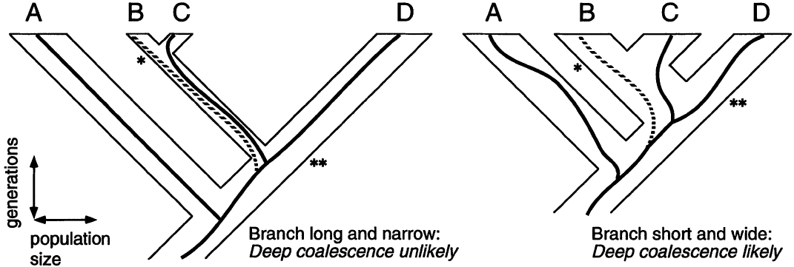
Incomplete lineage sorting
Degnan and Rosenberg, Syst. Biol. 2006
Maddison, Syst. Biol. 1997

Slide 17
Reconstructing species trees given ILS
Parsimony method: minimizing deep coalescences (Maddison 1997)
Distance method: NJst (Liu and Yu 2011)
Summary statistic methods: STAR (Liu et al, 2009), GLASS (Mossel and Roch 2010), iGLASS (Jewett and Rosenberg 2012)
Maximum Likelihood methods: STEM (Kubatko et al. 2009), MP-EST (Liu et al., 2010)
Bayesian methods: BeST (2007), *BEAST (Heled and Drummond, 2009)

Slide 18
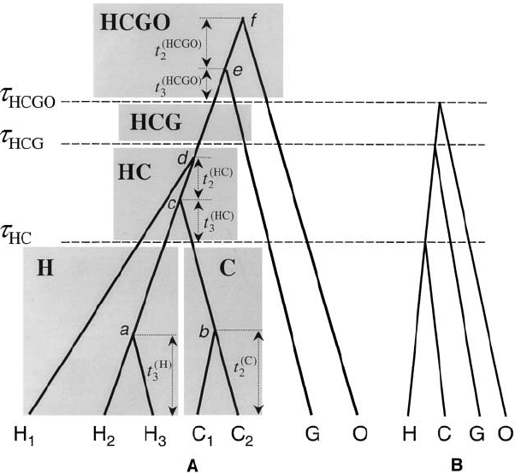
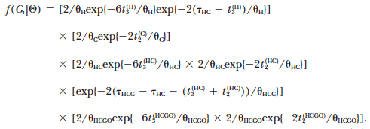
Likelihood of a gene tree given a species tree under the multi-species coalescent
Rannala and Yang, Genetics 2003

Slide 19
The species tree-gene tree graphical model with ILS
Species tree topology
T
r
Ne
Gene tree
Gene alignment

Slide 20
Plan
Modeling the relationship between species tree and gene tree
coalescent models (short!)
models of gene duplication and loss
models of gene transfer
models that combine the above
Results obtained using these models
Improving gene tree construction
Coestimation of gene and species trees
Inference of a species tree and time orders
Towards efficient Bayesian inference of gene trees and species trees

Slide 21
D
DL
LGT
ILS
Notes:
I use these models to study species and genomic evolution.
Here I have represented a species tree with 4 species.
These genomes have a history, they have evolved alongside species. This means that to understand how genomes encode the phenotypic characteristics of an organism, one has to take into account the confounding factor that evolutionary history represents.
Genomes contain lots of genes. Inside genomes, gene families evolve. Some have a very simple evolution, such as this one, that has one gene per species. During gene family evolution, gene sequences evolve through base substitutions as well as insertion/deletion events.
However, most gene families have a more complex evolution than this one. For instance, some gene families undergo gene duplications. Other families undergo gene losses. Other families undergo gene transfers, that cross species boundaries.
Overall, although genomes have exactly the same history as species, there are lots of different histories for gene families. Properly studying genome evolution requires reconstructing all these peculiar gene family histories.
However, current phylogenetic methods only consider these most simple gene families, even though they represent less than 7% of all gene families in Drosophilids or less than 1% in Vertebrates for instance.
Therefore in this talk I will show you that I develop methods to use all gene families in the genomes, not just a few percent of them, to study genomic and phenotypic evolution.

Slide 22
DL models
Reconciliation between a gene tree and a species tree:
Parsimony method: minimizing numbers of duplications (Goodman et al. 1979; Page 1994; Zmasek and Eddy 2001)
Model-based method: Arvestad et al. 2003, 2004, 2009; Görecki et al. 2011
Reconstruction of a gene tree given a species tree and alignment:
Parsimony method: Chen et al. 2000; Durand et al. 2006
Model-based method: Rasmussen and Kellis 2007, 2011; Akerborg et al. 2009; Sjöstrand et al. 2012
Reconstruction of a species tree given gene trees:
Parsimony methods: Page and Charleston 1997, Bansal et al. 2007; Wehe et al. 2008; Bansal et al. 2010; Chang et al. 2011
Joint reconstruction of gene and species trees given alignments:
Model-based method: Boussau et al., 2013

Slide 23
Parsimonious mapping a gene tree to a species tree
Zmasek and Eddy, Bioinf. 2001

Slide 24
Parsimonious mapping a gene tree to a species tree
Zmasek and Eddy, Bioinf. 2001

Slide 25
Parsimonious mapping a gene tree to a species tree
Zmasek and Eddy, Bioinf. 2001

Slide 26
Parsimonious mapping a gene tree to a species tree
Zmasek and Eddy, Bioinf. 2001

Slide 27
Parsimonious mapping a gene tree to a species tree
1 duplication
1 loss
Zmasek and Eddy, Bioinf. 2001

Slide 28
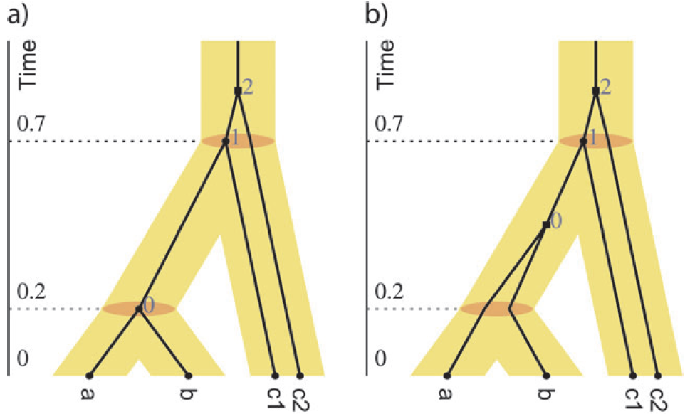
Many possible reconciliations
Need to integrate over all possible reconciliations
Sennblad and Lagergren, Syst. Biol. 2009

Slide 29
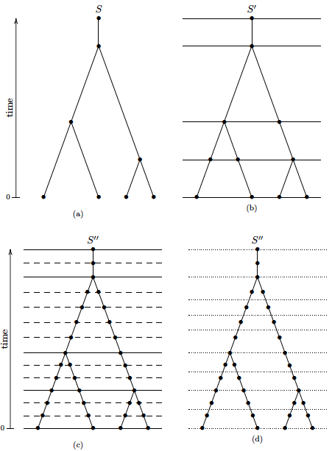
Considering all mappings: The species tree discretization approximation
Tofigh, PhD thesis
Mapping between a gene tree and species tree
⬄
Mapping between nodes of the gene tree and nodes of the augmented species tree
Integrating over all mappings: done through dynamic programming from the leaves of the gene tree to its root

Slide 30
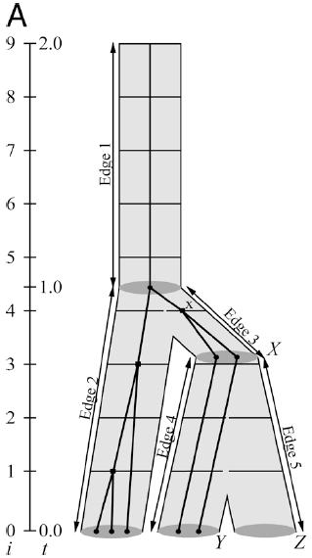
Birth-death models for DL
Model-based approaches:
often use a birth-death process (Arvestad et al., 2003, 2004, 2009; Akerborg et al., 2009; Sjöstrand et al., 2012; Boussau et al., 2013)
Birth=Duplication: λ
Death=Loss: μ
Akerborg et al., PNAS 2009

Slide 31
The Akerborg et al. 2009 model
Input: Species tree with time, rooted gene tree, λ and μ assumed to be known
Output: reconciliation between species tree and gene tree
Relaxed-clock model
Gene trees generated according to a birth-death model
Felsenstein 1981
Gamma prior
Dynamic programming to integrate over all mappings with BD model

Slide 32
The species tree-gene tree graphical model with DL (Akerborg 2009)
Sp tree
Topology
T
r
μ
λ
Gene tree
Gene alignment

Slide 33
The Akerborg et al. 2009 model
Integrates over a large space of mappings
Integrates over all possible scenarios of duplications and losses
To go faster and use unrooted, non-clock gene trees:
Use the most parsimonious mapping
Use a double-recursive tree traversal
Integrates over a large subset of possible scenarios of duplications and losses

Slide 34
To study genome evolution:
Genome scale computation:
Thousands of gene trees
Dozens of species

Slide 35
Parsimonious mapping a gene tree to a species tree
Zmasek and Eddy, Bioinf. 2001

Slide 36
P(gene tree|species tree):
Algorithmic details
Boussau et al., Genome Research 2013

Slide 37
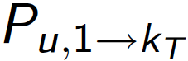
P(gene tree|organism tree):
Computing P_{u, 1➔kT}
Species tree
Gene tree
P_{B, 1→2}
A
B
A₁
B₂
B₁
Boussau et al., Genome Research 2013

Slide 38
Our approximations are not bad
Akerborg et al. 2009 log-likelihood

Slide 39
Plan
Modeling the relationship between species tree and gene tree
coalescent models (short!)
models of gene duplication and loss
models of gene transfer
models that combine the above
Results obtained using these models
Improving gene tree construction
Coestimation of gene and species trees
Inference of a species tree and time orders
Towards efficient Bayesian inference of gene trees and species trees

Slide 40
D
DL
LGT
ILS
Notes:
I use these models to study species and genomic evolution.
Here I have represented a species tree with 4 species.
These genomes have a history, they have evolved alongside species. This means that to understand how genomes encode the phenotypic characteristics of an organism, one has to take into account the confounding factor that evolutionary history represents.
Genomes contain lots of genes. Inside genomes, gene families evolve. Some have a very simple evolution, such as this one, that has one gene per species. During gene family evolution, gene sequences evolve through base substitutions as well as insertion/deletion events.
However, most gene families have a more complex evolution than this one. For instance, some gene families undergo gene duplications. Other families undergo gene losses. Other families undergo gene transfers, that cross species boundaries.
Overall, although genomes have exactly the same history as species, there are lots of different histories for gene families. Properly studying genome evolution requires reconstructing all these peculiar gene family histories.
However, current phylogenetic methods only consider these most simple gene families, even though they represent less than 7% of all gene families in Drosophilids or less than 1% in Vertebrates for instance.
Therefore in this talk I will show you that I develop methods to use all gene families in the genomes, not just a few percent of them, to study genomic and phenotypic evolution.

Slide 41
Transfer models
Identification of transfers:
Nakleh et al., 2005; Beiko and Hamilton 2006; Abby et al., 2010; Hill et al. 2010
Joint reconstruction of gene and species trees given alignments:
Model-based method: Suchard, Genetics 2005

Slide 42
Suchard “random walk through tree space” model
Input: gene alignments
Output: species tree, gene trees
Each gene tree is a Poisson number of transfers away from the species tree
Random walk through gene trees
C classes of genes, with different propensities to be transferred
Has been used with at most 6 species, 144 orthologous gene alignments, but could be used with 8 species or even more
Suchard, Genetics 2005

Slide 43
The species tree-gene tree graphical model with transfers (Suchard 2005)
Species tree
Topology
bl
Gene category
Expected number of transfers
Gene tree
Gene alignment

Slide 44
Plan
Modeling the relationship between species tree and gene tree
coalescent models (short!)
models of gene duplication and loss
models of gene transfer
models that combine the above
Results obtained using these models
Improving gene tree construction
Coestimation of gene and species trees
Inference of a species tree and time orders
Towards efficient Bayesian inference of gene trees and species trees

Slide 45
Model that combines DL and ILS
Reconciliation between gene tree and species tree:
Model-based method: Rasmussen and Kellis, Genome Research 2012
Input: dated and rooted species tree, DL rates, Ne
Output: Locus tree and DL+ILS scenario

Slide 46
D
DL
LGT
ILS
Notes:
I use these models to study species and genomic evolution.
Here I have represented a species tree with 4 species.
These genomes have a history, they have evolved alongside species. This means that to understand how genomes encode the phenotypic characteristics of an organism, one has to take into account the confounding factor that evolutionary history represents.
Genomes contain lots of genes. Inside genomes, gene families evolve. Some have a very simple evolution, such as this one, that has one gene per species. During gene family evolution, gene sequences evolve through base substitutions as well as insertion/deletion events.
However, most gene families have a more complex evolution than this one. For instance, some gene families undergo gene duplications. Other families undergo gene losses. Other families undergo gene transfers, that cross species boundaries.
Overall, although genomes have exactly the same history as species, there are lots of different histories for gene families. Properly studying genome evolution requires reconstructing all these peculiar gene family histories.
However, current phylogenetic methods only consider these most simple gene families, even though they represent less than 7% of all gene families in Drosophilids or less than 1% in Vertebrates for instance.
Therefore in this talk I will show you that I develop methods to use all gene families in the genomes, not just a few percent of them, to study genomic and phenotypic evolution.

Slide 47
The Rasmussen and Kellis model (2012)
Species tree
Species tree
DL model
Gene tree
Locus tree
Coalescent model
Gene alignment
Gene tree
Gene alignment

Slide 48
The Rasmussen and Kellis model (2012)
In practice:
Species tree
Species tree
DL model
DL model
Locus tree
Locus tree
Coalescent model
Coalescent model
Gene tree
Gene tree
Gene alignment

Slide 49
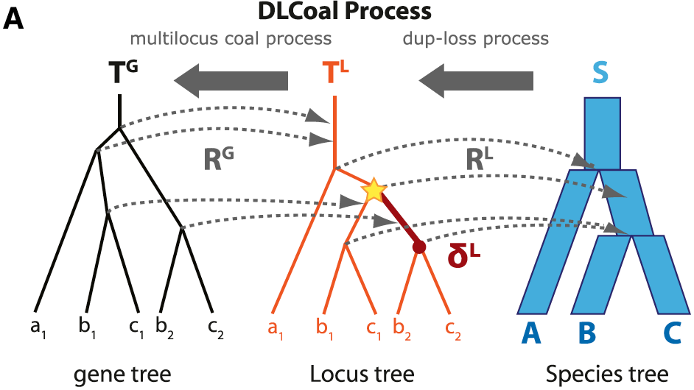
The Rasmussen and Kellis model (2012)

Slide 50
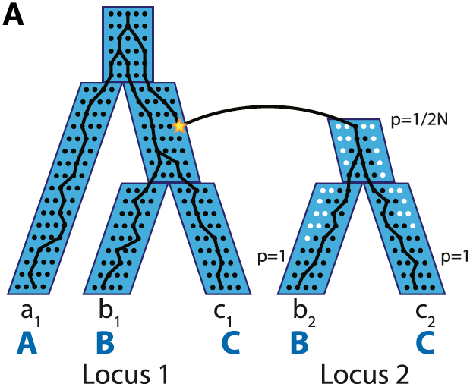
The Rasmussen and Kellis model (2012)

Slide 51
The species tree-gene tree graphical model with DL + ILS (Rasmussen and Kellis 2012)
Sp tree
Topology
T
μ
λ
Locus tree
Ne
r
Gene tree

Slide 52
D
DL
LGT
ILS
Notes:
I use these models to study species and genomic evolution.
Here I have represented a species tree with 4 species.
These genomes have a history, they have evolved alongside species. This means that to understand how genomes encode the phenotypic characteristics of an organism, one has to take into account the confounding factor that evolutionary history represents.
Genomes contain lots of genes. Inside genomes, gene families evolve. Some have a very simple evolution, such as this one, that has one gene per species. During gene family evolution, gene sequences evolve through base substitutions as well as insertion/deletion events.
However, most gene families have a more complex evolution than this one. For instance, some gene families undergo gene duplications. Other families undergo gene losses. Other families undergo gene transfers, that cross species boundaries.
Overall, although genomes have exactly the same history as species, there are lots of different histories for gene families. Properly studying genome evolution requires reconstructing all these peculiar gene family histories.
However, current phylogenetic methods only consider these most simple gene families, even though they represent less than 7% of all gene families in Drosophilids or less than 1% in Vertebrates for instance.
Therefore in this talk I will show you that I develop methods to use all gene families in the genomes, not just a few percent of them, to study genomic and phenotypic evolution.

Slide 53
Dating the tree of life is difficult
20 mya
20 mya
100
100
10 mya
10 mya
100
100
100
100
Very few fossils for the first 3 billion years of evolution on Earth
Other constraints are needed to date the tree of life
Notes:
Dating the tree of life is a very difficult problem for various reasons.
Usually one basically counts substitution events along a tree, and uses these counts to propagate fossil date to nearby nodes.
However, there are very few fossils for the first 3 billion years of evolution on Earth.

Slide 54
Using transfers to date clades
Notes:
In fact one can use gene transfers to date clades.
Let’s assume we have a tree in which we want to date the red and green nodes. Without fossil data, it is very hard to infer which is the oldest one.
Instead we can take into account gene transfers. If there was a gene transfer from a descendant of the green species to an ancestor of the red species, as shown, then because transfers can only occur between contemporaneous species, the second topology is impossible, because It assumes a transfer back in time.
This cartoon example shows that transfer events can be used to help date species phylogenetic trees.
We have therefore used a model that can detect gene transfers between genomes, to impose constraints for dating species trees.

Slide 55
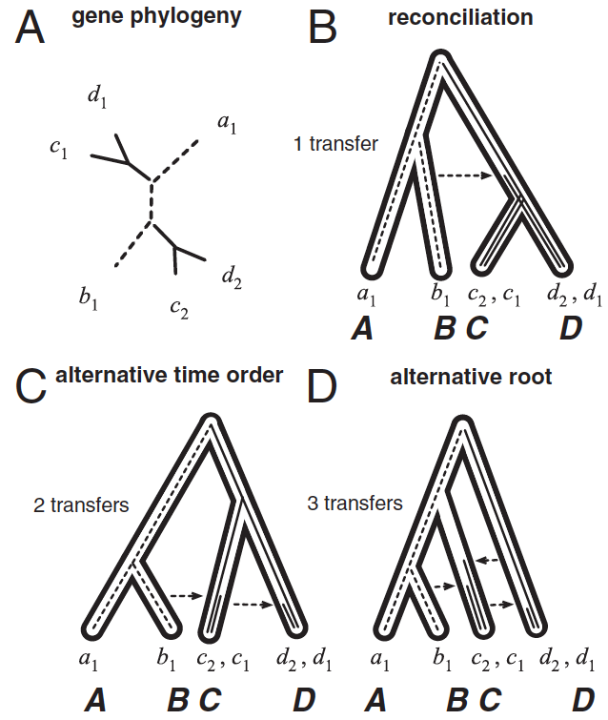
Gene transfers provide means to root and date species trees
Szöllősi et al., PNAS 2012

Slide 56
Model that combines DL and T
Reconciliation between a species tree and a gene tree: Parsimony setting: Gorecki, RECOMB 2004; Gorbunov and Lyubetski Mol. Biol. (Mosk), 2009; Libeskind-Hadas and Charleston, JCB 2009; Tofigh et al., IEEE ACM 2011; Doyon et al., Comparative Genomics 2011
Reconstruction of a species tree given gene trees:
Model-based method: Szöllősi et al., PNAS 2012; Szöllősi et al., Systematic Biology 2013

Slide 57
Tofigh 2011 parsimony method
Input: rooted species tree, rooted gene tree
Output: DTL scenario
Minimizes the number of duplications and transfers (different costs possible)
Finding scenarios can be done in polynomial time using DP:
Fill the cost matrix c (#GeneTreeNodes, #SpeciesTreeNodes)
Post-order traversal of the gene tree
For each node i of the gene tree:
Map it to each node j of the species tree
Compute the cost of node i being a S, D, or T event
Set c(i, j)=min(cost(S), cost(D), cost(T))
At the root, return the minimum cost found
Complexity in O(#GeneTreeNodes . #SpeciesTreeNodes)
Forbiding cyclic scenarios makes the algorithm NP-hard

Slide 58
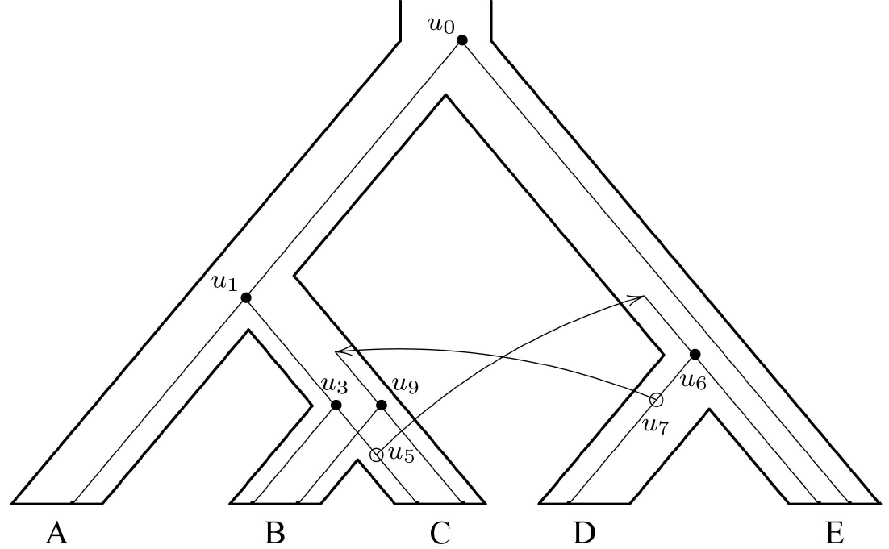
Cyclic scenarios
Tofigh et al., IEEE ACM 2011

Slide 59
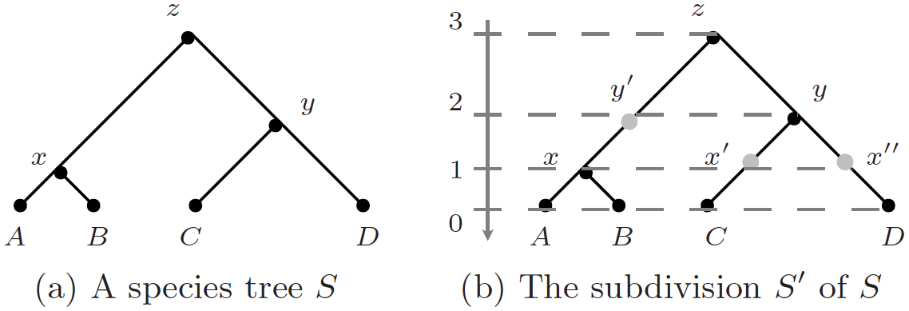
Slicing the tree to avoid cyclic scenarios
➔ Algorithm in O (#NodesInS’ . #NodesInG )
Doyon et al., Comparative Genomics 2011

Slide 60
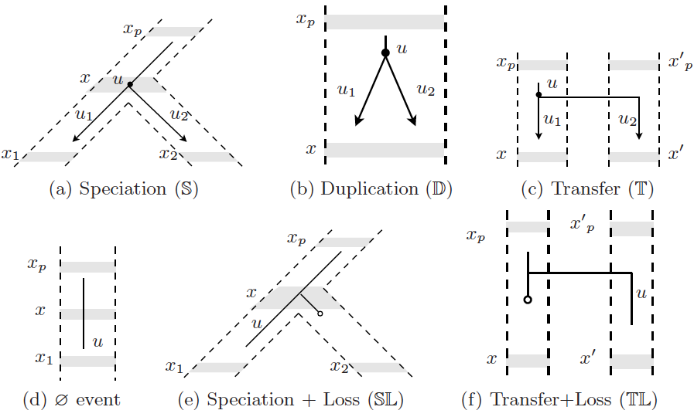
6 possible events are enough
Doyon et al., Comparative Genomics 2011

Slide 61
Dynamic programming in the Doyon et al. 2011 approach
Input: rooted augmented species tree S’, rooted gene tree G
Output: reconciliation scenario between S’ and G
Finding scenarios can be done in polynomial time using DP:
Fill the cost matrix c (#NodesInG, #NodesInS’)
Post-order traversal of the gene tree
For each node i of G:
Map it to each node j of S’
Consider all of 6 events, and set c(i, j)=min(cost(possible events))
At the root, return the minimum cost found

Slide 62
From parsimony to model-based
Input: gene trees
Output: reconciled rooted gene trees, rooted species tree with ordered nodes
Birth-death process to model gene evolution:
Birth parameters:
D
T: rate of receiving a gene through transfer
Death parameter:
L
One or more sets of D, T, L parameters
Double recursive DP for computing P(gene tree|species tree)
Integrating over all possible scenarios
Sliced species tree
Szöllősi et al., PNAS 2012

Slide 63
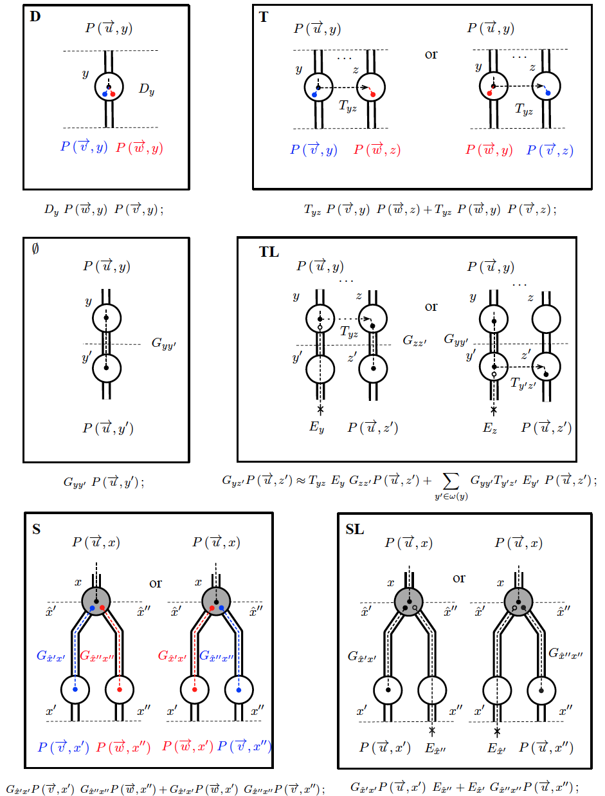
Use of the 6 events from Doyon et al. 2011
Szöllősi et al., PNAS 2012

Slide 64
Within-slice discretization for solving ordinary differential equations
Szöllősi et al., PNAS 2012

Slide 65
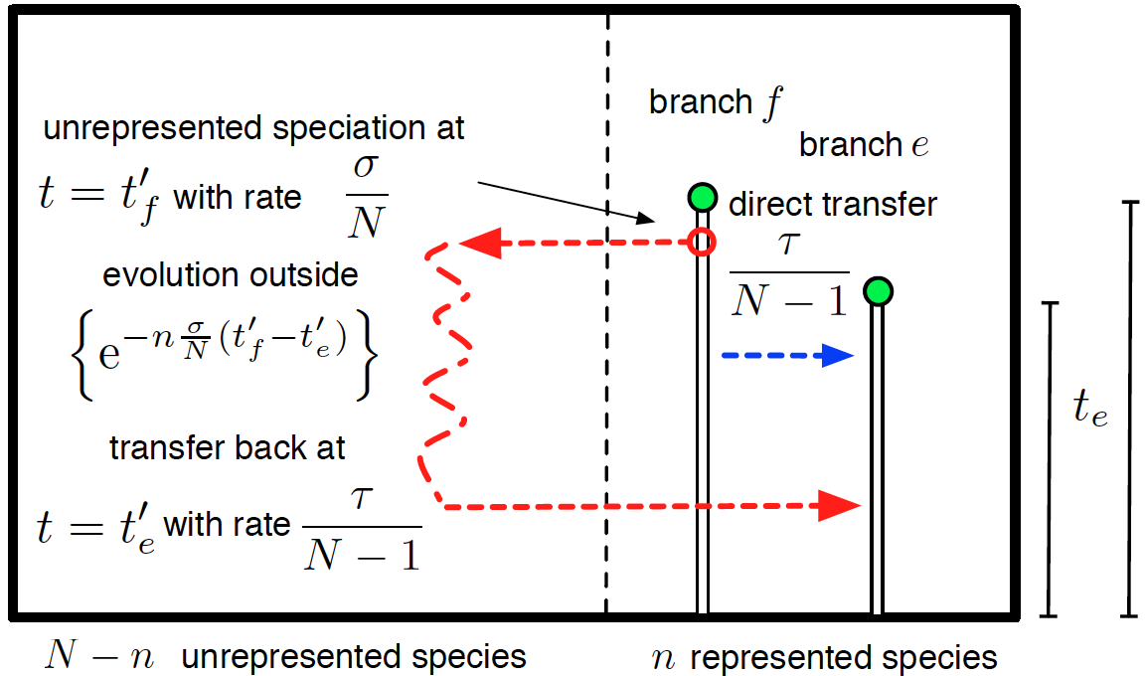
Further refinement: seeing dead lineages
Szöllősi et al., Syst. Biol. 2013

Slide 66
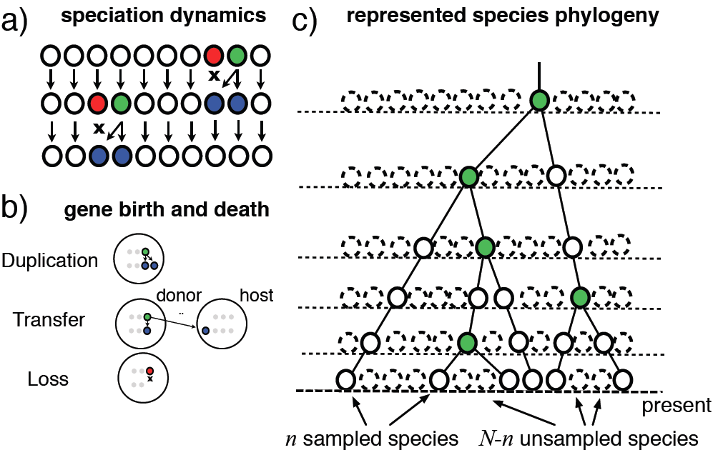
Further refinement: seeing dead lineages
Szöllősi et al., Syst. Biol. 2013

Slide 67
The exODT graphical model
Population of species
N
σ
Species tree
Topology
D
T
L
Gene tree

Slide 68
Plan
Modeling the relationship between species tree and gene tree
coalescent models (short!)
models of gene duplication and loss
models of gene transfer
models that combine the above
Results obtained using these models
Improving gene tree construction
Coestimation of gene and species trees
Inference of a species tree and time orders
Towards efficient Bayesian inference of gene trees and species trees

Slide 69
Species tree-gene tree models are better for predicting orthologous genes
Rasmussen and Kellis, MBE 2010

Slide 70
Plan
Modeling the relationship between species tree and gene tree
coalescent models (short!)
models of gene duplication and loss
models of gene transfer
models that combine the above
Results obtained using these models
Improving gene tree construction
Coestimation of gene and species trees
Inference of a species tree and time orders
Towards efficient Bayesian inference of gene trees and species trees

Slide 71
Coestimation of gene and species trees
PHYLDOG:
Input: gene alignments
Output: rooted reconciled gene trees, rooted species tree, branch-wise expected numbers of duplications and losses
Model based
Parallel algorithm
Uses Bio++ (Dutheil et al., 2013)
Boussau et al., Genome Research 2013

Slide 72
Study of mammalian genomes
Challenging but well-studied phylogeny
36 mammalian genomes available in Ensembl v. 57
About 7000 gene families
Correction for poorly sequenced genomes
Boussau et al., Genome Research 2013

Slide 73
PHYLDOG finds a good species tree
Boussau et al., Genome Research 2013
Notes:
I therefore used PHYLDOG on more than 7000 gene families from 36 mammalian genomes. PHYLDOG inferred a species tree well rooted and mostly in agreement with current mammalian classification (e.g. laurasiatheria).
Now we also want to assess the quality of gene trees reconstructed by PHYLDOG: even if on simulations PHYLDOG performed well, we need to check that it also performs well on real data.

Slide 74
Assessing the quality of gene trees
Comparison between:
PhyML (used for the PhylomeDB and Homolens databases )
TreeBeST (used for the Ensembl-Compara database)
PHYLDOG
Two approaches:
Looking at ancestral genome sizes
Assessing how well one can recover ancestral syntenies using reconstructed gene trees (Bérard et al., Bioinformatics 2012)
Boussau et al., Genome Research 2013
Notes:
To do that, we can benefit from a finding by Matthew Hahn, who found that…
Therefore, if gene trees contain lots of mistakes, we should obtain …
If however there are no mistakes in gene trees, we should see no difference in internal against external branches in terms of losses and duplications.
Eventually, if genomes tend to be poorly sequenced, external branches should have more losses than internal branches, but we should see no big difference in terms of duplications.
So the best way to assess errors in gene trees on the mammalian data is to check whether there is a difference between external and internal branches in terms of numbers of duplications.

Slide 75
1) Junk trees generate obesity
Errors in gene tree reconstruction result in larger ancestral genomes
Better methods should yield smaller ancestral genomes
Boussau et al., Genome Research 2013
Notes:
With PHYLDOG, contrary to PHYML, we find no significant difference between external and internal branches for numbers of gene duplications. However we still see an effect of sequencing quality, with more losses on external branches, and lots of internal branches with very low numbers of duplications.
A look at the numbers of duplications and losses mapped on the tree shows that indeed sequencing quality may impede a proper estimation of duplication numbers along the mammalian tree.

Slide 76
1) PHYLDOG fights genome obesity
Boussau et al., Genome Research 2013
Notes:
I therefore used PHYLDOG on more than 7000 gene families from 36 mammalian genomes. PHYLDOG inferred a species tree well rooted and mostly in agreement with current mammalian classification (e.g. laurasiatheria).
Now we also want to assess the quality of gene trees reconstructed by PHYLDOG: even if on simulations PHYLDOG performed well, we need to check that it also performs well on real data.

Slide 77
1) PHYLDOG fights genome obesity
**
TreeBeST
Boussau et al.,
Genome Research 2013
**: Student t-test p-value: 6.615e-06, Wilcoxon test p-value: 2.91e-11
Notes:
With PHYLDOG, contrary to PHYML, we find no significant difference between external and internal branches for numbers of gene duplications. However we still see an effect of sequencing quality, with more losses on external branches, and lots of internal branches with very low numbers of duplications.
A look at the numbers of duplications and losses mapped on the tree shows that indeed sequencing quality may impede a proper estimation of duplication numbers along the mammalian tree.

Slide 78
2) Junk trees break synteny groups
We use a method by Bérard et al. (2012) to reconstruct ancestral synteny groups using gene trees
Errors in gene tree reconstruction break synteny groups
Better methods should yield more genes in ancestral synteny groups
Notes:
With PHYLDOG, contrary to PHYML, we find no significant difference between external and internal branches for numbers of gene duplications. However we still see an effect of sequencing quality, with more losses on external branches, and lots of internal branches with very low numbers of duplications.
A look at the numbers of duplications and losses mapped on the tree shows that indeed sequencing quality may impede a proper estimation of duplication numbers along the mammalian tree.

Slide 79
2) Ancestral synteny says PHYLDOG gene trees are better
Proportion of ancestral genes
in synteny groups
0.0
Bérard et al.,
Bioinformatics 2012

Slide 80
PHYLDOG improves gene trees
TreeBEST (Ensembl-Compara)
PHYLDOG
Boussau et al., Genome Research 2013
Notes:
With PHYLDOG, contrary to PHYML, we find no significant difference between external and internal branches for numbers of gene duplications. However we still see an effect of sequencing quality, with more losses on external branches, and lots of internal branches with very low numbers of duplications.
A look at the numbers of duplications and losses mapped on the tree shows that indeed sequencing quality may impede a proper estimation of duplication numbers along the mammalian tree.

Slide 81
Plan
Modeling the relationship between species tree and gene tree
coalescent models (short!)
models of gene duplication and loss
models of gene transfer
models that combine the above
Results obtained using these models
Improving gene tree construction
Coestimation of gene and species trees
Inference of a species tree and time orders
Towards efficient Bayesian inference of gene trees and species trees

Slide 82
A model of gene duplication, loss, and transfer
Maximum Likelihood reconstruction of a time-ordered species tree
Fixed gene trees
Parallel implementation
We use it on Cyanobacteria
36 complete genomes
8,332 families of homologous genes (77,678 genes in total)
Szöllősi et al., PNAS 2012

Slide 83
Reconstructing a species tree for Cyanobacteria
Szöllősi et al., PNAS 2012

Slide 84
Reconstructing a species tree for Cyanobacteria
Szöllősi et al., PNAS 2012

Slide 85
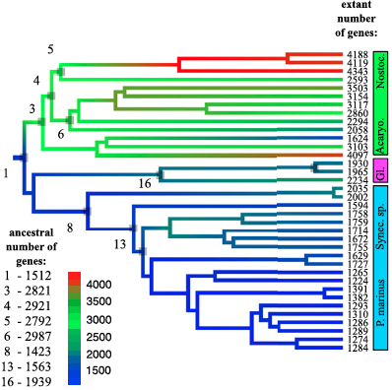
Reconstructing ancestral genome contents for Cyanobacteria
Szöllősi et al., PNAS 2012

Slide 86
Plan
Modeling the relationship between species tree and gene tree
coalescent models (short!)
models of gene duplication and loss
models of gene transfer
models that combine the above
Results obtained using these models
Improving gene tree construction
Coestimation of gene and species trees
Inference of a species tree and time orders
Towards efficient Bayesian inference of gene trees and species trees

Slide 87
Integrating out the gene tree when inferring the species tree
Species tree
Species tree
Gene tree
Distribution of gene trees
Example: BeST (Liu et al., 2007): obtain the distribution of gene trees from mrBayes
Gene alignment
Problem: Summing over all trees in a posterior distribution is time-consuming

Slide 88
DP for integrating over a tree distribution
Amalgamated Posterior Probability estimation: Dynamic Programming using conditional clade probabilities (Hoehna and Drummond 2011, Larget 2013, Szöllősi et al. 2013)
Probabilities for clades: sum over all possible clades while computing P(gene tree | species tree)

Slide 89
Computing P(alignment|species tree)
Formula:
P(alignment | gene tree)=P(gene tree| alignment) P(alignment)/ P(gene tree)
P(alignment | gene tree) = K P(gene tree| alignment)
P(alignment|species tree) = Σ_{gene tree}P(gene tree| species tree) P(alignment | gene tree)
P(alignment|species tree) = K Σ_{gene tree}P(gene tree| species tree) P(gene tree|alignment )
=1
Uniform

Slide 90
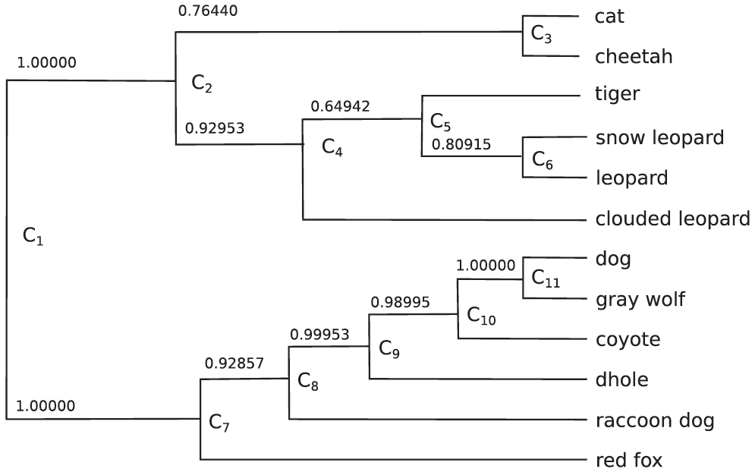
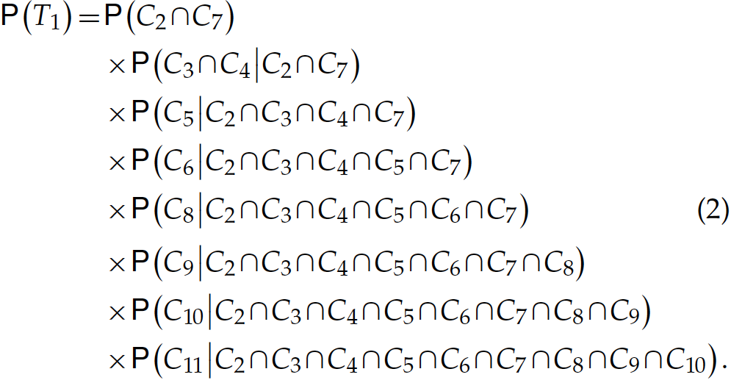
Conditional clade probabilities
Larget, Syst. Biol. 2013

Slide 91
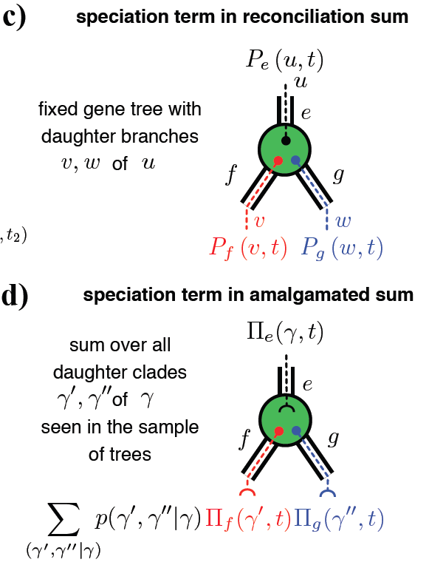
From DP along a tree to DP through a tree distribution
Szöllősi et al., Syst. Biol. 2013

Slide 92
Amalgamated Posterior Probability computation: more to it than speed
Number of different trees in a posterior sample of 10,000 trees of genes from 36 Cyanobacteria: between 3,000 and 10,000
Number of different trees that can be amalgamated from this sample: around 10¹²
Szöllősi et al., Syst. Biol. 2013

Slide 93
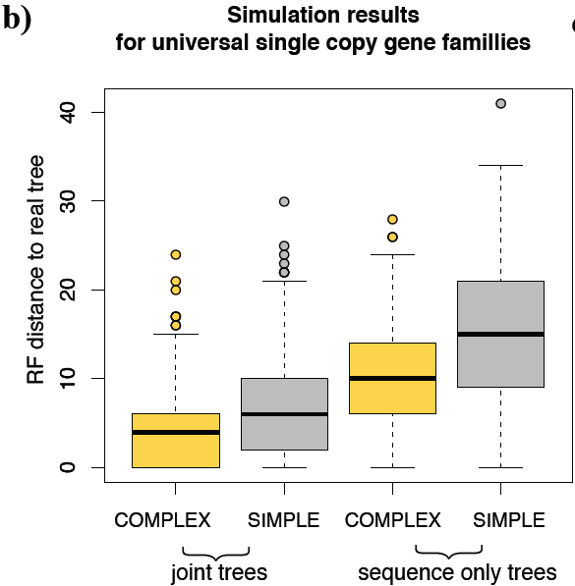
Amalgamated Likelihood computation improves gene tree reconstruction
Szöllősi et al., Syst. Biol. 2013

Slide 94
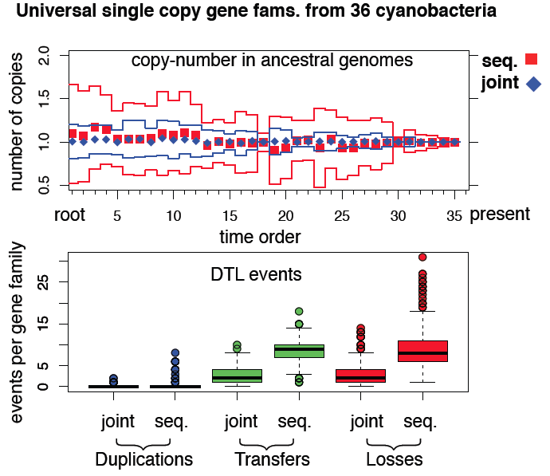
Amalgamated Likelihood computation: more to it than speed
Szöllősi et al., Syst. Biol. 2013

Slide 95
Bayesian reconstruction of species trees using ALE
MCMC to estimate the species tree and ODTL rates
Simulated tempering
Improved proposal mechanism for tree topologies (Hoehna and Drummond 2012)
Parallel program using MPI + openMP
Runs on hundreds of processors
Currently tested on 36 genomes, plans for using it on 102
Notes:
This first example of an integrative model of genome evolution, PHYLDOG, shows that these integrative approaches can provide better inferences of genome and species evolution, even for large datasets such as for multicellular organisms.
In unicellular organisms, another type of event can also be used by these integrative models: gene transfers. For instance, in collaboration with colleagues from Lyon, we have developed a model incorporating gene transfers in addition to duplications and losses. To illustrate how integrative models can inform genome and species evolution, I will show you how we use this model to help date the tree of life.

Slide 96
Thank you!
Organizers!
LBBE collaborators: Gergely Szöllősi, Laurent Duret, Manolo Gouy, Eric Tannier, Vincent Daubin
John Huelsenbeck and the Huelsenbeck lab at UC Berkeley
Notes:
This first example of an integrative model of genome evolution, PHYLDOG, shows that these integrative approaches can provide better inferences of genome and species evolution, even for large datasets such as for multicellular organisms.
In unicellular organisms, another type of event can also be used by these integrative models: gene transfers. For instance, in collaboration with colleagues from Lyon, we have developed a model incorporating gene transfers in addition to duplications and losses. To illustrate how integrative models can inform genome and species evolution, I will show you how we use this model to help date the tree of life.

