Slide 1
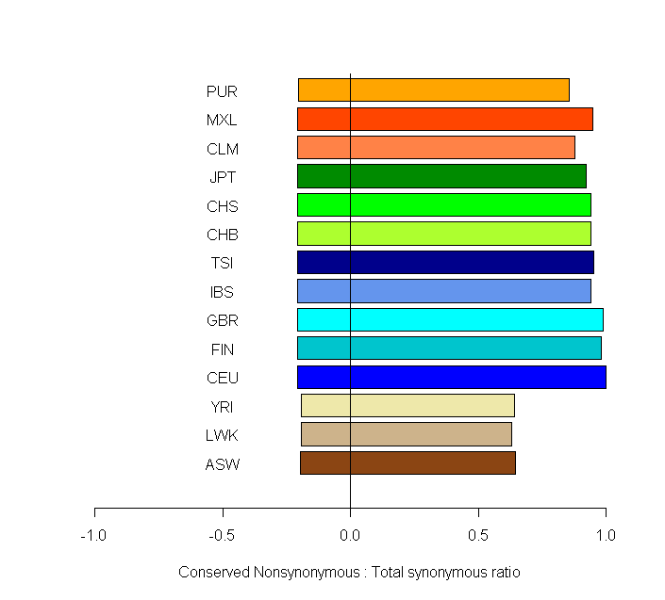
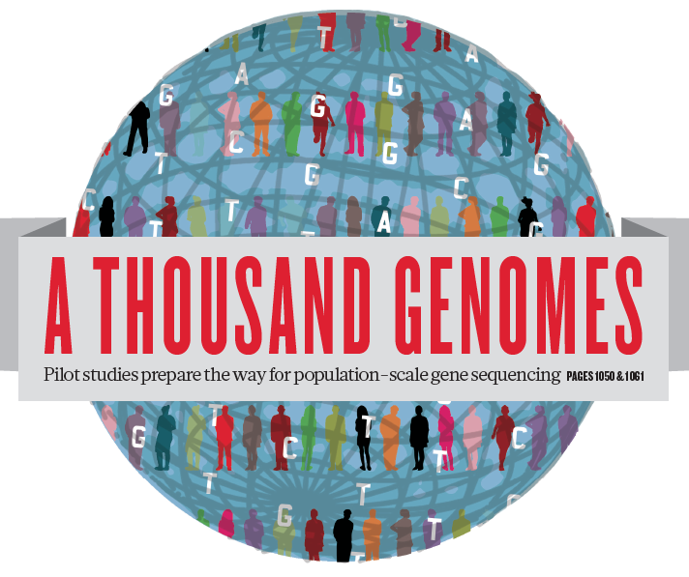
Human genetic variation: Recombination, rare variants and selection
Gil McVean

Slide 2
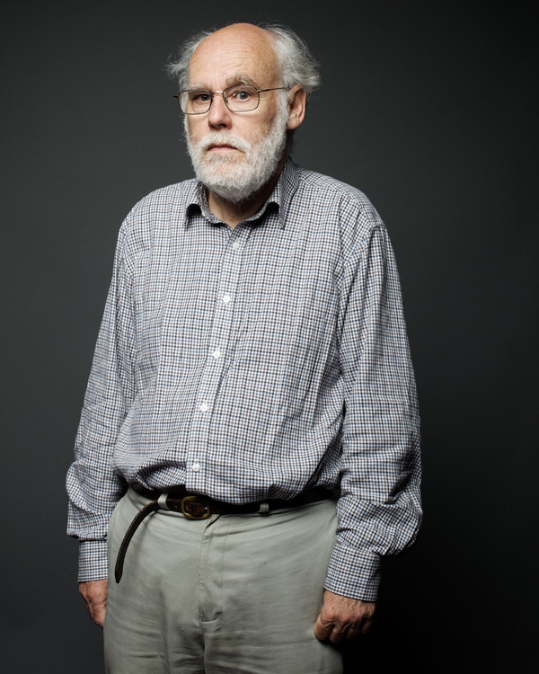
There are no new questions in population genetics
…only new types of data

Slide 3
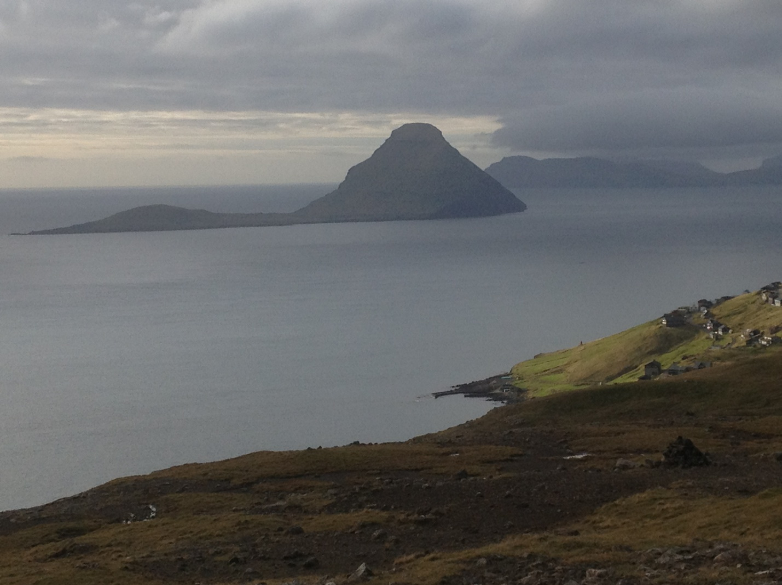
Genome sequences of entire populations

Slide 4
Data with linkage to deep phenotype information

Slide 5
Data from multiple species

Slide 6
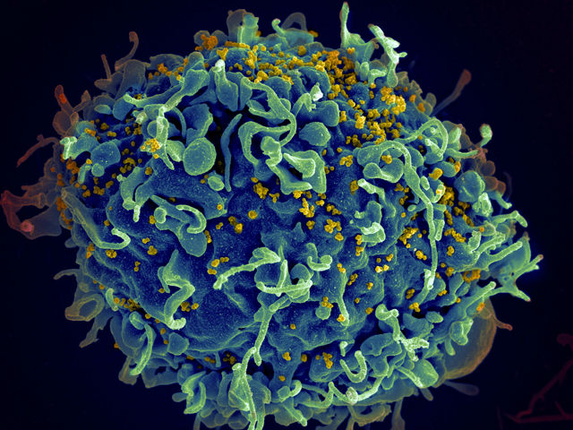
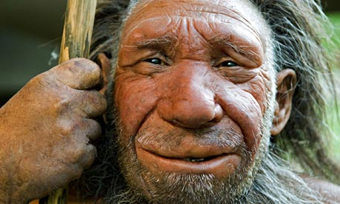
Longitudinal data

Slide 7
Overview
How should we think about genetic variation in humans?
The ancestral recombination graph (ARG)
Learning about recombination
What we know about the ARG in humans
The 1000 Genomes Project
Common and rare variation
Relatedness among ‘unrelated’ samples
How can a genealogical perspective influence the search for disease genes?
Rare variant contributions

Slide 8
Gene genealogies and genetic variation

Slide 10
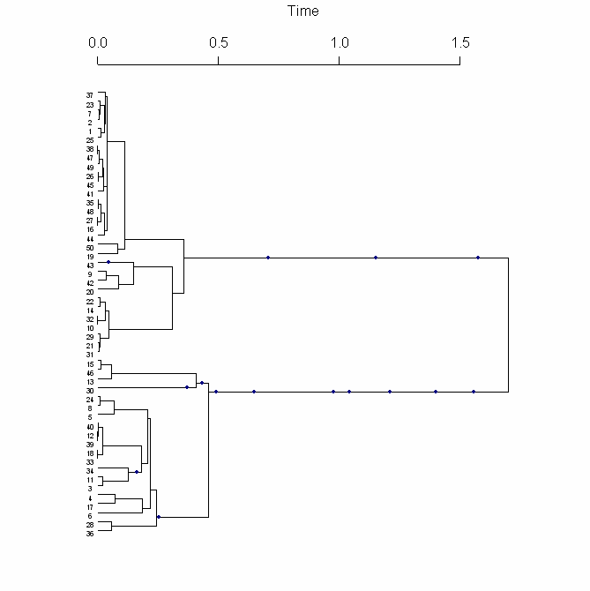
What defines the structure of genetic variation?
In the absence of recombination, the most natural way to think about haplotypes is in terms of the genealogical tree representing the history of the chromosomes

Slide 11
What determines the shape of the tree?
Present day

Slide 12
Ancestry of current population
Present day

Slide 13
Ancestry of sample
Present day

Slide 14
The coalescent: a model of genealogies
Most recent common ancestor (MRCA)
coalescence
Ancestral lineages
Present day
time

Slide 15
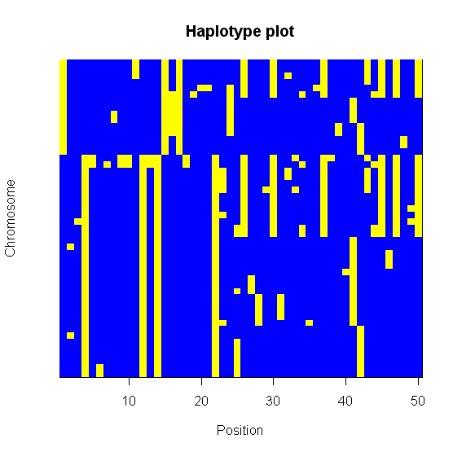
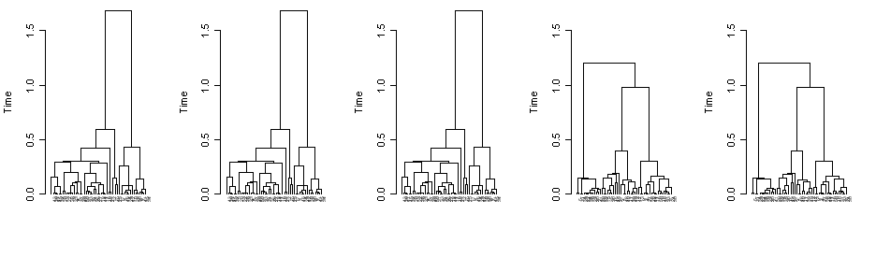
What happens in the presence of recombination?
When there is some recombination, every nucleotide position has a tree, but the tree changes along the chromosome at a rate determined by the local recombination landscape

Slide 16
Recombination and genealogical history
Forwards in time
Backwards in time
Grandpaternal sequence
Grandmaternal sequence
x
TCAGGCATGGATCAGGGAGCT
TCACGCATGGAACAGGGAGCT
TCAGGCATGG
AACAGGGAGCT
Non-ancestral genetic material
G
A
G A

Slide 17
The ancestral recombination graph (ARG)
The combined history of recombination, mutation and coalescence is described by the ancestral recombination graph
Coalescence
Mutation
Coalescence
Coalescence
Mutation
Coalescence
Recombination
Event

Slide 18
Deconstructing the ARG

Slide 19
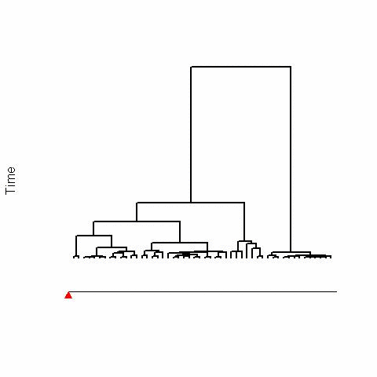
The decay of a tree by recombination

Slide 20
The decay of a tree by recombination
0
100

Slide 21
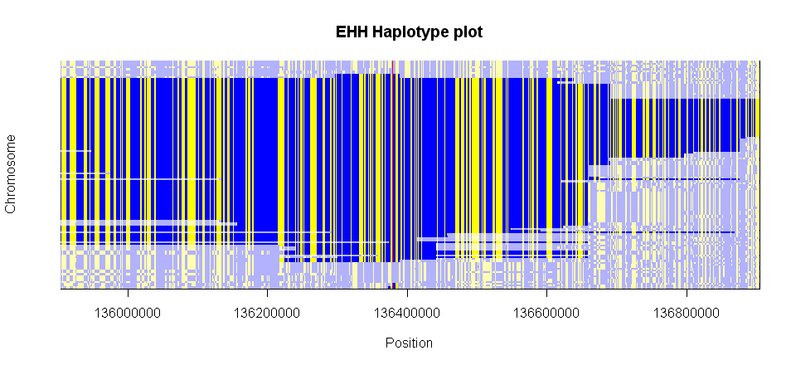
Genealogical thinking to interpret genetic variation
Age of mutation
Date of population founding
Migration and admixture
?

Slide 22
ARG-based inference
time
Coalescence
t_{MRCA}
Mutation
t₇
Coalescence
t₆
Coalescence
t₅
Mutation
t₄
Coalescence
t₃
Recombination
t₂
Coalescence
t₁
t = 0

Slide 23
A problem and a possible solution
Efficient exploration of the space of ARGs is a difficult problem
The difficulties of performing efficient exact genealogical inference (at least within a coalescent framework) currently seem insurmountable
There are several possible solutions
Dimension-reduction
Approximate the model
Approximate the likelihood function
One approach that has proved useful is to combine information from subsets of data for which the likelihood function can be estimated
Composite likelihood

Slide 24
Composite likelihood estimation of the recombination rate
Composite likelihood estimation of 4Ner: Hudson (2001)
DlnL
DlnL
4N_{e}r
4N_{e}r
15
7
1
1
2
7
2
2
4
2
3
1
1
1
1
Full likelihood
Composite-likelihood approximation
DlnL
4N_{e}r

Slide 25
Fitting a variable recombination rate
Use a reversible-jump MCMC approach (Green 1995)
Cold
SNP positions
Split blocks
Hot
Merge blocks
Change block size
Change block rate

Slide 27
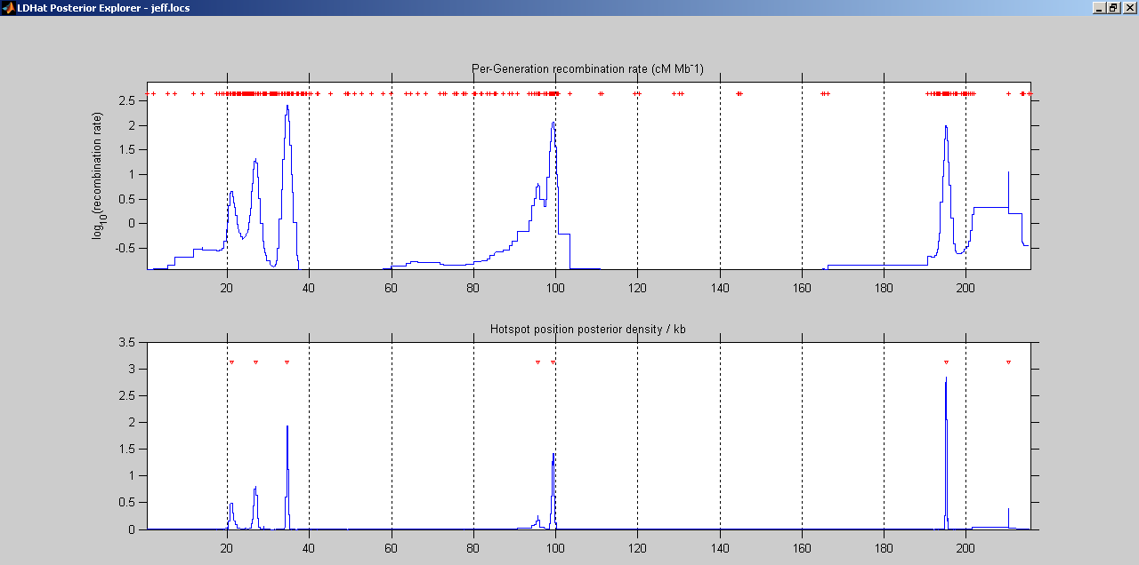
Strong concordance between fine-scale rate estimates from sperm and genetic variation
Fine-scale validation of the method
Rates estimated from genetic variation
McVean et al (2004)
Rates estimated from sperm
Jeffreys et al (2001)

Slide 28
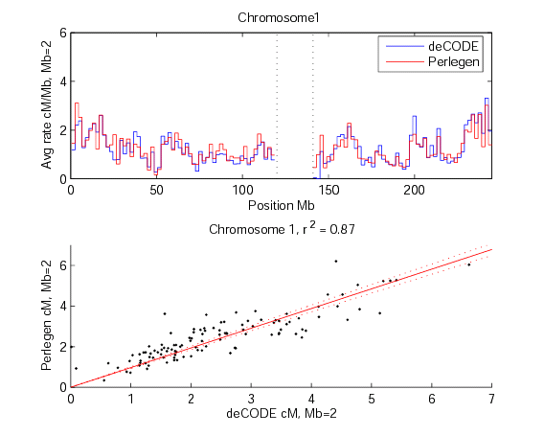
Broad-scale validation of the method
2Mb correlation between Perlegen and deCODE rates

Slide 29
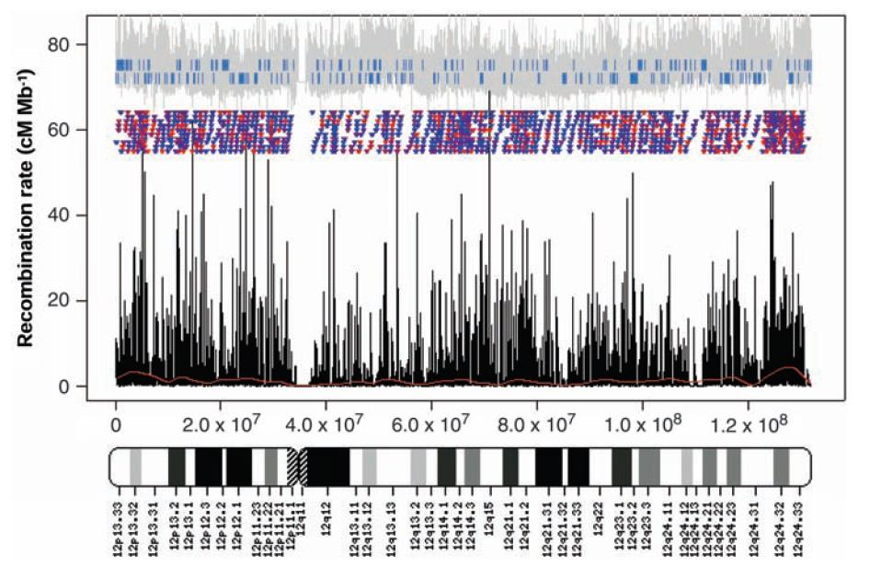
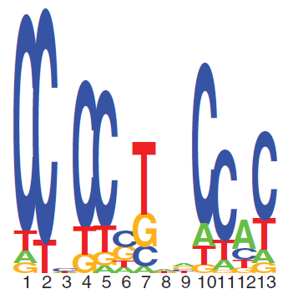
From hotspots to PRDM9

Slide 30
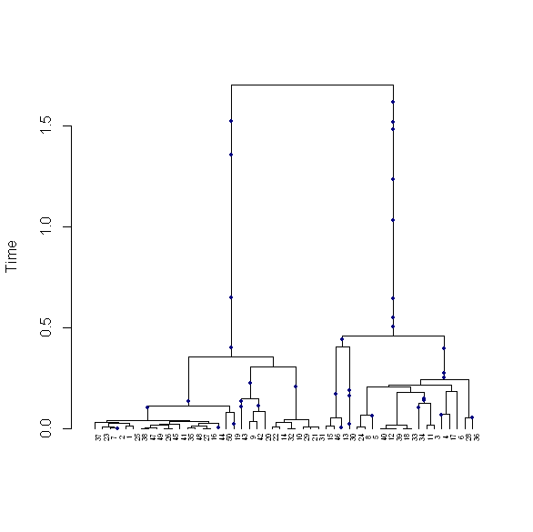
Dating haplotypes with genetic length
Genetic distance over which MRCA for two sequences extends
~ Gamma(2, 1/t_{CO})

Slide 31
The human ARG

Slide 32
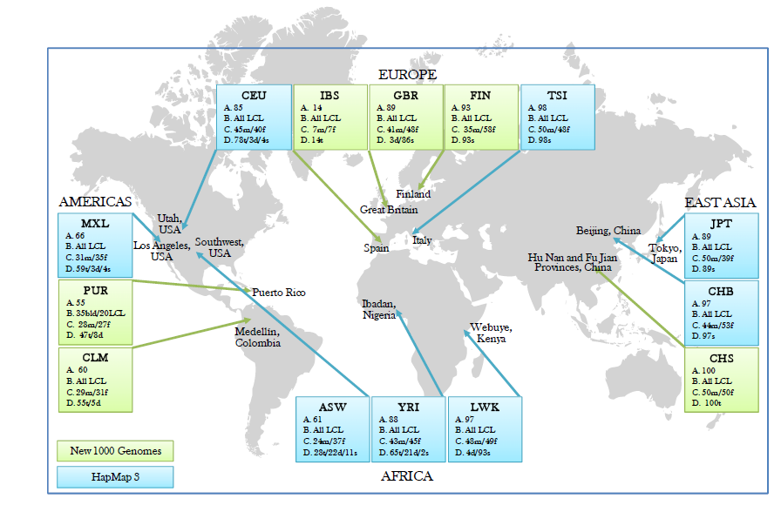
The 1000 Genomes Project

Slide 33
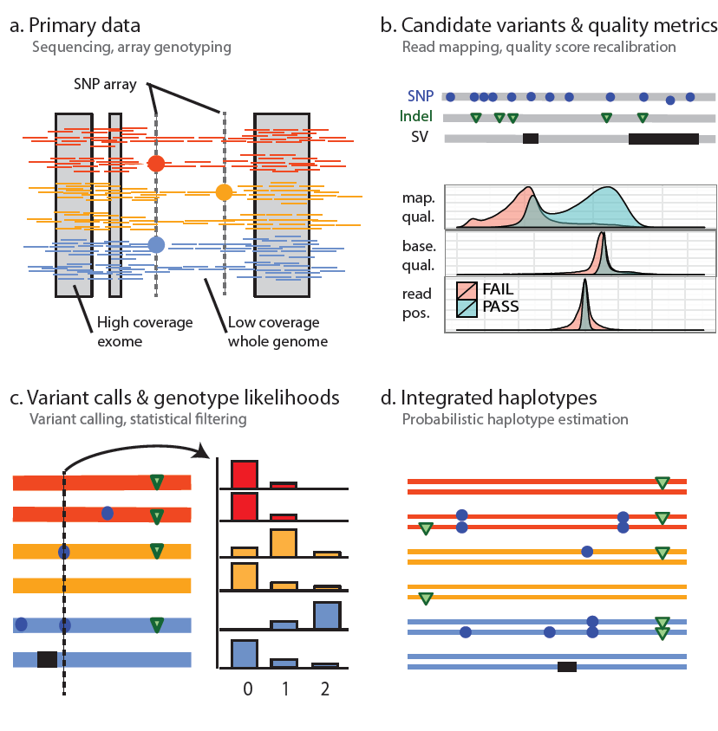
1000 Genomes Project design

Slide 34
Population sequencing
Haplotypes
2x
10x

Slide 35
4 million sites that differ from the human reference genome
12,000 changes to proteins
100 changes that knockout gene function
5 rare variants that are known to cause disease

Slide 36
Most variation is common – Most common variation is cosmopolitan
Number of variants in typical genome
Found in all continents
92%
Found only in Europe
0.3%
Found only in the UK
0.1%
Found only in you
0.002%

Slide 37
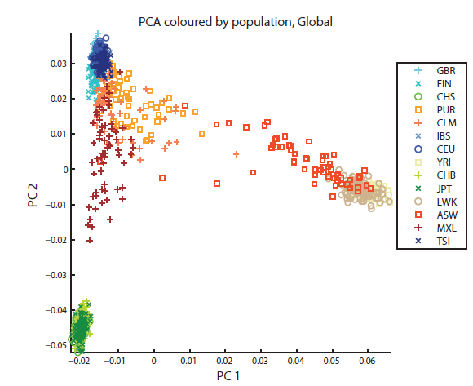
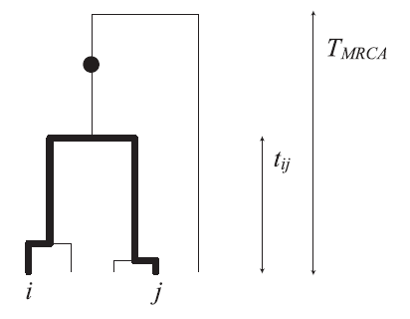
Common variants define broad structures of population relatedness

Slide 38
Mutation sharing defines average time to events
GBR sample
1.8 MY
Average time to MRCA
0.79 MY
Average time to CA with YRI
0.64 MY
Average time to CA with CHS
0.60 MY
Average time to CA with GBR
Origin of anatomically modern humans
Out of Africa
Assumes mutation rate of 1.5e-8 /bp /gen and 25 years / gen

Slide 39
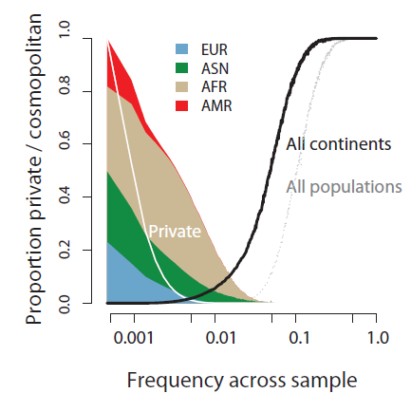
Most variants are rare, most rare variation is private

Slide 40
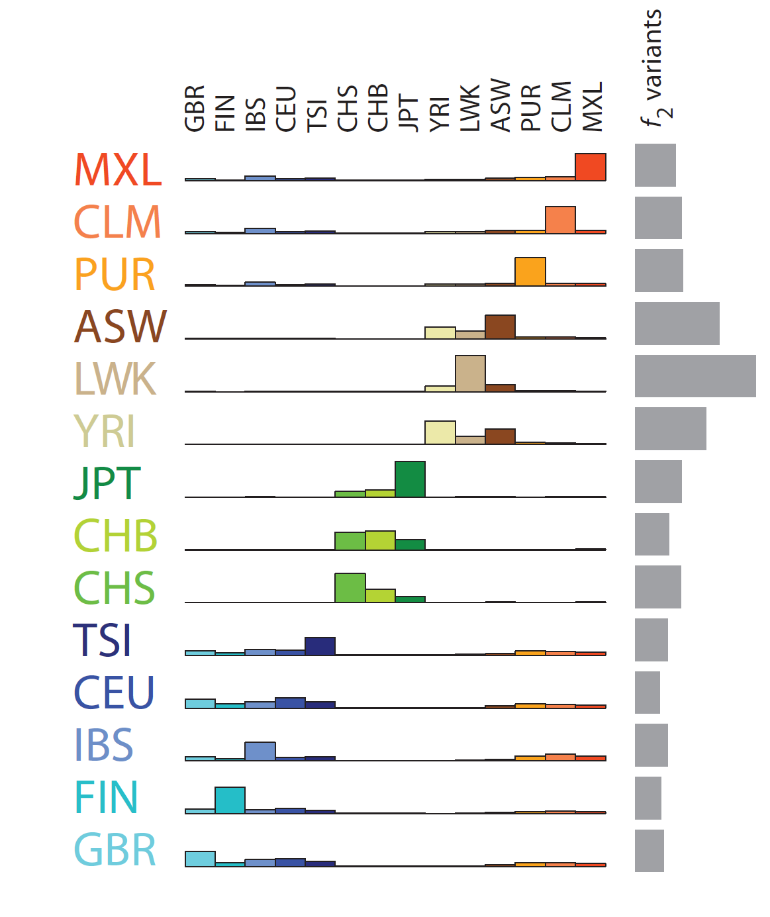
Rare variants define recent historical connections between populations
ASW shows stronger sharing with YRI than LWK
48% of IBS variants shared with American populations

Slide 41
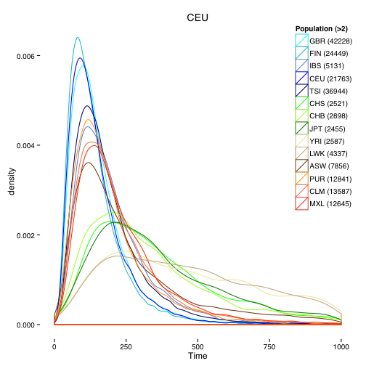
Using recombination to date the age of coalescence
f2
f1
f1
00120020010101100112020120110111011010101011101
01022010200111010021010110010111010100121000102
Median coalescence age for f2 GBR variants (1% DAF) is c. 100 generations, i.e. c. 2,500 years

Slide 42
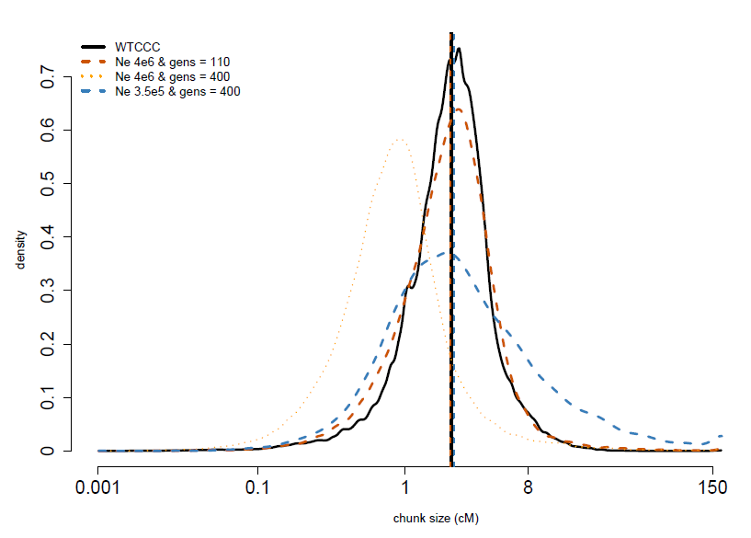
Larger samples
We would like to analyse data sets on >10,000 samples
Graph-based genotype HMM approach to find ‘pseudo-parents’ for each sample
Implies nearest CA typically c. 50 generations ago – c. 1,500 years.
=> Variants down to frequencies of 1/10,000 likely to be >1,000 years old

Slide 43
Rare variants and selection

Slide 44
Many people believe rare variants contain the key to understanding familial, sporadic and complex disease
A shared, rare variant, influences risk for erythrocytosis
c. 20 generations

Slide 45
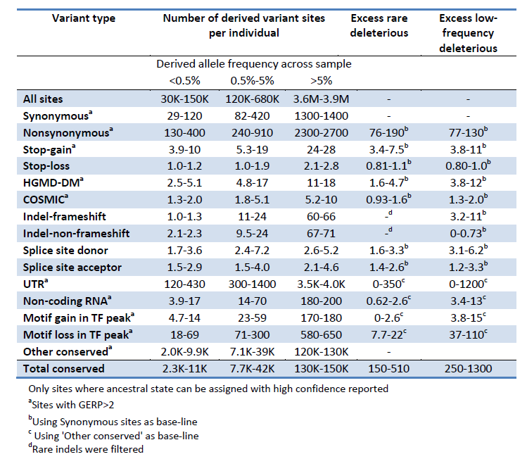
Individuals carry many rare variants of functional effect

Slide 46
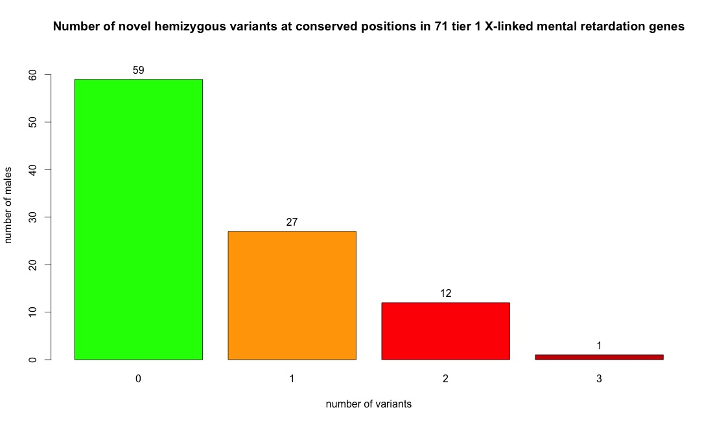
Do 40% of males have MR?

Slide 47
Rare variants are enriched for deleterious mutations
Common
Rare

Slide 48
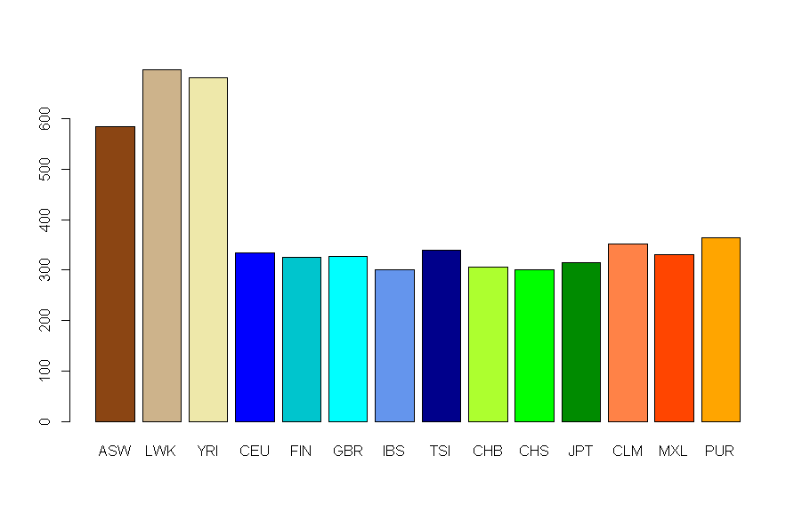
Rare variant load can be measured in different ways
Excess low frequency nonsynonymous mutations at conserved sites

Slide 49
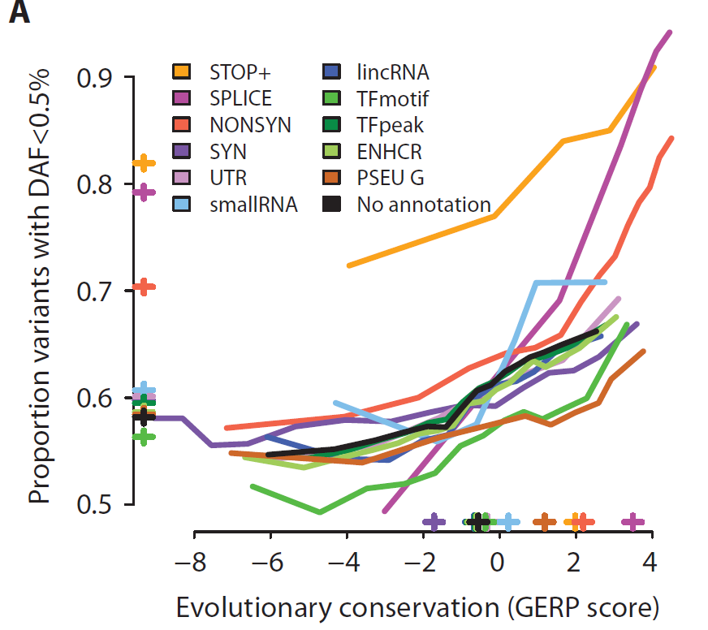
Selection on variants varies by conservation and coding consequence

Slide 50
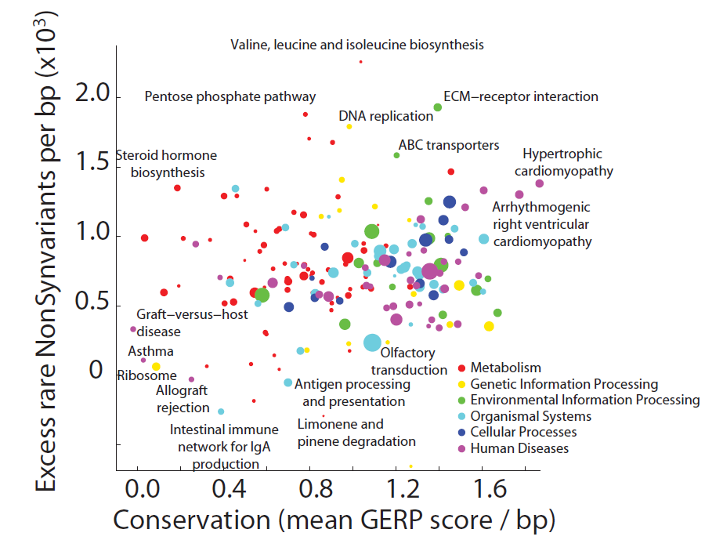
Rare variant load varies between KEGG pathways

Slide 51
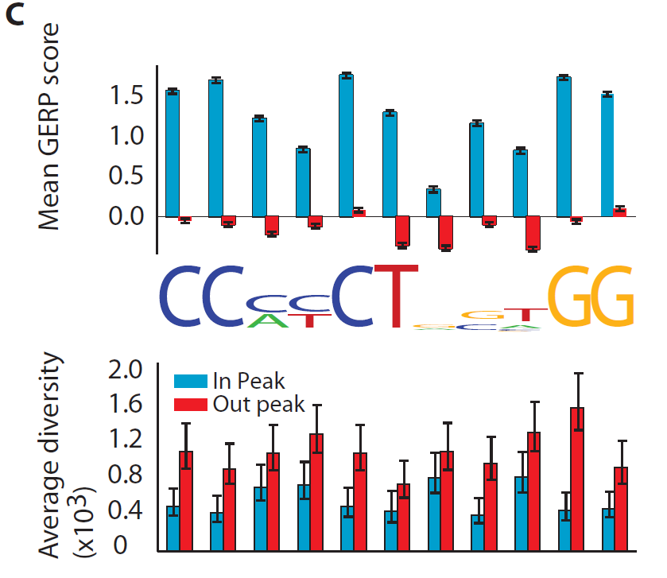
Regulatory load may be very considerable
CTCF-binding motif

Slide 52
Rare variant differentiation can confound the genetic study of disease
Mathieson and McVean (2012)

Slide 53
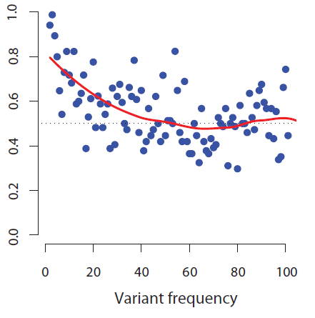
Variants under selection showed elevated levels of population differentiation
Proportion of pairwise comparisons where nonsynonymous variants are more differentiated than synonymous ones

Slide 54
Prospects and open questions
As the size of genetic data sets grows, so will our ability to identify rare variants that influence disk risk. However, so will the problems of rare variant stratification.
There are effective ways of controlling stratification that use family structures (e.g. linkage, TDT). It may be possible to adapt these to settings of more distant relatedness.
Building maps of genealogical relatedness between samples is likely to be key to such approaches and will also open the door to accurate dating of mutations and connections between people and populations.

Slide 55
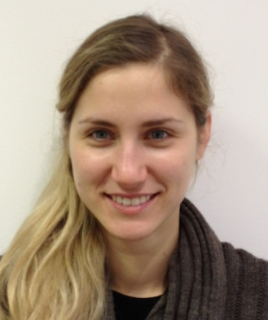
With thanks to..
Iain Mathieson
Adam Auton
Dionysia Xifara
Alison Feder
The 1000 Genomes Project Consortium

