Slide 1

MEDICC
Minimum Event Distance for Intra-tumour Copy-number Comparisons
Roland F Schwarz

Slide 2
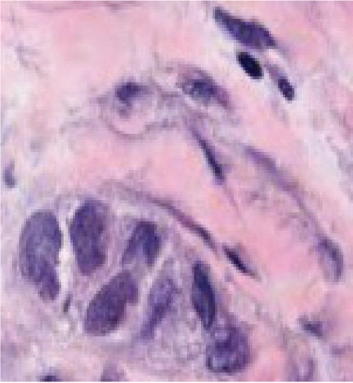
Intra-tumour heterogeneity
Population
Intra-tumor
Spatial, temporal
Intra-sample
Tissue
Intra-sample
Genetic




















Single nucleotide variants
Genomic rearrangements / CN changes
Polyploidies
Chromothripsis

Slide 3
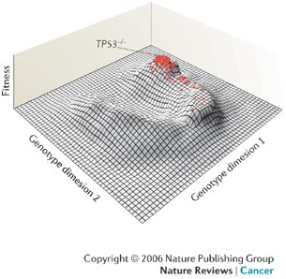
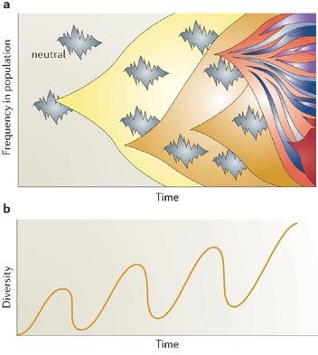
ITH enables resistance development
Main goals:
Reconstruct evolutionary history of cancer in the patient
Quantify ITH and tumour adaptability
Evaluate potential application for routine diagnostics
Merlo et al. Nature Reviews Cancer ; published online 16 November 2006

Slide 4
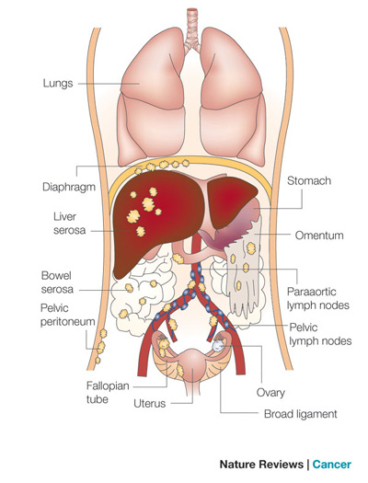
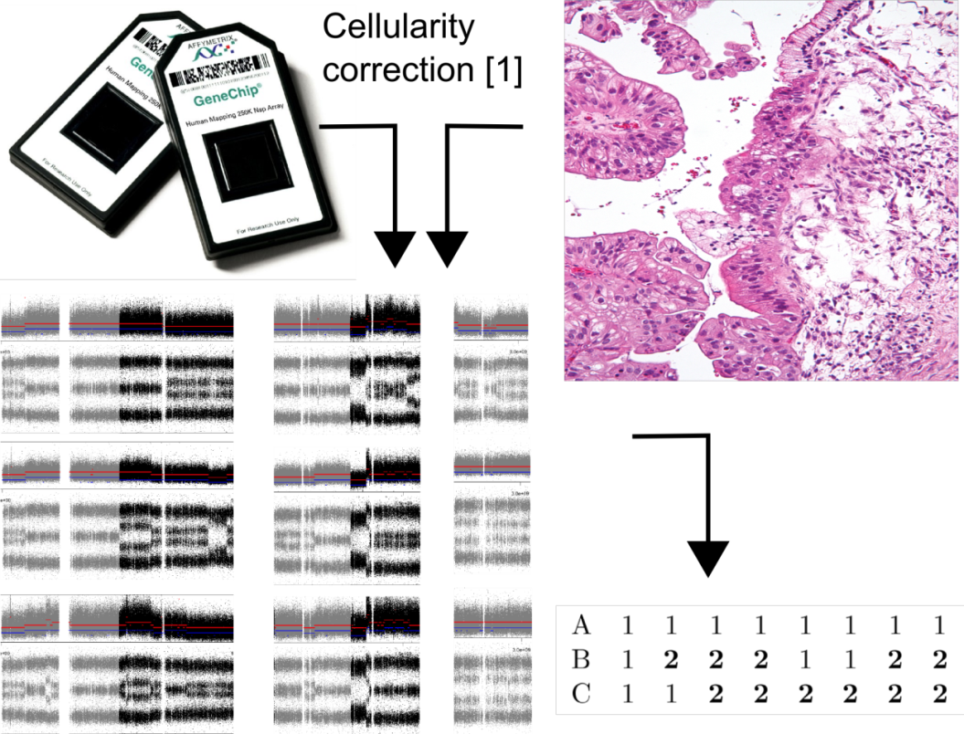
CN profiling
Challenges:
Phasing of allele-specific CNs
Deal with horizontal dependencies and overlapping events
Find meaningful distance measure
Find a measure that quantifies ITH

Slide 5
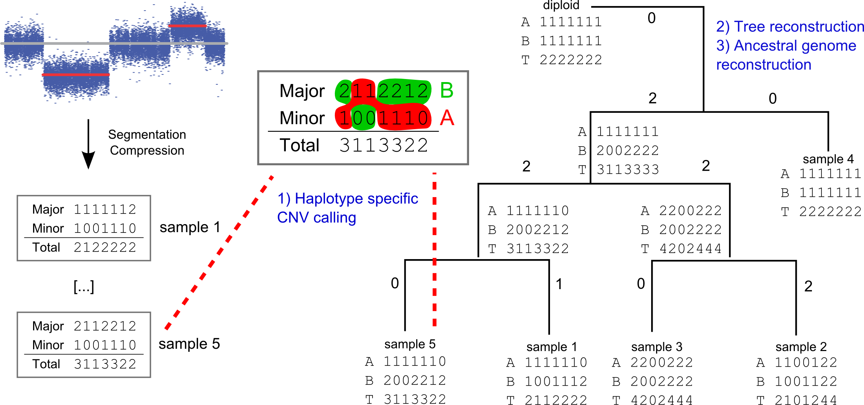
MEDICC’s 3 steps of tree inference

Slide 6
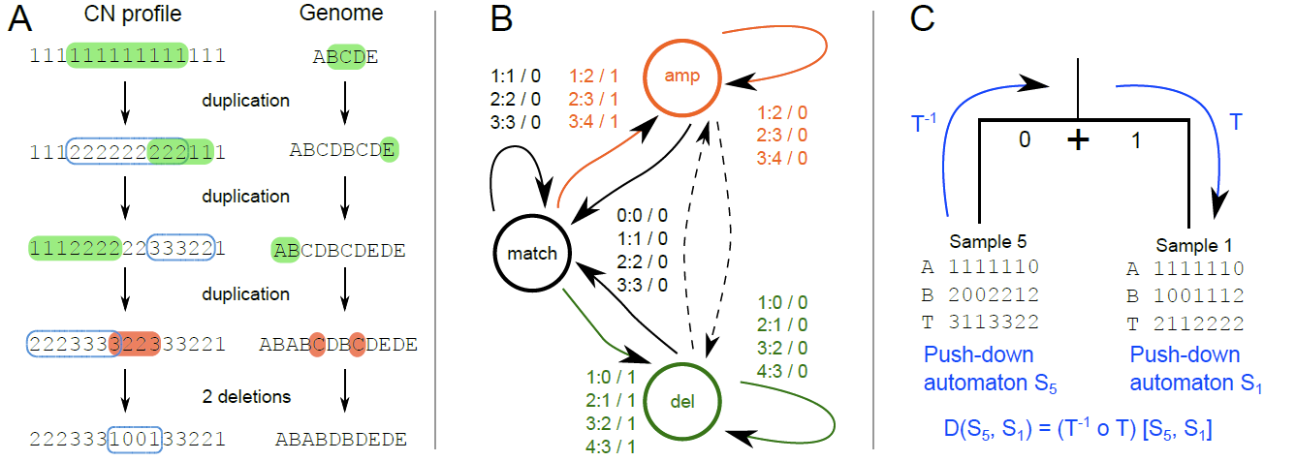
Minimum Event Distance
Cascading events and
horizontal dependencies
Minimum Event Distance
The distance is the
shortest path over all
possible ancestors
Notes:
A Talk about ancestor and descendants
B This enables us to calculate the distance (stress that!)

Slide 7
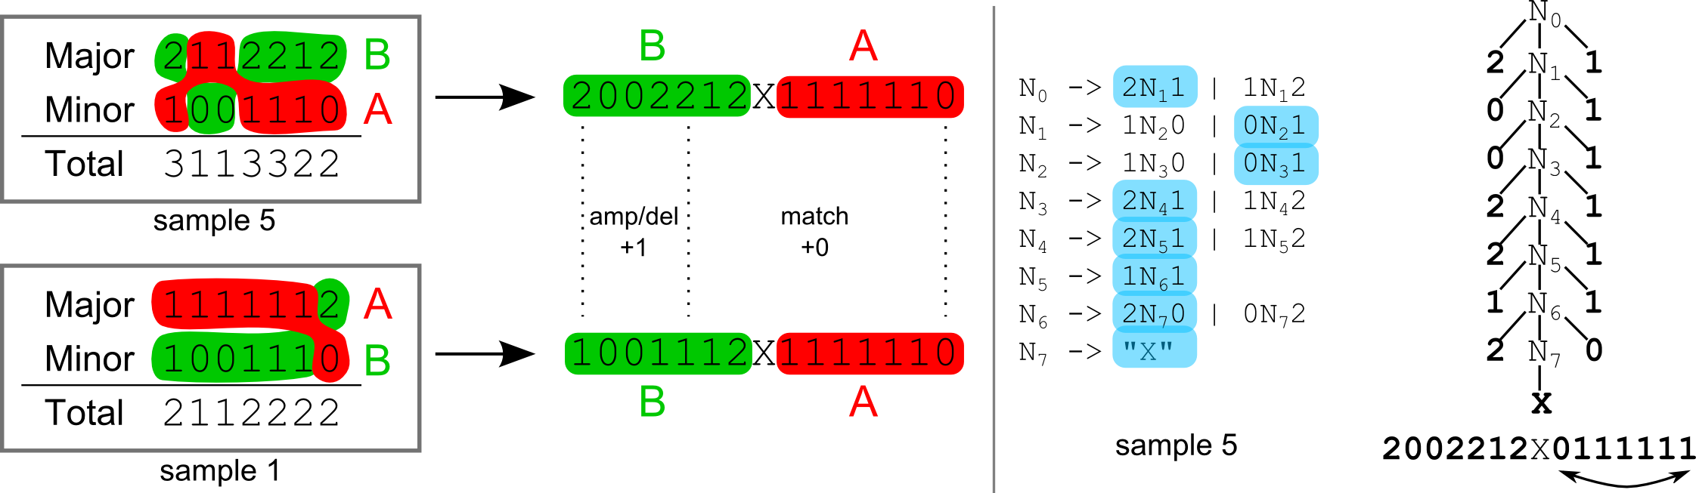
Allele-specific CN assignment
Possible phasing choices are modelled as CFG
Every parse tree realises one possible phasing scenario
Evolutionary shortest distance gives us the optimal phasing
Notes:
Blue is green
Why do we worry about the phasing?

Slide 8
MEDICC’s 3 steps of tree inference

Slide 9
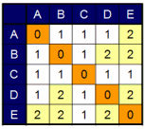
Quantifying ITH
k(x,z) = -exp(d(x,z))
From distances to relative positions and angles
Allows computation of centers of mass
Allows measuring the distribution of genomes in the mutational landscape
Schwarz et al. 2011, Evolutionary distances in the twilight zone: a rational kernel approach

Slide 10
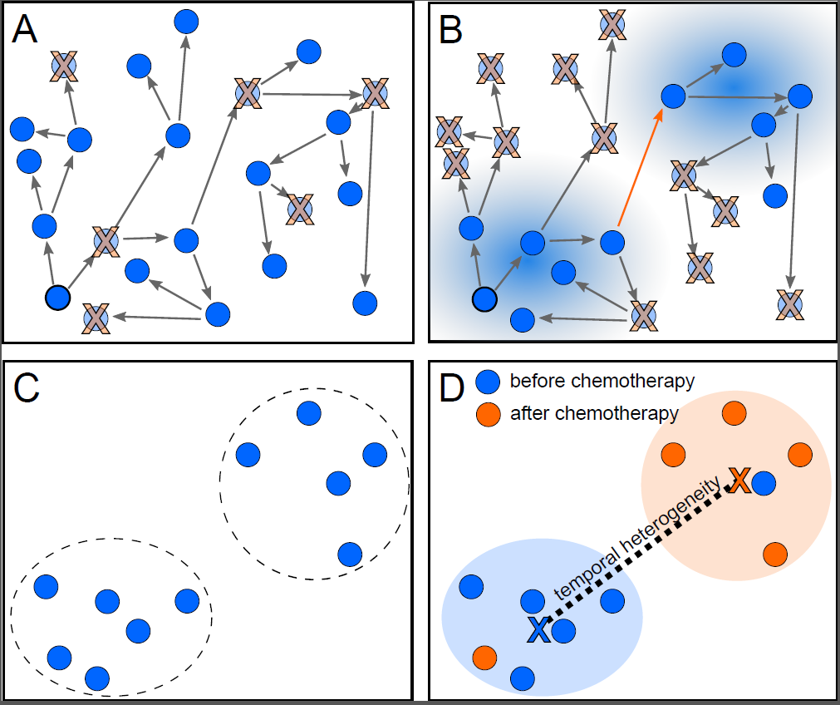
Quantifying ITH
A) Neutral evolution with no selection pressure

Slide 11
Quantifying ITH
Neutral evolution with no selection pressure
Certain mutations confer fitness advantage

Slide 12
Quantifying ITH
Neutral evolution with no selection pressure
Certain mutations confer fittness advantage
Clonal expansions (Ripley’s K)
Distances between subgroups (Robust center of mass)
Notes:
Make sure D is an extra
Independent annotation

Slide 13
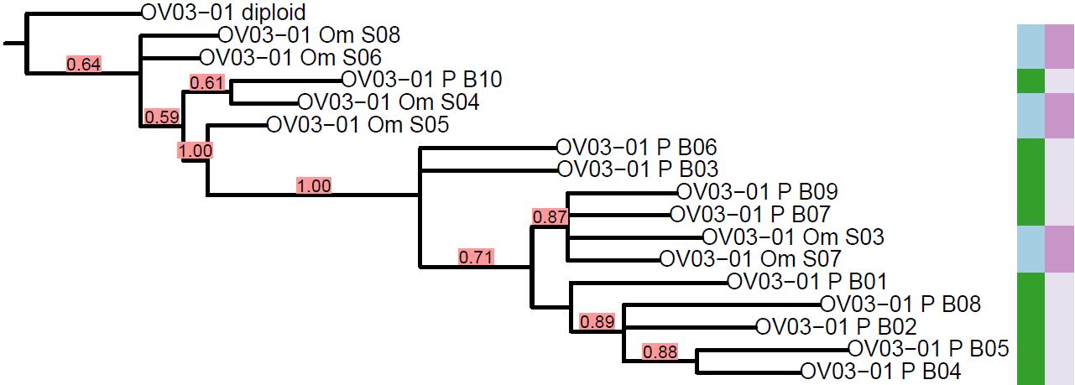
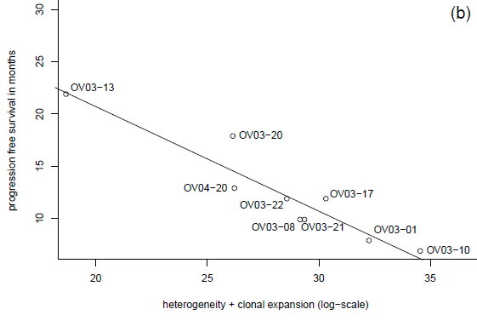
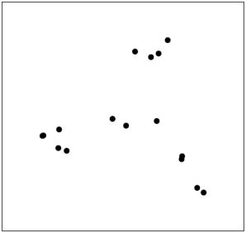
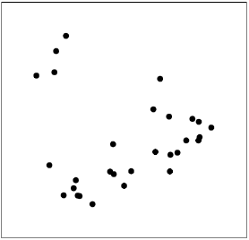

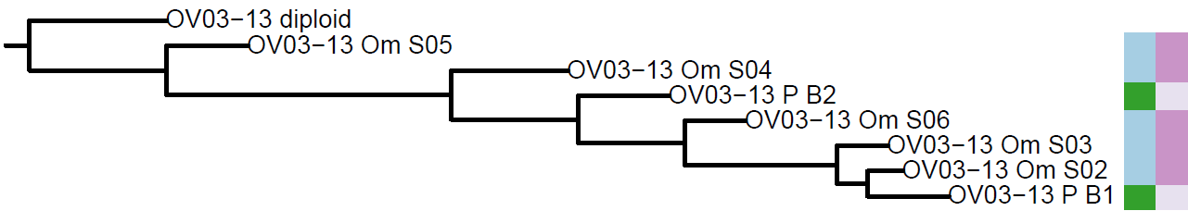
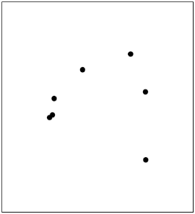
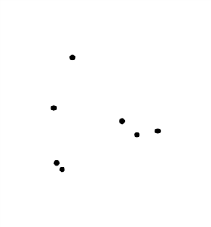
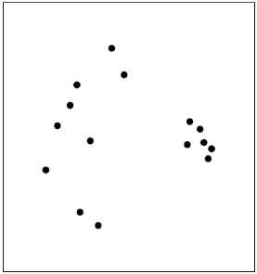
ITH and clonal expansion determines survival
resistant
OV03-01
OV03-08
OV03-17
A high degree of clonal expansion and temporal heterogeneity indicates poor outcome.
OV03-13
OV03-22
OV03-20
sensitive
Notes:
Regression is across ALL patients!

Slide 14
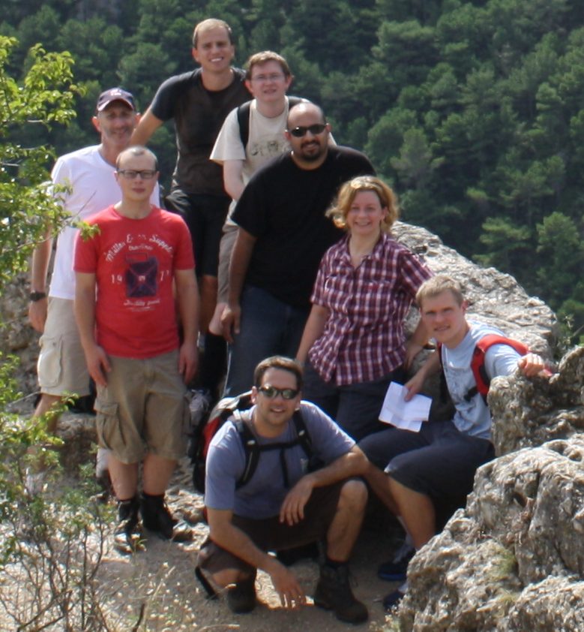
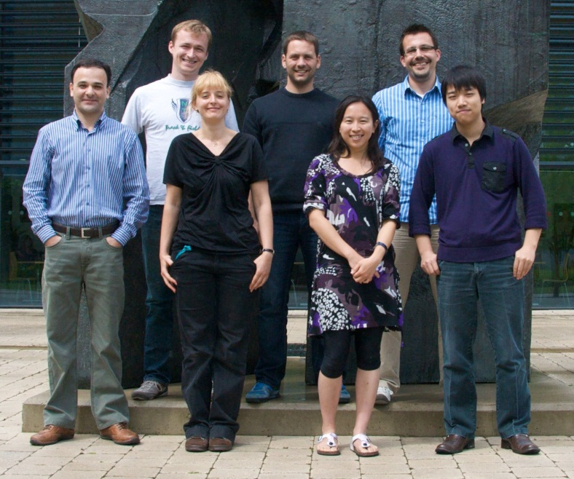




Acknowledgements
EBI:
Nick Goldman
Boton Sipos
CI:
Florian Markowetz
Anne Trinh
CUED:
Adria de Gispert
Gonzalo Iglesias
UBC:
Sohrab Shah

Slide 15
Ancestral reconstruction allows timing of events
4q: EGFR ligand epiregulin (EREG)
Toll-like receptor 3 (TLR3)
NPY5R, VEGFC
8p: DEFA/DAFB, ANGPT2
5q: GNB2L1/RACK1
17: P53, BRCA1

Slide 16
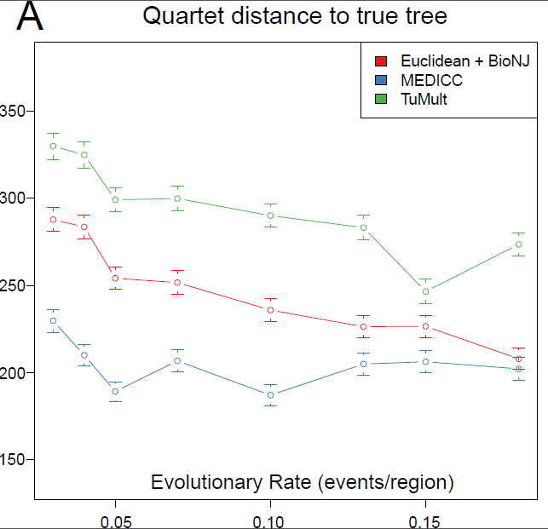
Simulation results

