Slide 1
The rise and spread of diversity in early SIV infection
George Shirreff
MCEB 2013

Slide 2
Early infection
Low population sizes make it
vulnerable (Haase 2011
Ann Rev Med).
Latent reservoir established early in infection (Chun et al. 1998 PNAS)
  Treatment initiation in primary infection may lead to long-term control (Sáez-Cirión et al. 2013 PLoS Pathog).
Escape occurs early in infection (Borrow et al. 1994 J Virol, Fischer et al. 2010 PLoS One).

Slide 3
Compartmentalisation
HIV in humans:
  Blood and semen (Coombs et al. 1998 JID)
  Lymph nodes and blood (PBMC) (Haddad et al. 2000 AIDS)
  Blood and female genital tissue (Bull et al. 2009 PLoS One)
  Blood and central nervous system (Sturdevant et al. 2012 PLoS Pathog)
  Between parts of the gut (van Marle et al. 2007 Retrovirology).
SIV in macaques
  Compartmentalisation between semen and blood, but only after resolution of primary infection (Whitney et al. 2011 PLoS Pathog)
  Plasma and multiple tissues are well mixed (Kearney et al. 2013 CROI #272)
Early samples not generally available in HIV.
  Also true of compartmental samples.

Slide 4
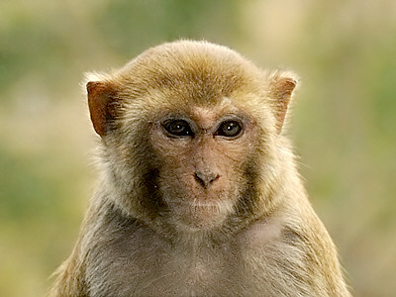
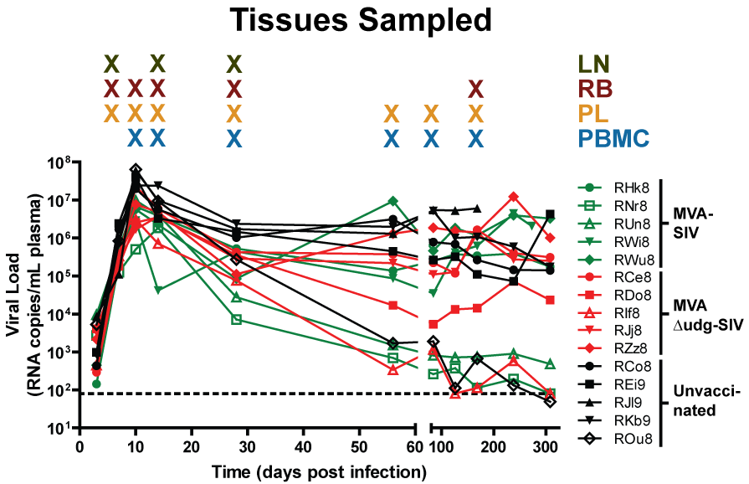
Macaques - vaccine study
15 MHC I type-matched Rhesus macaques
10 vaccinated (Engram et al. 2009 J Immunol)
All infected 1 year later with SIVmac239.
Samples taken between 7 and 168 days
post-infection.
www.ecologyasia.com
Lymphatic tissue:
1. Lymph nodes – LN
2. Rectal biopsy – RB
Blood:
3. Plasma – PL
4. Peripheral blood mononuclear cells - PBMC

Slide 5
High-throughput sequencing
454 sequencing
Reads over two regions, containing gag and tat epitopes, 220 and 250 respectively.
  Gag-CM9 CTPYDINQM
  Tat-SL8 STPESANL
No overlap
Aligned to known inoculation sequence SIVmac239.
Indels removed
1000-3000 haplotypes per animal tissue time-point.
  Corrected errors using ShoRAH diri_sampler (Zagordi et al. 2011 BMC Bioinformatics).
Reads
Reference sequence
Epitope

Slide 6
Where and when does diversity arise?
RJj8, tat gene
tat escape
  Starts in lymph nodes,
  and spreads (Vanderford et al. 2011 PLoS Pathog)
gag escape not so fast, requires compensatory mutations (Friedrich et al. 2004 J Virol)

Slide 7
Quantify rates
How fast does diversity arise?
How fast does it spread?
Minimise effect of selection.
  Degenerate sites only
Consider change in nucleotide
between time points and compartments
Amino acid | Codon
Alanine | GCN
Glycine | GGN
Leucine | CTN
Proline | CCN
aRginine | CGN
Serine | TCN
Threonine | ACN
Valine | GTN

Slide 8
Substitution rate model
Proportion of nucleotide i'
Substitution rate matrix

Slide 9
Fit substitution rate
Expected value at time 0 is 100% founder sequence.
Compare proportion of nucleotides with expected on a given day.
  Multinomial likelihood
  Sum over all codons and animals
Substitution rate:
  Relative to baseline (2.2e-5 substitutions per site per generation, Huang & Wooley 2005, J Virol Meth)
Migration rates:
  Proportion moving from one compartment to another per day)
day

Slide 10
Estimate substitution rate
Fit substitution rate.
Ignore migration.
A lower substitution rate fits the tat data
  Greater level of escape.
  Diversity is purged.

Slide 11
Migration rate model
Proportion in compartment j’ of nucleotide i'
Migration rate matrix

Slide 12
Model – migration rate
Migration between lymph nodes and gut tissue (major replicating compartments)
Likelihood plots (light colours = higher likelihood)

Slide 13
Model – all migration rates
Between all compartments.
Values drawn by latin hypercube sampling.
Maximum likelihood identified.
FROM
LN
PBMC
 | LN | PBMC | PL | RB
LN | 0.45 | 0.02 | 0.00 | 0.13
PBMC | 0.21 | 0.80 | 0.04 | 0.23
PL | 0.21 | 0.12 | 0.96 | 0.04
RB | 0.13 | 0.05 | 0.00 | 0.60
TO
RB
PL

Slide 14
Conclusion
Simple model for spatial structure in high throughput datasets.
  Control for direct selection.
tat has low substitution rate.
  is under strong selection (Vanderford et al. 2011).
  gag less so
More viral migration stronger from gut lymphocytes to lymph nodes than vice versa.
Strong migration to blood compartments from lymph tissue, not vice versa
Future directions:
  Consider linkage and recombination
  Stochastic framework

Slide 15

Acknowledgements
ETH Zürich
Victor Garcia
Roland Regoes
Yerkes Primate Centre
Thomas Vanderford
Guido Silvestri

Slide 16
Animal - RWi8
tat
gag

Slide 17
Locus - tat
RDo8
RWi8

Slide 18
Phylogenetic visualisation
RHk8, tat gene
Subsample
  Phylogenetic inference (BEAST)
  Visualisation
  Estimate migration rates
How representative are subsampled trees?
  Minority variants in every tissue are probably ignored.
  Overcompensates for sequencing errors.

Slide 19
Multi-dimensional scaling
Each codon is a variable.
Throw out a lot of data
Hard to track with incomplete sampling
Unfeasible to do same dimensions for all.

Slide 20
Model – all migration rates
Between all compartments.
Values drawn by latin hypercube sampling.
Maximum likelihood identified.
LN
0.15
PBMC
0.29
0.04
0.13
0.01
RB
PL
0.01

Slide 21
Limitations
Constant generation time
Ignore linkage
Not totally unselected
Assumes e.g. lymph nodes are all one compartment
Ignores extinction

