Slide 1
FastMinTC+
a Fast and Effective Heuristic for Minimum Timeline Cover on Temporal Networks
Giorgio Lazzarinetti *
Riccardo Dondi **
Sara Manzoni *
Italo Zoppis*
* Università degli studi Milano-Bicocca, Italy
** Università degli studi di Bergamo, Italy
TIME 2024

Slide 2
Introduction
Problem Definition
FastMinTC+
Experimental Results
Conclusion
AGENDA

Slide 3
Introduction

Slide 4
Motivations
Temporal Networks
Applications require for Summarization
Summarization Challenges
With the widespread availability of temporal information, many datasets, traditionally modeled as networks, are now being treated as temporal networks.
Temporal network summarization poses unique challenges stemming from their inherent complexity and the diverse objectives of summarization, for which different methods have been proposed . These methods employ a variety of techniques, including temporal motifs, graphlets, vocabulary-based summaries, evolutionary patterns and community evolution. While effective, such techniques can be complex and difficult to interpret.
To use them, modern applications necessitates redefined approaches to networks summarization

Slide 5
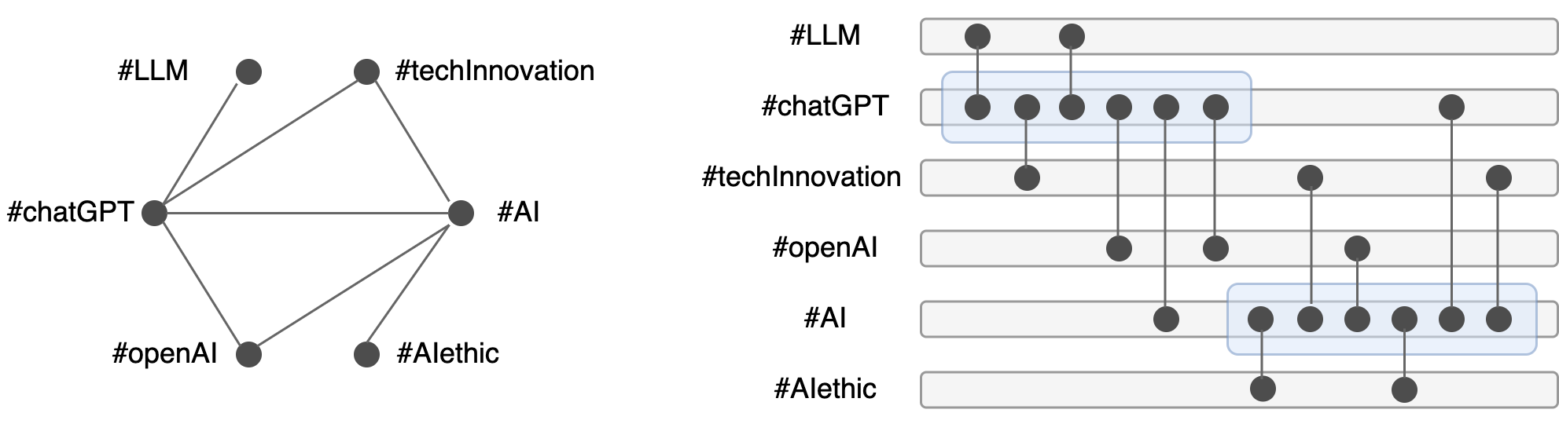
Summarization as Activity Intervals
Use activity time intervals to represent interactions between entities. An interaction between two entities is accounted for if, at the time of their interaction, at least one of the entities is active.
The related summarization task involves identifying these latent activity intervals for all entities, producing an activity timeline that encompasses the entire network. → NETWORK UNTANGLING PROBLEM or MINIMUM TIMELINE COVER (MinTCover) PROBLEM [1].
[1] Polina Rozenshtein, Nikolaj Tatti, and Aristides Gionis. The network-untangling problem: from interactions to activity timelines. Data Min. Knowl. Discov., 35(1):213–247, 2021. URL: https://doi.org/10.1007/s10618-020-00717-5, doi:10.1007/S10618-020-00717-5.

Slide 6
MinTCover main issues
NP-Hard
Researches on the hardness and parametrized complexity have shown that the this problem is NP-Hard
1
Not approximable within any constant factor
Studies have shown that when considering more than one time interval the problem is not even approximable within any constant factor
2
Lack of scalable solutions
Being a recent problem, most of the researches focused on the parametrized complexity, and only few works propose a scalable yet effective solution for the problem
3

Slide 7
Problem Definition

Slide 8
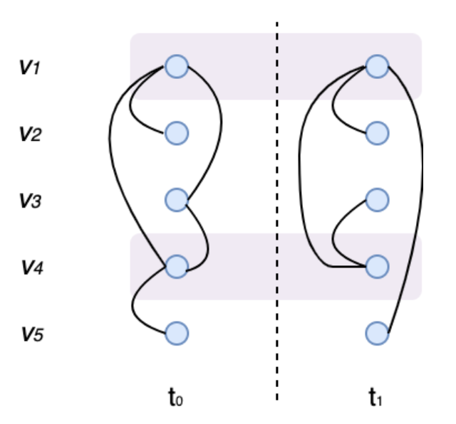
Problem Definition: MinTCover+
.

Slide 9
Related Works
INNER → Using an inner point iterative method to initially solve a subproblem named COALESCE, which involves finding optimal activity timelines that include predetermined time points for each vertex, called inner points. The authors proposed to find a solution to the relaxation of the ILP formulation of such problem finding a 2-factor approximate solution, which they finally used as solution for the MinTCover problem. → Linear, but no theoretical guarantees [1].
2PHASES → 2 phases approach that consider the union graph (which is a static labeled graph, where labels for each edge are the union of all the timestamps t associated to edges (u,v,t), for each pair (u,v)). The first phase consists in finding a minimum vertex cover with a 2-factor approximation algorithm for the subgraph of the union graph that contains edges with at least three labels. Vertices in this set ar then removed from the temporal graph. Then the second phase, inspired by an approximation algorithm for SetCover, uses a randomized rounding algorithm to find an approximation solution to a variant of the problem where each vertex can be active in non consecutive timestamps. Finally used this solution to compute a solution to MinTCover problem [2]. → O(TlogN) complexity
[1] Polina Rozenshtein, Nikolaj Tatti, and Aristides Gionis. The network-untangling problem: from interactions to activity timelines. Data Min. Knowl. Discov., 35(1):213–247, 2021. URL: https://doi.org/10.1007/s10618-020-00717-5, doi:10.1007/S10618-020-00717-5.
[2] Riccardo Dondi and Alexandru Popa. Exact and approximation algorithms for covering timeline in temporal graphs. Annals of Operations Research, 04 2024. doi:10.1007/s10479-0 24-05993-8.

Slide 10
Goals
1
Define a new approach for MinTCover which is fast and effective and that can scale to massive graphs.
2
Measure the results and compare them against state-of-the-art solutions to define a benchmark for future works.

Slide 11
FastMinTC+

Slide 12
The Idea
Inspired by [2], we consider that the MinTCover problem, is actually an extension to the temporal dimension of the Minimum Vertex Cover problem, a classical NP-hard optimization problem that consists in, given a graph G(V, E), find a subset of vertices S in V such that every edge in G has at least one end-point in S.
This problem is widely studied and many approaches have been proposed in the past to solve it effectively especially for large instances.
Among these, FastVC [3], is one of the most used heuristic-based approaches, that enhances the efficiency and effectiveness of the selection process using the Best from Multiple Selection (BMS) heuristic.
From hence, we decided to design an Algorithm based on the BMS heuristic also for MinTCover.
[3] Shaowei Cai, Kaile Su, Chuan Luo, and Abdul Sattar. Numvc: An efficient local search algorithm for minimum vertex cover. J. Artif. Intell. Res., 46:687–716, 2013. URL: https: //doi.org/10.1613/jair.3907, doi:10.1613/JAIR.3907.

Slide 13
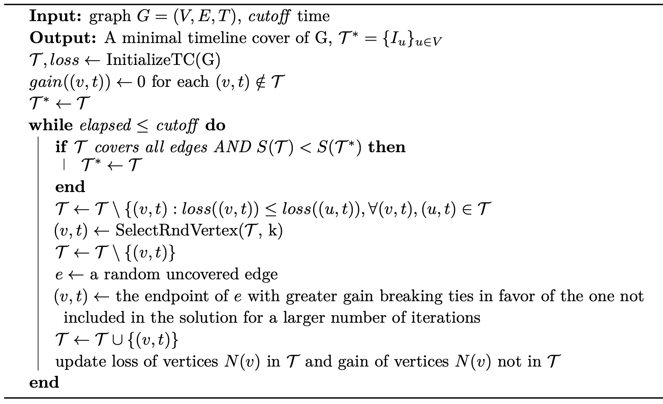
FastMinTC+: Overall Algorithm
Initialization Step
Exchange Step

Slide 14
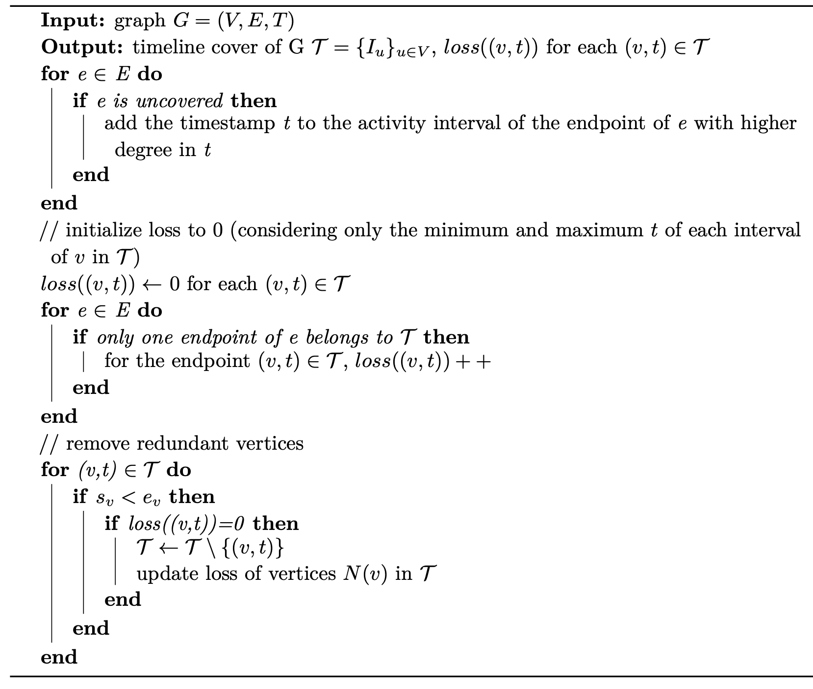
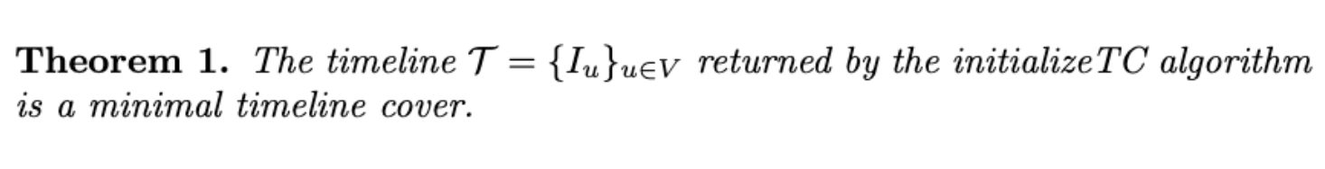
FastMinTC+: Initialization Algorithm
COMPLEXITY
Extending phase: O(m)
Loss computation: loss is computed only for vertices in T (which are at most twice for each node → 2n), scanning all edges. Thus, it is O(m+2n). Generally, m>>n, Thus O(m+n).
Shrinking phase: depends on loss update, which at most are twice the number of edges. Thus O(m)
Complexity of InitializeTC → O(m+n):
Extending Phase
Shrinking Phase

Slide 15
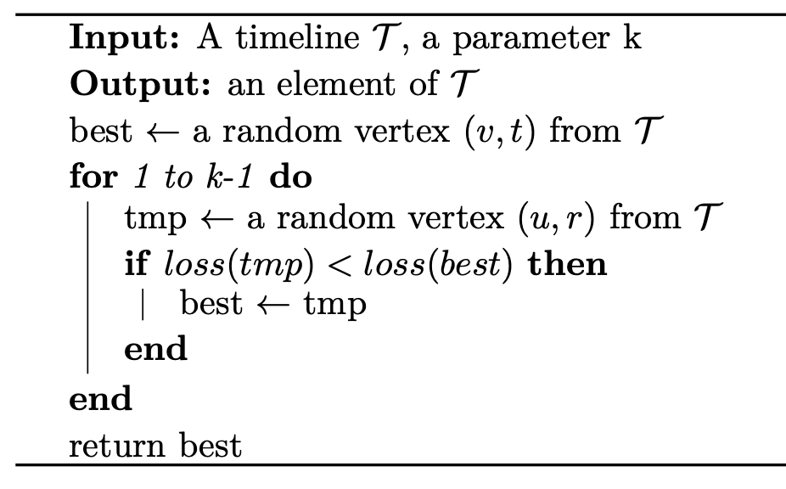
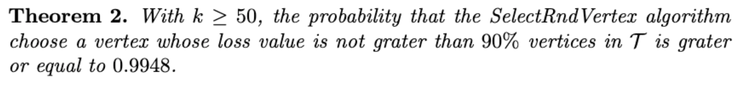
FastMinTC+: BMS heuristic
COMPLEXITY
Depends on the number of iterations k, thus O(k)-->O(1)

Slide 16
Experimental Results

Slide 17
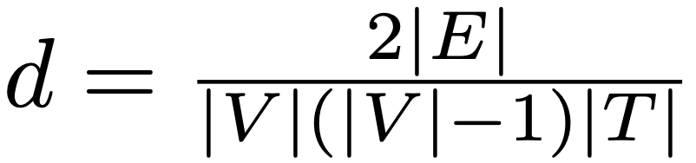
Dataset Description
Dataset | Source | Type | Support | |V| | |T| | |E|
Dataset1 | Synthetic | Sparse | 264 | [10, 10000] | [4, 5000] | [10, 1000000]
Dataset2 | Synthetic | Dense | 195 | [10, 10000] | [2, 5000] | [100, 20000000]
Dataset3 | DIMACS [4] | Mixed | 25 | [24, 596313] | [1, 736674] | [516, 3394979]
For more granular analysis, instances of Datasets 1 and 2 are categorized as small (up to 50 vertices and 20 timestamps), medium (up to 500 vertices and 500 timestamps), and hard (up to 10000 vertices and 5000 timestamps)
[4] Ryan A. Rossi and Nesreen K. Ahmed. The network data repository with interactive graph analytics and visualization. In AAAI, 2015. URL: https://networkrepository.com.

Slide 18
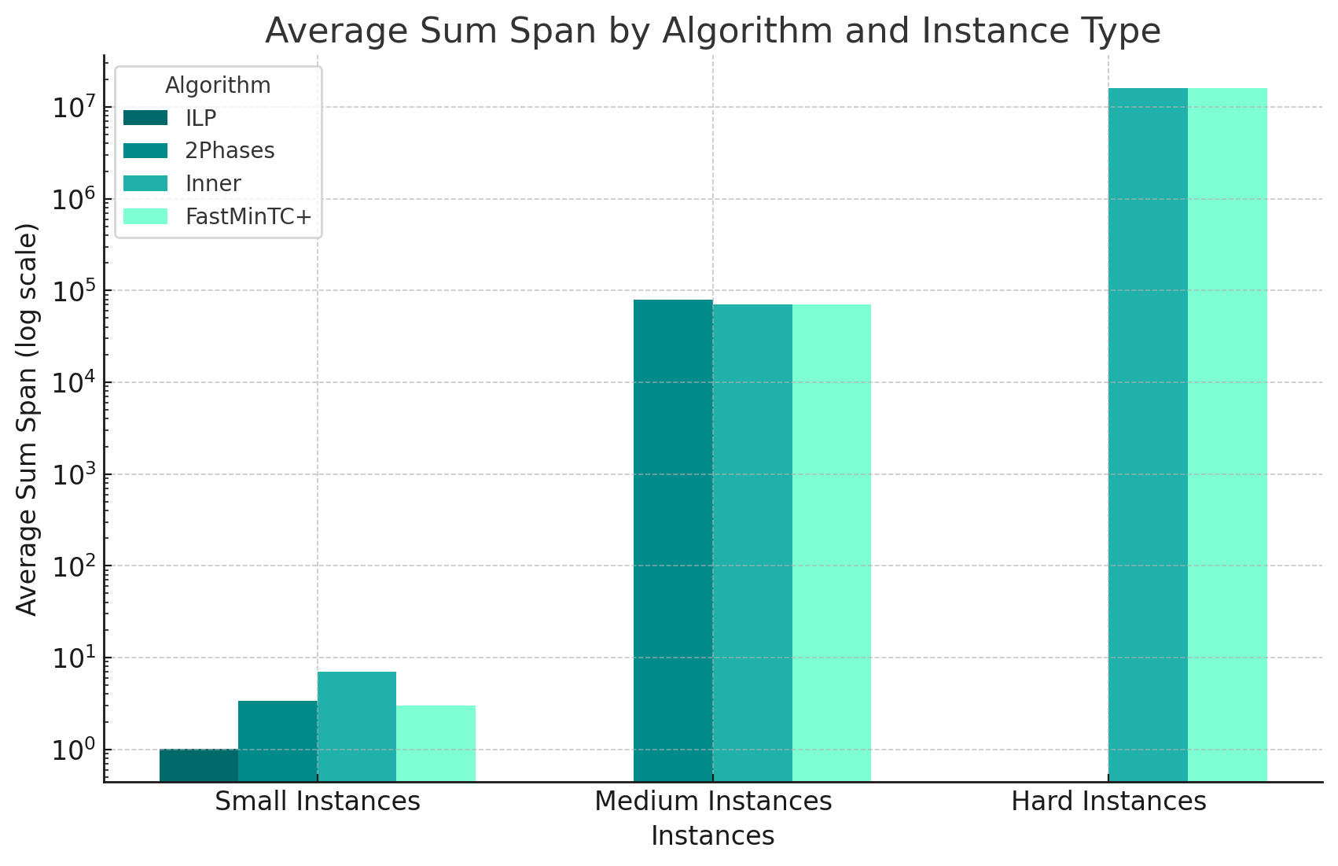
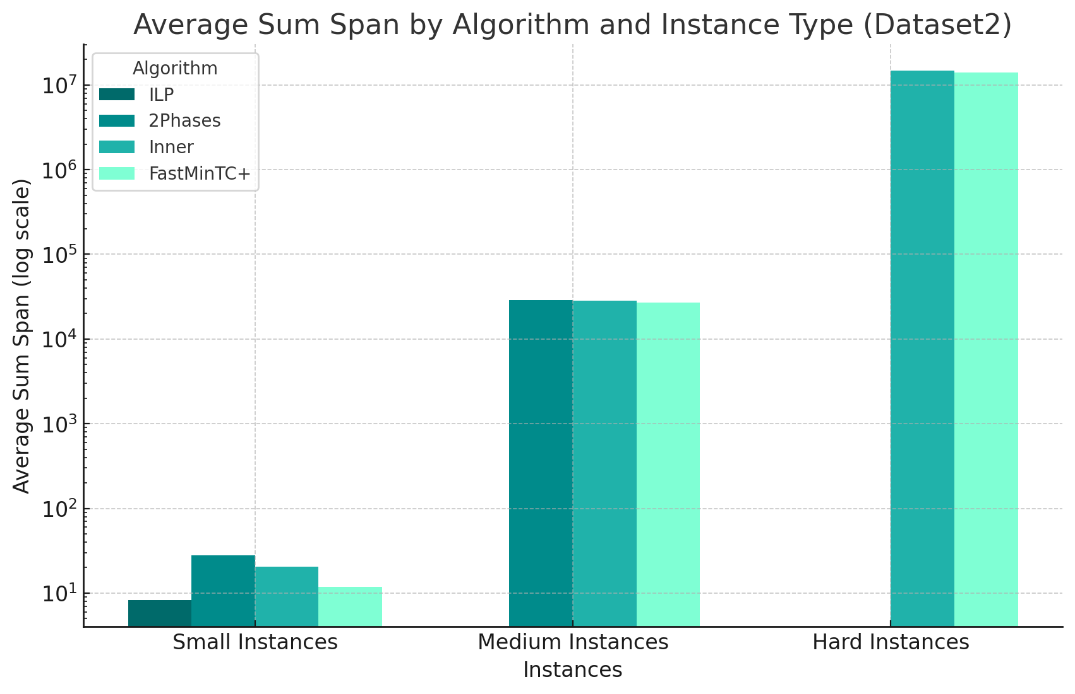
Experimental Evaluation of Synthetic Instances - Sum Span
Dataset 1
Dataset 2
6e+04
69e+04
2e+02
1,3e+03
4,03e+00
8,51e+00
INNER surpasses FastMinTC+ in 39 cases over 264
INNER surpasses FastMinTC+ in 1 case over 195

Slide 19
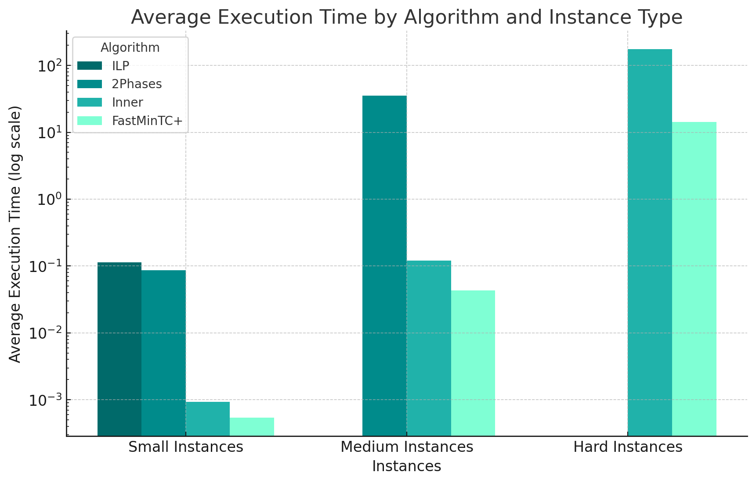
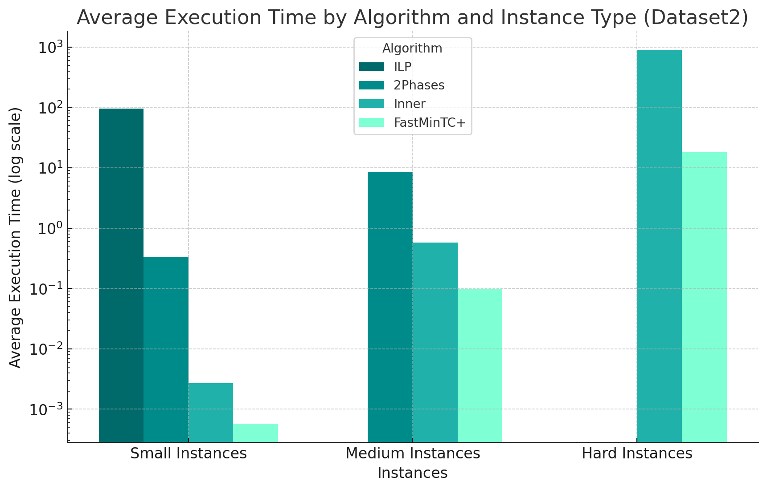
Experimental Evaluation of Synthetic Instances - Execution Time
Dataset 1
Dataset 2

Slide 20
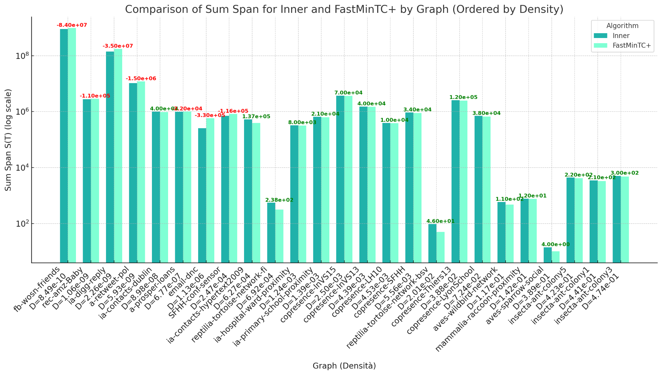
Experimental Evaluation on Real Instances
Average Execution Time
INNER: 10,6 s
FASTMINTC+: 4,43 s

Slide 21
Conclusions

Slide 22
Conclusion and Future Works
Overall FastMinTC+ achieves superior performance in terms of sum-span w.r.t. state-of-the-art algorithms in the majority of the cases, even though, when dealing very sparse graphs, it demonstrates comparable performance w.r.t. INNER.
FastMinTC+ is the fastest algorithm in all cases.
FastMinTC+ allows to find fast and effective solutions in reasonable time even for massive graphs.
FastMinTC+ shows the effective application of the BMS heuristic to the temporal version of the MVC problem, for which the BMS approach has been shown to be very effective
As for MVC, future direction concerns the adoption of data-driven learning algorithms, as Deep Learning, for solving temporal combinatorial optimization problems like the MinTCover problem.

Slide 23
Thanks
Giorgio Lazzarinetti

