Slide 1
Interactive matching and visual comparison of graphs
Mountaz Hascoët, mountaz@lirmm.fr, LIRMM, CNRS, Univ. Montpellier
Pierre Dragicevic, dragice@lri.fr, INRIA, Univ. Paris-Sud
Problem
Approach
Results

Slide 2
Lexical network
Lexical network for French
« Jeux de mots »
200 000 French terms
1 200 000 lexical relations
~30 types of relations (hyponymy, hyperonymy, meronymy, associated ideas, etc)
~3 versions of the network each year
http://www.jeuxdemots.org/
=>Tools to analyze the quality of the network are needed

Slide 3
Graph comparison, what for?
Are two subgraphs different?
Are subgraphs for different relations consistent?
Which graph has lower error rate?

Slide 4
Infovis benchmark
The Infovis 2004 benchmark contains
Metadata for 614 papers
Published between 1974 and 2004
Extraction of Topic Maps
Topics from title and keyword lists
One topic map per each

Slide 5
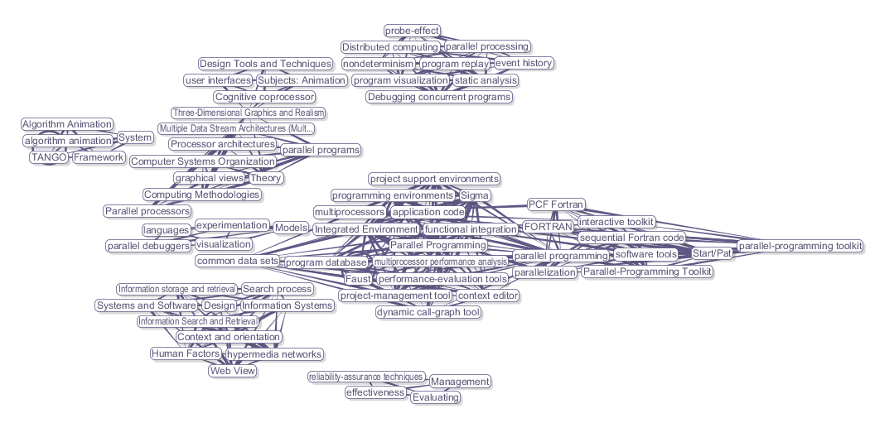
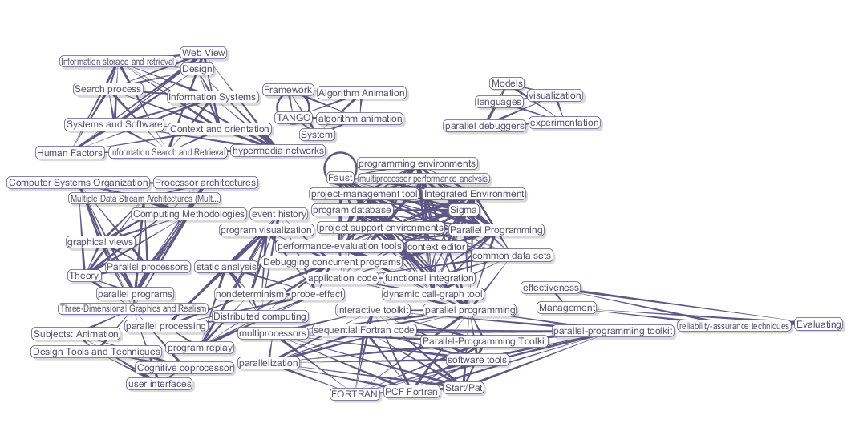
Graph comparison, what for?
Do several topic maps differ significantly?
How topics evolve over time
Appear/disappear/refine
How does the connectivity evolve over time?

Slide 6
Approach
Optimisation
Use optimized layout from previous work
Visualization
Introduce presentation strategies suitable for graph comparison
Interaction
Leave important matching choices to end-users
Notes:
Algorithmically nightmare

Slide 7
Results
Proposal
Multi-layer model
Animated reconfigurations
Reification of matching functions
Proof of concept
A system named Donatien
Two case studies with real data

Slide 8
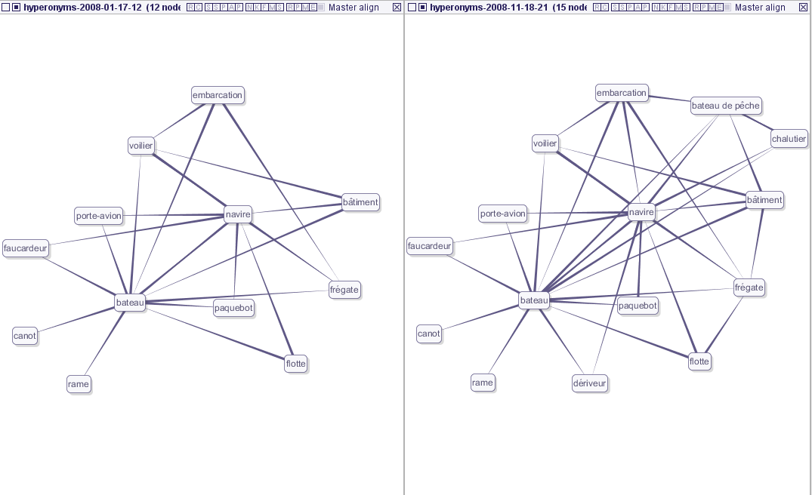
1. Multiple layers
Direct Manipulation on layers
Side-by-side arrangement
Superposed
Crossing
Notes:
A layer is associated with
a graph
a layout algorithm
a transformation
Layer arrangement
superposed or side by side
smooth interaction and reconfiguration

Slide 9
2. Animated reconfiguration
Optimized layout
Optimisation of aesthetic criteria
Property
Enhanced legibility of graphs
Limits
If two graphs are the exact same graph
No guarantee that layout are the same
Optimized layouts
Invariant layout
Determinist layout
Based on node signatures
Property
2 identical graphs have the same layout
Warning: reciprocally not true
Limits
Legibility of graphs

Slide 10
Visual comparison through reconfiguration

Slide 11
Comparison with matching
Requirements
Compute matching nodes
Interactively adjust this matching
Superimpose matching nodes
Solution
Create a master graph
From invariant layout
To embody the matching function in a layer
Integrated smoothly with other layers

Slide 12
3. Reifying Matching Function
Notations
G₁(V₁,E₁), G₂(V₂,E₂)… G_{n}(V_{n},E_{n})
graphs to be compared
M : A matching function
A hypergraph H(V₁uV₂u…V_{n},EM)
Master Graph
Embodies the Matching Function
G(V,E) is a graph
V represents hyper-edges of H
∀n  V, ∀(v₁,v_{2,}…v_{k})  EM
n -> (v₁,v_{2,}…v_{k})
E represents edges of E₁, E₂, … E_{n}

Slide 13
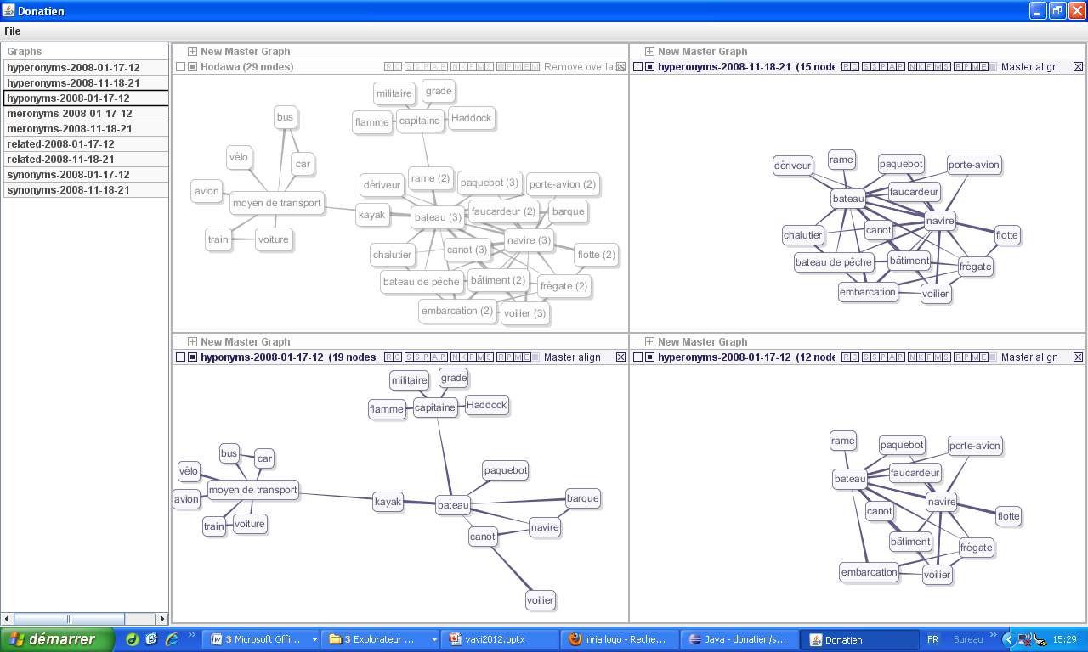
Reifying Matching Function

Slide 14
Matching Example

Slide 15
Conclusion
Visual comparison of graphs
Invariant lMulti-layer model
Animated reconfiguration
Reifies Matching Function
Layout and superposition
Smooth integration of master graph
Future work
Enhance interaction model
Enhance invariant layouts

Slide 16
Thanks for your attention
demo at lunch
Questions ?

Slide 17
Comparing clustered graphs

