Slide 1
Subgraph Isomorphism for Small Graph Patterns
Virginia Vassilevska Williams, MIT
Based on joint work with Mina Dalirrooyfard and June Vuong
ICGT 2022

Slide 2
Subgraphs: induced and not
A graph $H=(V_{H},E_{H})$ is an induced subgraph of $G=(V,E)$ if there is a 1:1 function $f:V_{H}→V$ s.t.
For all $\left(u,v\right)∈E_{H}$, $\left(f\left(u\right),f\left(v\right)\right)∈E,$ and
For all $\left(u,v\right)∉E_{H}, \left(f\left(u\right),f\left(v\right)\right)∉E.$
If only the first condition above holds, $H$ is a (not necessarily induced) subgraph of $G.$
Here $H$ is a subgraph of $G$ but it is not an induced subgraph of $G.$
H
G

Slide 3
Subgraph Isomorphism (SI)
Why study: graphs encode a variety of objects; SI useful in anomaly detection, protein-protein interaction and more…
The computational problem SI is to decide:
Given $H=\left(V_{H},E_{H}\right),G=(V,E)$, is $H$ a subgraph of $G?$
There’s an induced and not induced version.
Karp’1972: SI is NP-complete.
If $\left|V_{H}\right|=k$ is a fixed constant, independent of $n=|V|$, then there’s an easy $O(n^{k})$ time algorithm: Brute Force!
Is there a faster algorithm?

Slide 4
Cliques are hardest
For constant $k$, if $k$-clique can be detected in $O\left(n^{c}\right)$ time, then so can any $k$-node $H.$
Theorem: The SI problem for every $k$-node $H$ in an $n$-node $G$ can be reduced in $O(k^{2}n^{2})$ time to detecting a $k$-clique in an $kn$-node graph $G′$.
Proof: (Every node $u$of $G$ gets $k$ copies $u_{i}$ in $G′$, every edge $(u,v)$ of $G$ gets copies $(u_{i},v_{j})$ for $i≠j, \left(i,j\right)∈E_{H}$, every non-edge $(x,y)$ of $G$ with $x≠y$gets $(x_{i},y_{j})$ for $i≠j,\left(i,j\right)∉E_{H}$.)
$$a_{1}$$
$$b_{1}$$
$$c_{1}$$
$$d_{1}$$
1
a
c
in
2
3
b
d
$$a_{2}$$
$$b_{2}$$
$$c_{2}$$
$$d_{2}$$
$$a_{3}$$
$$b_{3}$$
$$c_{3}$$
$$d_{3}$$
$$H$$
$$G$$
$$G′$$

Slide 5
Nešetril-Poljak’1985: from k-clique to triangle
Theorem [NS’85]: The $k$-clique problem in an $N$-node $G$ can be reduced in $O(n^{2\left\lceil \frac{k}{3}\right\rceil })$ time to detecting a $3$-clique in an $O(n^{⌈\frac{k}{3}⌉})$-node graph.
Proof: Set $a_{1}=$ $\left\lceil \frac{k}{3}\right\rceil$, $a_{2}=$ $\left\lfloor \frac{k}{3}\right\rfloor$, $a_{3}=\left(k−\left\lceil \frac{k}{3}\right\rceil −\left\lfloor \frac{k}{3}\right\rfloor \right)$.
Create a node for every $a_{i}−$tuple of nodes of $G$ for each $i$,
Add edge between every $a_{i}−$tuple and $a_{j}−$tuple if:
$i≠j,$ the tuples are disjoint and form an $a_{i}+a_{j}$ - clique in $G$.
A triangle corresponds to $a_{1}$-tuple, $a_{2}$-tuple, $a_{3}$-tuple, all disjoint (so $k$ nodes altogether) s.t. every pair of their nodes are connected by an edge. So a $k$-clique!

Slide 6
Itai-Rodeh’1978
Theorem [IP’78]: A 3-clique (triangle) can be found/detected in an $n$-node graph $G$ in $O(n^{ω})$ time, where $ω<2.37286$[AV’21] is the exponent of square matrix multiplication.
Proof:
$\left|V\right|=n.$Let $A$ be the $n×n$adjacency matrix of $G=(V,E).$
That is, $A\left[i,j\right]=1$ if $\left(i,j\right)∈E$and $A\left[i,j\right]=0$ otherwise.
Compute $A^{2}=A⋅A$ in $O(n^{ω})$ time.
Look at $A^{2}\left[i,j\right]=\sum_{k}{A\left[i,k\right]⋅A[k,j]}$. It is nonzero iff there is a path $i−k−j$ in $G.$
Then $\sum_{\left(i,j\right)∈E}{A^{2}[i,j]}≠0$iff there is a triangle in $G.$ (in fact, this is $3×$#triangles).
One can also find a triangle (if one exists) in the same time.

Slide 7
Corollary of NS’85, IR’78
Corollary: Any $H$ can be detected in an $n$-node graph in $O(n^{ω⌈\frac{k}{3}⌉})$ time.
More generally, clique runtime is $C\left(n,k\right):$
If $k=3t: C\left(n,k\right)= O\left(n^{\frac{ωk}{3}}\right),$
if $k=3t+1$, $C\left(n,k\right)=O\left(n^{ω\left(t,t,t+1\right)}\right)≤O(n^{ωk/3+1})$,
if $k=3t+2$, $C\left(n,k\right)=O\left(n^{ω\left(t,t+1,t+1\right)}\right)≤O(n^{ωk/3+2})$.
$H$ detection in $n$ node $G→$ $k$-clique in $O(n)$ node $G′$ $→$ triangle in $O(n^{\left\lceil \frac{k}{3}\right\rceil })$ node $G′′$ $→$matrix multiplication
Can some $H$ be detected faster as induced subgraphs than $C\left(n,k\right)?$
(easily true for non-induced patterns- e.g. independent sets)

Slide 8
Outline
1. Some $k$-node induced patterns can be detected faster than $k$-clique
2. Hardness results
3. Conclusions

Slide 9
Three and four node H
Can all $k$-node $H$ except for clique and independent set be detected in $C(n,k−1)$ time?
For $k=3,$ $C\left(n,3\right)=O\left(n^{ω}\right)≤O(n^{2.373})$.
Folklore: All $H$ except for triangle and 3-independent set as induced subgraphs, can be found in $C\left(n,2\right)=O\left(n^{2}\right)$ time.
E.g. to detect assume graph is connected with $n≥3$ and check if it is a clique by counting edges!
For $k=4,$ $C\left(n,4\right)=O(n^{3.294})$, at least cubic…
Theorem [VWWY’15]: All $4$-node $H$ except clique and independent set can be detected in $C\left(n,3\right)=O\left(n^{ω}\right)$time.

Slide 10
Bläser, Komarath, Sreenivasaiah’18
Theorem: For $k<7$, every $k$-node $H$ except for the clique and independent set can be detected as an induced subgraph in $C(n,k−1)$time.
Techniques break for $k≥7$, but every $k$-node $H$ except for the clique and independent set can be detected in $O(n^{k−1})$time without using matrix multiplication, and this is the runtime for $k−1$ clique without matrix mult.

Slide 11
4-node patterns in $n^{ω}$
Idea:
1. Write an equation relating the number of occurrences of patterns.
2. Allows you to compute the number of occurrences of $H$ modulo some $d$.
3. Using random sampling ensure that if $G$ has $H$, then the number of $H$ is also nonzero mod $d$.

Slide 12
Diamond detection
$\left|V\right|=n.$Let $A$ be the $n×n$adjacency matrix of $G=(V,E).$
That is, $A\left[i,j\right]=1$ if $\left(i,j\right)∈E$and $A\left[i,j\right]=0$ otherwise.
$A_{u,v}^{2}$ $=\#x$s.t. $\left(u,x\right),\left(x,v\right)∈E.$
Left hand side can be computed in $O(n^{ω})$ time!
Chooses two vertices $x,y$ such that $u−x−v$ and $u−y−v$ are paths in $G$
So, can compute #diamonds modulo 6!
What if #diamonds is 0 mod 6, but a diamond still exists?
u
$K_{4}$has 6 choices for $(u,v)$ in sum
Diamond has only 1 choice for $(u,v)$ in sum
v

Slide 13
#Diamonds mod 6
Take $G$, and create an induced subgraph $G′$ by placing every vertex of $G$ into $G′$ with probability ½.
Theorem [VWWY’15]: If $G$ contains a diamond, then the number of diamonds mod 6 in $G′$ is nonzero with probability at least $1/16$. If $G$ has no diamonds, then neither does $G^{′}.$
So: take $G,$ and repeat $O(\log{n)}$ times:
Create $G′$, let $A$ be its adjacency matrix, compute $X:=$
If $X≠0$ mod 6, return YES.
Return NO.
Running time $\tilde{O}\left(n^{ω}\right)$
Correct with probability at least $1−1/poly(n)$.

Slide 14
Embarrassing question
Widely believed that the best running time for triangle detection is $O(n^{ω})$.
Evidence VW’10.
A diamond contains a triangle, so intuitively it should be at least as hard to detect as a triangle, so maybe the $\tilde{O}(n^{ω})$ time algorithm is optimal??
Is it true that if $H$contains a $t$-clique, then it’s at least as hard to detect as a $t$-clique?

Slide 15
Outline
1. Some $k$-node induced patterns can be detected faster than $k$-clique
2. Hardness results: any pattern that contains a $t$-clique is at least as hard as $t$-clique to detect, and more
3. Conclusions

Slide 16
Hardness?
$$H\backslash T$$
Suppose a $k$-node $H$ contains a $t$-clique as a subgraph.
Is detecting $H$ as an induced subgraph in an $n$-node graph $G′$ as hard as detecting a $t$-clique in an $n$-node graph $G$?
What if $G$ doesn’t contain any $H$?
$t$-clique$T$
$k$-node H
$n$-node G
$n$-node G
Hardcode the rest of H?
$t$-clique?
$t$-clique?
Attempt to reduce?
$$H\backslash T$$

Slide 17
Diamond detection
b
d
a
c
Let’s try to reduce triangle detection to diamond detection
Take $G$in which we want to find a triangle.
WLOG $G$ is tripartite.
Try to hardcode a new node $d$, s.t. the new graph $G^{′}=G∪\{d\}$ contains a diamond iff $G$had a triangle.
Main issue: We can’t force the remaining 3 nodes of the diamond to be in different parts of $G.$
B
Insert edges from $d$ to all of $B$and $C.$
If $a∈A,b∈B,c∈C$ form a triangle in $G$, then $a,b,c,d$ form a diamond.
But: even if $G$ has no triangle, $G′$ has a diamond!...
d
A
C

Slide 18
A correct reduction from triangle to diamond SI
Start with tripartite $G$ with parts $A,B,C.$ Any triangle in $G$ is of the form $a∈A, b∈B, c∈C.$
Copy partition $B$ with all its edges– get $B′$ and new graph $G^{′}.$
B
B’
Any triangle in $G$ corresponds to a diamond in $G′$.
Any diamond in $G^{′}$has two triangles. Any triangle of $G′$ either has its three nodes in $A,B,C$ or in $A,B^{′},C$. In either case, it corresponds to a triangle in $G.$
A
C

Slide 19
General reduction
Take $G=(V,E)$ and $H$ that contains $t$-clique
Create $k$ copies of $V,$ $V_{1},…, V_{k}$, all independent sets.
Each $V_{a}$ corresponds to node $a$ of $H.$
$$V_{2}$$
1. If $G’$ contains $H$, it also contains a $t$-clique $Q.$
The nodes of $Q$ must be in different parts (as $V_{a}s$ are independent sets)
So they must correspond to distinct nodes of $G$ that are connected by edges so $G$ has a $t$-clique.
2. But if $G$ has a $t$-clique, why should $G’$ contain $H$?
Independent sets
$$V_{1}$$
$$…$$
Graph $G′$
on $nk$ nodes
$$V_{a}$$
$$V_{k}$$
$$…$$
$E_{G}$ or $∅$
$$…$$
$$V_{b}$$
For $a,b∈\left[k\right]=V_{H}$, $a≠b:$
If $\left(a,b\right)∉E_{H},$ no edges between $V_{a}$ and $V_{b}$
If $\left(a,b\right)∈E_{H},$ for all $(u,v)∈E_{G}$ edge $(u_{a},v_{b})$.

Slide 20
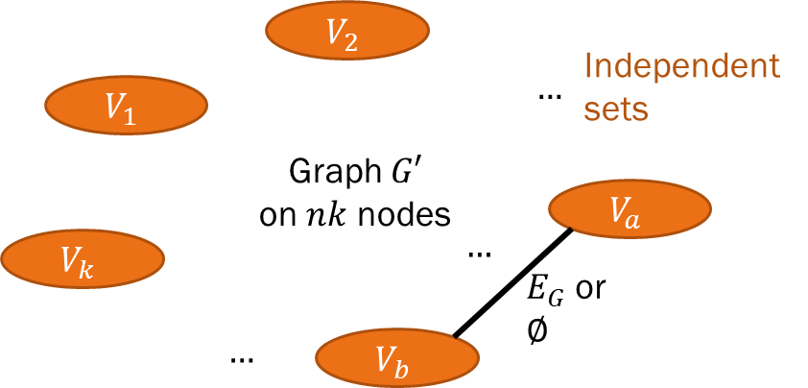
[DVV’19]: Reduction works for $t$-chromatic patterns
Let’s now assume that $H$ is a $k$-node pattern that contains a $t$-clique and has chromatic number $t.$
We want to show that if $G$ contains a $t$-clique $T$, then our reduction graph $G′$ contains $H.$
Since $H$ is $t$-chromatic, consider a $t$-coloring $c.$
Let $v_{1},…,v_{t}$ be the nodes of the $t$-clique $T$ of $G.$
For every $a∈V_{H},$will pick a node $h_{a}$ from $V_{a}$ and show that the $k$ nodes we pick form $H.$
For each $V_{a},$ if $c\left(a\right)=j$, select the copy of $v_{j}$ in $V_{a}$to be $h_{a}$.
For every $a,b$ of $H$, if $\left(a,b\right)∉E_{H}$, there are no edges between $V_{a}$ and $V_{b}$, so $\left(h_{a},h_{b}\right)∉E(G^{′})$.
If $\left(a,b\right)∈E_{H}$ then $c\left(a\right)≠c(b)$, so $h_{a}$ and $h_{b}$ are different nodes of $T$, and they are connected by an edge of $G′$ as $T$ is a clique.
So the $h_{a}$ form a copy of $H.$

Slide 21
Example: H contains 3-clique, 3-chromatic
$$H:$$
$$G:$$
$$G′:$$
$$a, c\left(a\right)=1$$
$$v_{1}$$
$$d, c\left(d\right)=1$$
$$V_{a}$$
$$v_{1}$$
$$V_{d}$$
$$v_{1}$$
$$∅$$
$$v_{2}$$
$$v_{3}$$
$$∅$$
$$b, c\left(b\right)=2$$
$$c, c\left(c\right)=3$$
$$E_{G}$$
$$E_{G}$$
$$E_{G}$$
$G$ is the $3$-clique
$$V_{b}$$
$$v_{2}$$
$$E_{G}$$
$$V_{c}$$
$$v_{3}$$
If $G$ contains a 3-clique, then $G′$ contains $H.$

Slide 22
If H is not t-chromatic, reduction no longer works… a new reduction is needed
Definition: A $t$-clique covering $C$ of $H$ is a set of vertex subsets $C_{1},C_{2},…,C_{p}$ s.t.:
The subgraph induced by $C_{i}$ is $t$-chromatic for every $i$
Every clique of $H$ is contained in some $C_{i}$
The size of $C$ is the number $p$ of subsets.
A minimum covering is one of smallest size.
If $H$ is not $t$-chromatic, then the min covering size is at least 2.
New reduction: Apply old reduction for the subgraph of $H$ induced by $C_{1},$ and add a new node for each node of $H$ not in $C_{1}.$
$$C_{2}$$
$$a_{1}$$
$$C_{1}$$
$$a_{5}$$
$$a_{6}$$
$$a_{2}$$
$$a_{4}$$
$$a_{3}$$

Slide 23
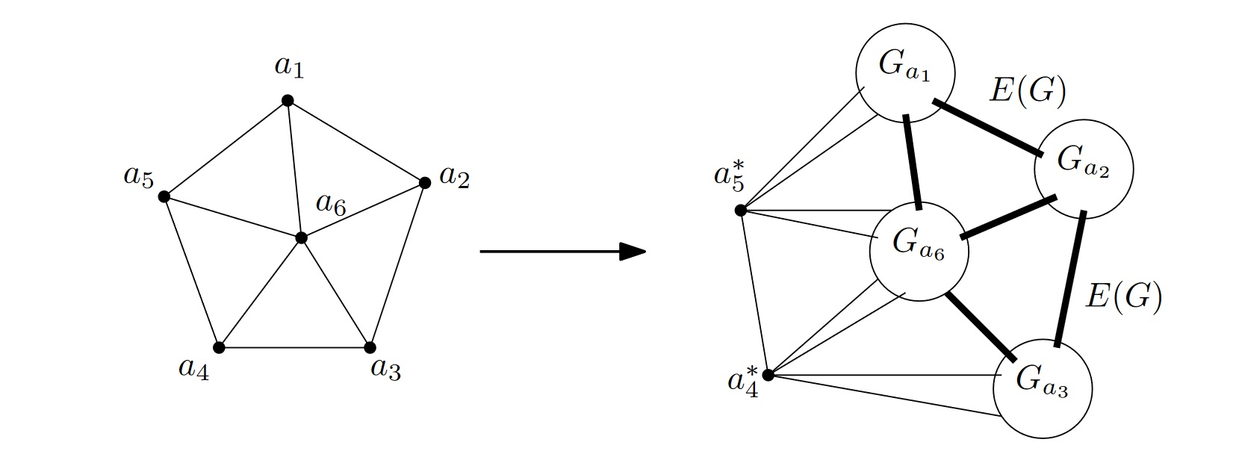
Reduction exemplified
Here $H$ is 4-chromatic. Min 3-clique covering is $\left\{\left\{a_{1},a_{2},a_{3},a_{6}\right\},\left\{a_{1},a_{3},a_{4},a_{5},a_{6}\right\}\right\}.$
If $G$ has a $3$-clique $v_{1},v_{2},v_{3}$, since
$C_{1}=\left\{a_{1},a_{2},a_{3},a_{6}\right\}$ is $3$-chromatic with colors $\{1,2,3,1\}$, select ${v_{1}∈G}_{a_{1}},{v_{2}∈G}_{a_{2}},{v_{3}∈G}_{a_{3}},{v_{1}∈G}_{a_{6}}.$
These form an induced copy of $C_{1}$, and adding $a_{5}^{∗}$ and $a_{4}^{∗}$ we get a copy of $H!$
If $G^{′}$ has a copy $H′$ of $H,$[DVV’20] show that the minimality of the covering implies that
some 3-clique of $H′$ must be contained in
${ G}_{a_{1}}∪G_{a_{2}}∪G_{a_{3}}∪G_{a_{6}}$.
But then this 3-clique is in 3 different parts $G_{a_{i}}$ as these are independent sets and thus it is a 3-clique in $G.$

Slide 24
Recap and further results
Theorem [DVV’19]: If $H$ contains a $t$-clique, then for any $n$ node $G$ in $O\left(n^{2}k^{2}\right)$ time one can construct a graph $G′$ on $O(nk)$ nodes, so that $G$ contains a $t$-clique if and only if $G′$ contains a copy of $H.$
More:
Theorem [DVV’19]: Suppose that the Hadwiger conjecture is true (chromatic number $≤max$ clique minor size). Then, if $H$ has chromatic number $t$, then for any $n$ node $G$ in $O\left(n^{2}k^{2}\right)$ time one can construct a graph $G′$ on $O(nk)$ nodes, so that $G$ contains a $t$-clique if and only if $G′$ contains a copy of $H.$
So the hardness of a pattern grows at least as its chromatic number.

Slide 25
More results
Theorem [DV’22]: If $H$ is a core with Hadwiger number $h$, then for any $n$ node $G$ in $O\left(n^{2}k^{2}\right)$ time one can construct a graph $G′$ on $O(nk)$ nodes, so that $G$ contains a $h$-clique if and only if $G′$ contains a copy of $H.$
I.e. for cores, hardness grows at least as the largest clique minor size.
Corollary [DV’22]: Finding an induced k-cycle in an $n$ node graph is at least as hard as finding a ~$3k/4$-clique in an $n$ node graph.
(previously only $\sim k/2$ known: $k$-cycle has a ~$k/2$-independent set)

Slide 26
Conclusion
What makes a pattern easy/hard to detect?
In particular, how fast can one detect an induced $k$-cycle?
Is $O(n^{\frac{3k}{4}})$ time possible? $C\left(n,\frac{3k}{4}\right)?$
Or are induced cycles even harder to detect?
Thank you!

